Slide 1
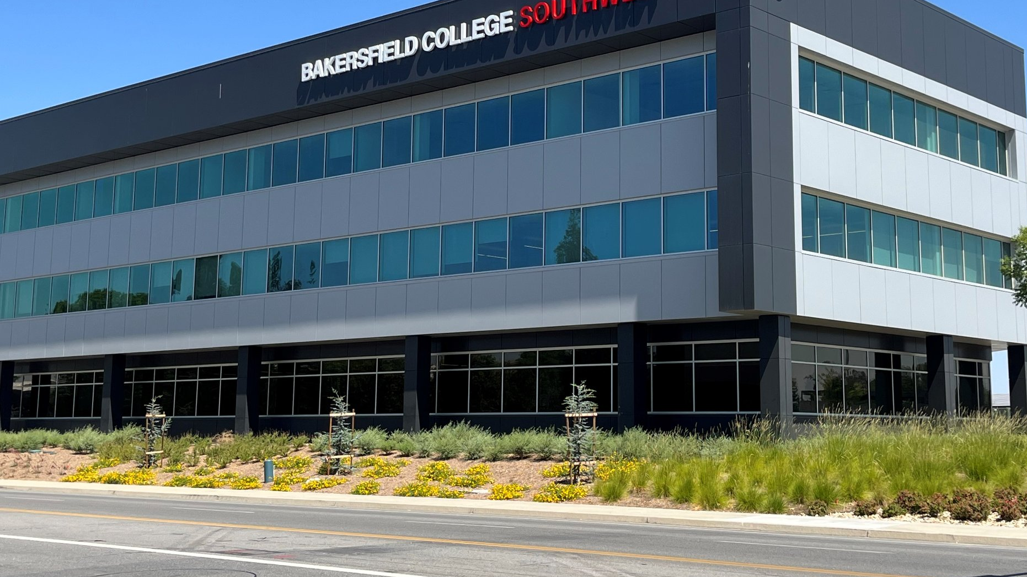
Bakersfield College Southwest
College Council September 2, 2022

Slide 2
Center Status: Title V & CA Education Code
Educational Center: a postsecondary operation established and administered by an existing college or district at a location away from the campus of the parent.
(1) the center:
(A) is planned to continue for ten or more years;
(B) generates at least 500 full-time equivalent student (FTES) annually.
(C) has an on-site administrator;
(D) offers programs leading to certificates and/or degrees conferred by the parent institution; and
(E) has been approved by the Board of Governors pursuant to this article.
Or grandfathered in

Slide 3
Why establish a Center?
Meet specific population needs
Selected Instruction programs not yet available in the area
Support services
Overcome location-based obstacles
Additional College Funding
Base Allocation of SCFF
Over $1 million per center (2 current centers)

Slide 4
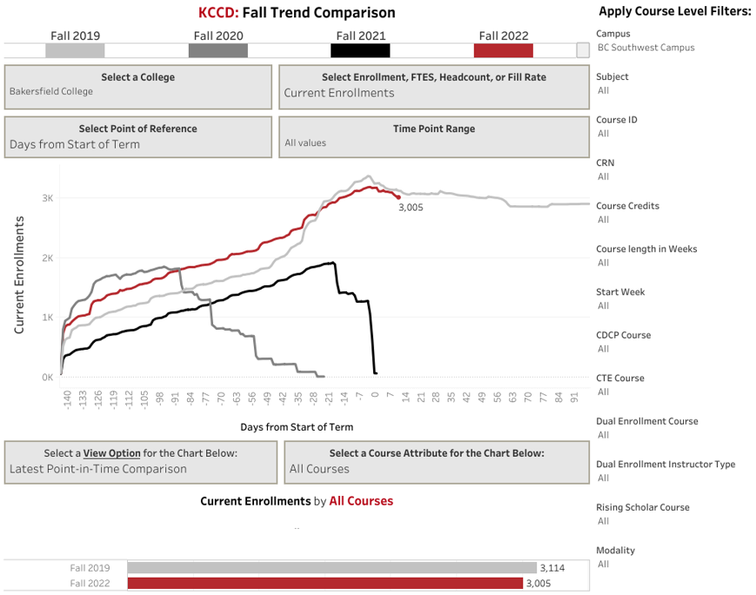
Estimated Enrollments Note: Hybrid courses not included

Slide 5
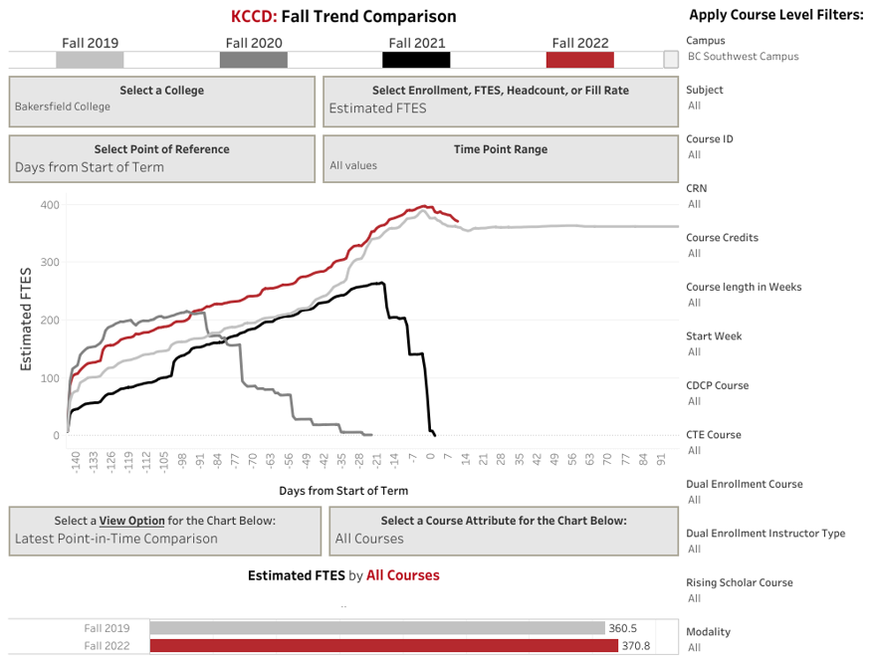
Estimated Fall FTES Note: Hybrid courses not included

Slide 6
Fall 2022 – At a Glance
Current:
158 sections
Face to Face: 130 Sections
Hybrid: 23
Headcount: over 2000
Enrollments: over 3000
Approximately 440 estimated FTES

Slide 7
BC SouthWest ADT Programs
Administration of Justice
Anthropology
Business Administration
Communication Studies
Child and Adolescent Dev.
Economics
Elementary Teacher Education
History
Kinesiology
Law and Public Policy
Psychology
Sociology
BC GE CSU GE IGETC GE

Slide 8
Fall 2022 – Student Services
Counseling (Mon – Fri)
Early College Counseling (Mon – Fri)
Tutoring Center (Mon- Fri)
Financial Aid (every Thur)
CSUB Advising (every Tues and Wed)
Job Developer (every Wed)
DSPS Accommodated Testing (as requested)
In progress: Student Pantry, Writing Center

Slide 9
Any Questions?

