Slide 1
Bakersfield College Enrollment and Completion Updates: Summer and Fall 2023
College Council
4/21/2023
Imelda Valdez
Sooyeon Kim

Slide 2
Overview
Quick overview: Spring Trends
FTES goal accomplished!
Summer enrollment growth: Strong
Our enrollments are above pre-pandemic level
Fall enrollment growth
Still below Fall 2019 and Fall 2020, but
Up relative to a year ago, growing at faster rates than previous years
Degrees and Certificates Awarded
2022-23 (In Process)

Slide 3
Spring 2023

Slide 4
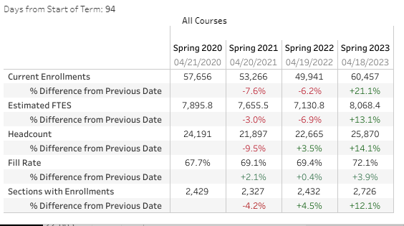
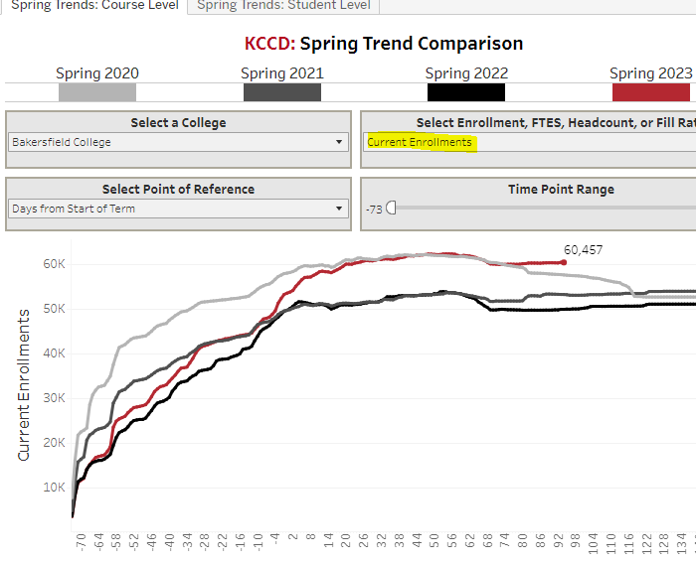
FTES target growth rate for 2022-23
12%
Notes:
As of Wednesday (4/18/23)

Slide 5
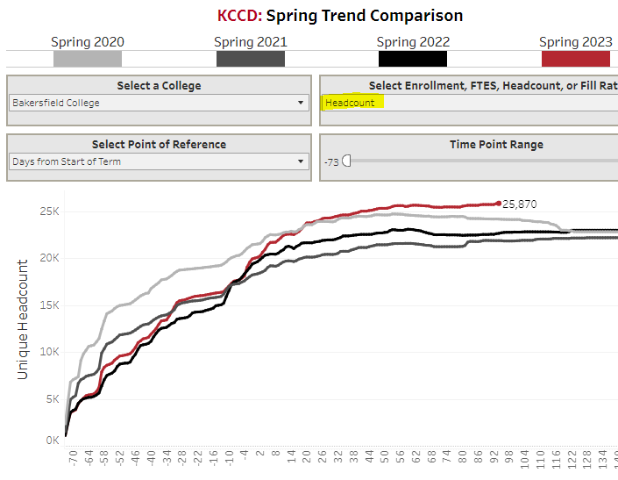
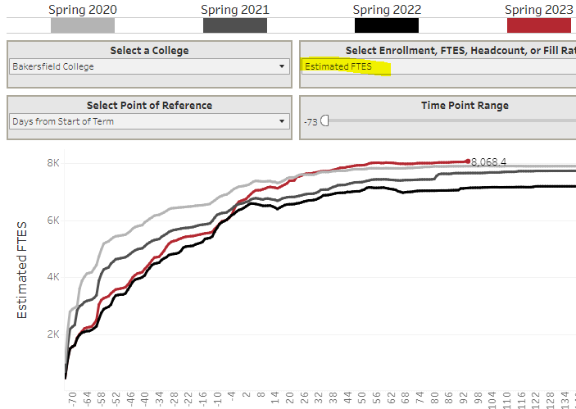

Slide 6
Summer 2023

Slide 7
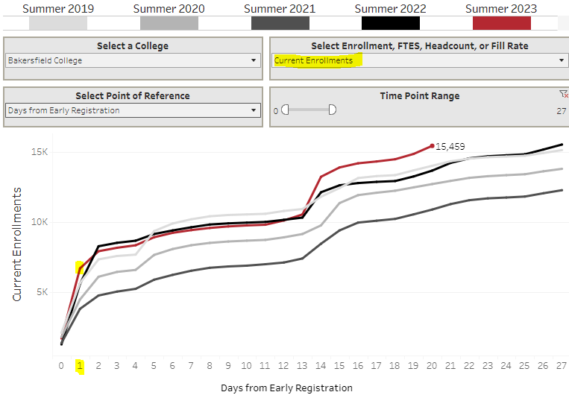
Summer has a strong start and continues to grow!
Notes:
Started 3/29/2023, Strong Start-Day one
4/11 and 4/12=13244-10547=2697 one day!
RSP and DuE-none
Growing in all instructional modes from prior summer
Growing in most subjects
Decreased PY in Math, Educ, Std Dev, Phys Educ, Criminology, Geology, TechMath, Welding, Ind Tech,

Slide 8
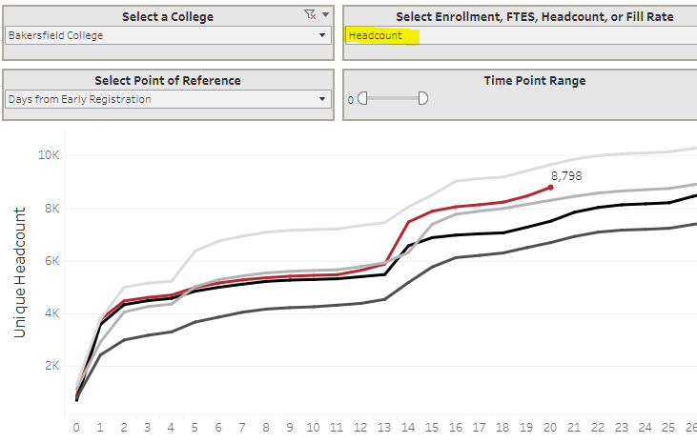
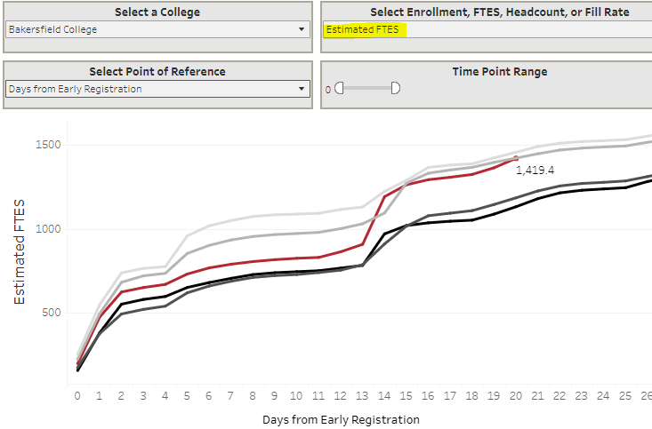
It appears that summer enrollment growth is driven by students enrolling in fewer than 6 units (61% of all students)
Notes:
Students for noncredit courses only 23% (n=2011)

Slide 9
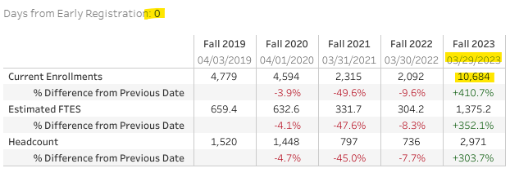
Fall 2023 enrollment also had a strong start!
Day 1
Large turnout on first registration day!
Notes:
5 times larger than fall2022

Slide 10
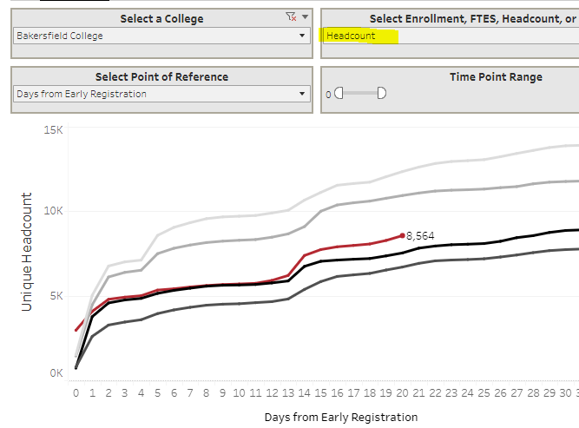
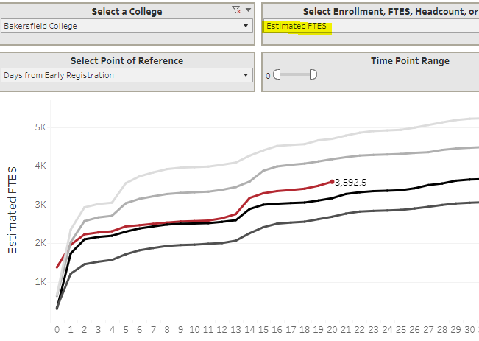
Growing at faster rates relative to a year ago.
As of Tuesday (4/17/2023) headcount, FTES, and enrollments are up 14%

Slide 11
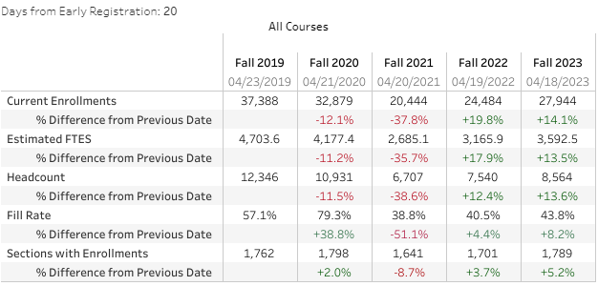
BC’s Fall 2023 Enrollments & FTES
BC’s Fall 2023 numbers are still below Fall 2019 and 2020, but larger than a year ago.

Slide 12
Program Awards for 2022-23 (In Process)

Slide 13
Record number of Degrees and Certificates awarded: 8865 (Up 33% over last year, 256% increased over the last 5 years)

