Slide 1
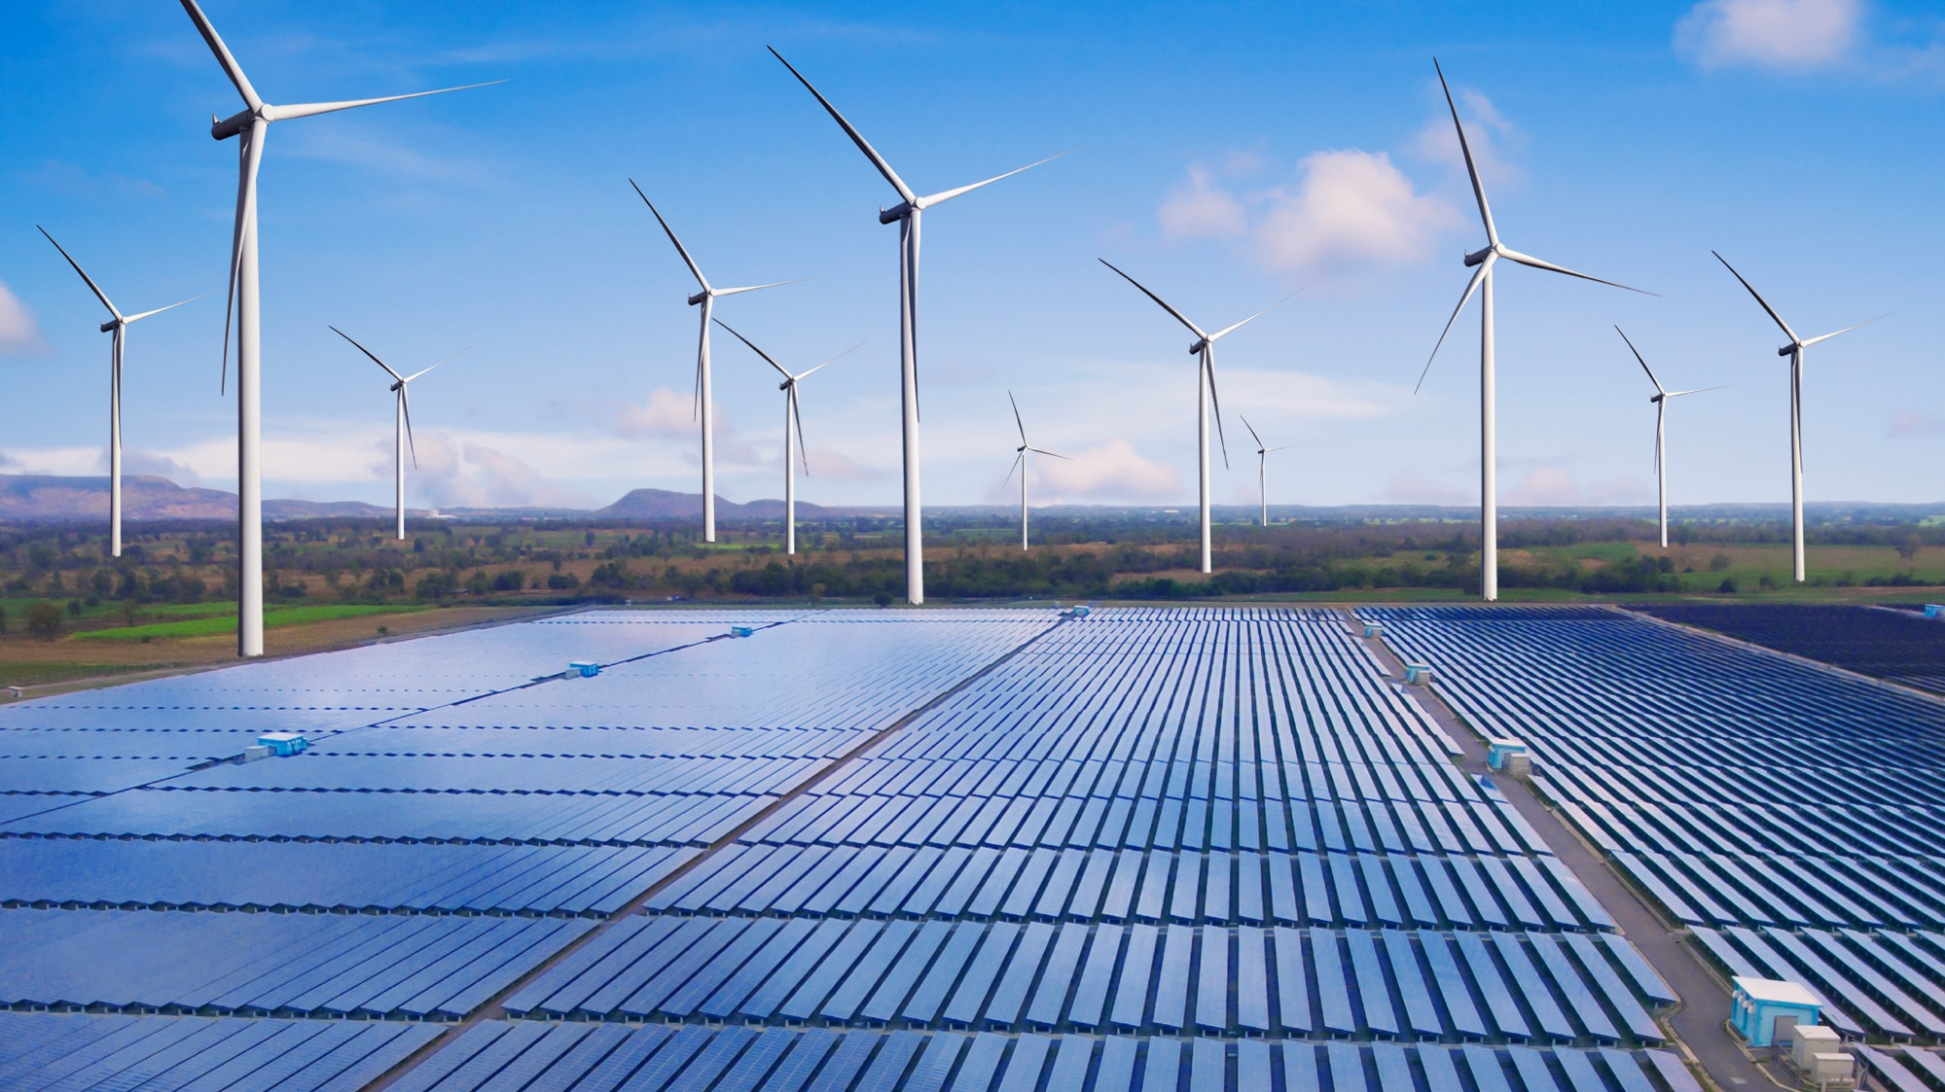
Energy Technology Transfer and Workforce Development (TT&WD) Presentation to College Council September 10, 2021
Liz Rozell
Director
Energy Technology Transfer and Workforce Development
James McGarrah
Associate Dean
STEM

Slide 2
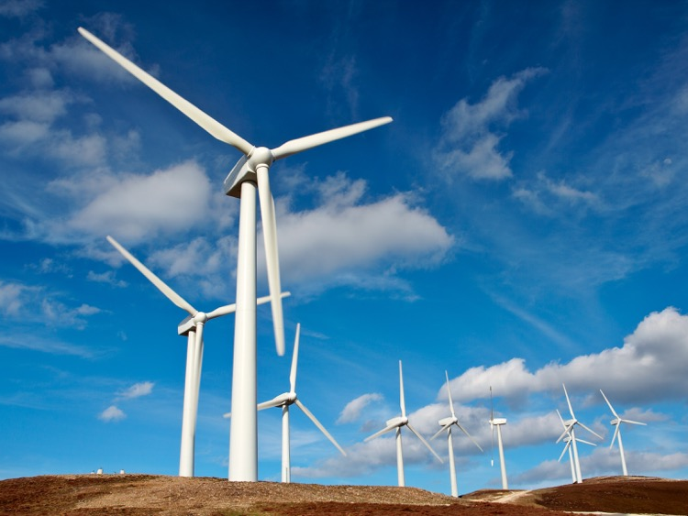
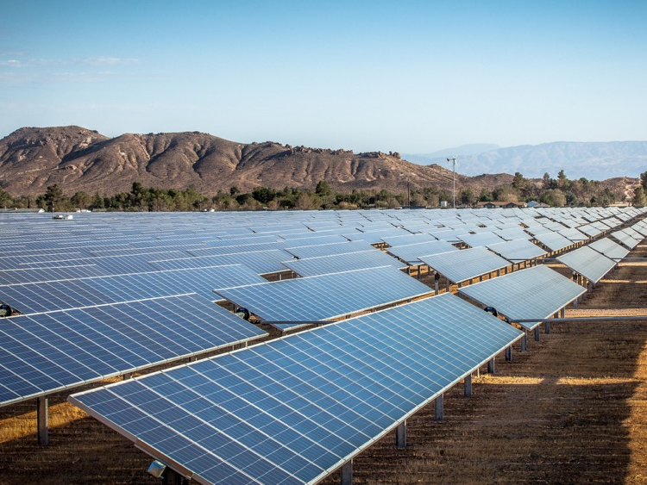
Kern County’s Wind and Solar Assets
Dave Mooney, NREL, quote: “If Kern County were a country, it would be 20th in solar production and 21st in wind in the world.”
More than 5,000 wind turbines in the Tehachapi-Mojave wind corridor, producing 1.3 terawatt hours (1.3 million megawatts) each year
The East Kern Mojave Desert has some of the best solar resources in the nation, home to one of two utility scale solar power plants in Kern County (200+ MW each) and 19 commercial projects (20 MW or less) are in permitting
(https://www.kerncounty.com/government/county-administrative-office/cao/economic-development/economic-development-clusters/energy-and-natural-resources)

Slide 3
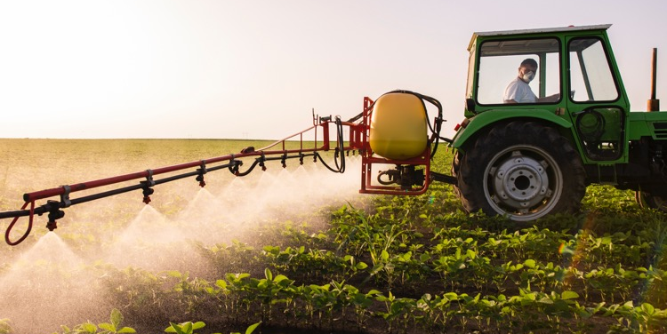
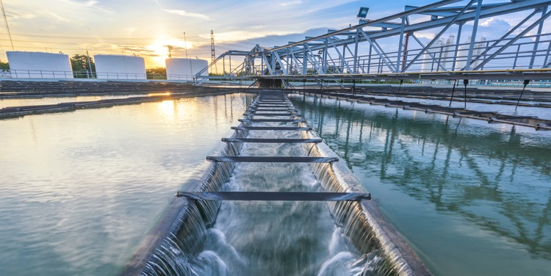
Kern County’s Other Assets
Kern county produces 72% of California’s total oil production and is the 5th producing county in the nation
(https://kernedc.com/wp-content/uploads/2019/09/AC5152-Kern-EDC-2019-Market-Overview-Member-Directory-January-2019_WEB.pdf)
Kern agriculture commodities are valued over $7.6B+
(http://www.kernag.com/dept/news/2020/2019_Kern_County_Crop_Report.pdf)
Kern county leads in the growing need for and development of energy storage projects — battery storage, water storage, and underground energy storage.
The Central Valley is home to many of the 76 potential carbon storage sites statewide that can bury 60 million tons of CO₂ per year. (https://www.forbes.com/sites/jamesconca/2021/08/06/can-carbon-capture-and-storage-save-californias-grid/?sh=7697f19373e4)

Slide 4
What is Energy TT&WD?
Future of a stable energy sector in Kern County depends on an innovative coalition of public and private partners
Workforce Development
Provide critical job training to the region to ensure an economically inclusive expansion of the energy sector.
Research
Connecting with partners who have the research capabilities for deployment into the workplace.
Innovation
Provide capacity building for communication of innovative projects in the energy sector
Policy
Facilitate discussions on energy expansion issues resulting in influence on governmental policy.

Slide 5
Workforce Development and Education
In 2020-21 the Energy Curriculum Discussion Group established the needs
Enhancing programs in the Industrial Technology & Transportation Pathway to match a rapidly evolving technologies (fuel cells, batteries, gas systems).
Realigning the Engineering program along the engineering disciplines.
A degree/certificate in Energy with the emphasis on energy concepts, technologies, project management/development, and public policy.
Internships and stackable career paths
Partner with the NREL to feed students into their new Research Technician program
Visualization of career mapping (like PPM) based on the Interstate Renewable Energy Council (IREC) career maps. (https://irecusa.org/career-maps/)
Expanded opportunities with old and new partners for experiential learning.
Primary education for an evolving energy world
Planned curriculum submission of Introduction to Energy this fall.
Public outreach and education through the Energy TT&WD webinar series
Faculty search for Instructor of Energy Sciences and Sustainability

Slide 6
Research & Innovation
Partnering on research with industry, NREL, and LLNL
Student internships and research opportunities.
Creating a test facility/learning labs at BC (agrivoltaics, drones/imaging, IoT sensing, microgrid learning lab . . .)
UC Merced
Identifying potential collaboration on research projects, including joint efforts between UC Merced graduate students and BC students
Building capacity for communicating innovative projects
Advisory Committee
Planning Committee
Webinar Series
https://www.bakersfieldcollege.edu/energy-TTWD

Slide 7
POLICY
Facilitate discussions on energy expansion issues resulting in influence on governmental policy.
Webinar Series
Energy Series 2020-21
Ag/Water/Energy (AWE) Education Series 2021-22
Steering Committee
Governmental Representatives
University Representatives
Industry Representatives
Research Representatives
Advisory Committee
Renewable Energy Industries
Oil & Gas Industries
Biomass Industries

Slide 8
Questions?

