Slide 1
Rising Scholars Program

Slide 2
What is the Rising Scholars Program?
A face to face and correspondence educational program through Bakersfield College that gives incarcerated individuals the opportunity to take college level courses and earn transferable degrees and certificates of achievement.

Slide 3
Why Did you change your name?
Formerly known as the Inmate Scholars Program
Inmate has a negative connotation within our field of higher education and our targeted student population
Our name aligns with the Rising Scholars Network at the California Community Colleges Chancellor’s Office

Slide 4
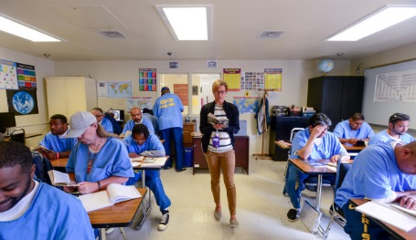
What Types of Institutions Are We Teaching In?
California State Prisons
Wasco State Prison-1 yard
Kern Valley State Prison-4 yards
North Kern State Prison-1 yard
Corcoran State Prison-4 yards
Substance Abuse Treatment Facility-4 yards

Slide 5
Learning and Career Pathways
Communication Studies Associate in Arts Degree for Transfer
Sociology Associate in Arts Degree for Transfer
History Associate in Arts Degree for Transfer
Psychology Associate in Arts Degree for Transfer
Industrial Automation Bachelor of Science Degree
Kern Valley State Prison Pilot Program

Slide 6
Enrollment Overview for Spring 2022 Semester
Continued Operations in 6 Facilities, for a Total of 14 Yards
86 Total Sections
Estimated student headcount is 952
Approximately 1,639 Student Enrollment
40 Instructors

Slide 7
Juvenile Hall Pilot
Partnered with Dual Enrollment
Offering STDV B6-Tools for College Success
Plans to Expand:
Kern Crossroads Facility
Camp Erwin Owen

Slide 8
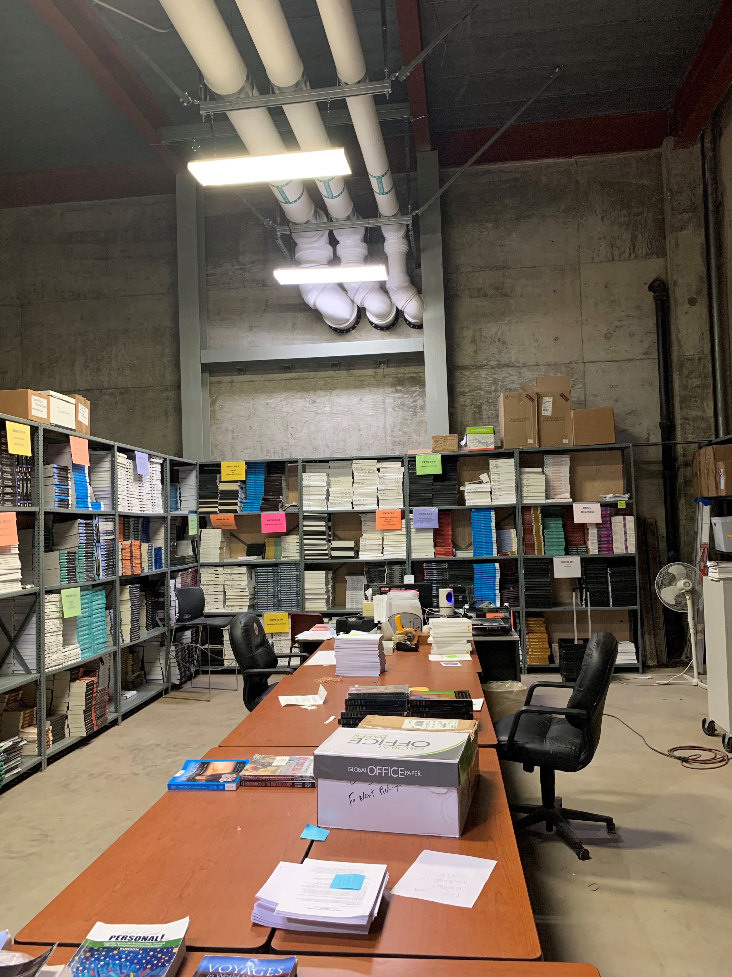
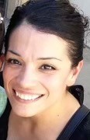
Staff and Facilities Updates
New Department Assistant III
Rita Gabaldon
Basement Expansion

Slide 9
Industrial Automation BA Update
Mobile Classroom
Laptops (No Internet)
Electronics Courses:
ELET B1A-Basic Electronics
ELET B3-Programmable Logic Controllers

Slide 10
Summer Entrepreneur Academy
Includes the following courses:
Introduction to Entrepreneurship
Business Plan I: Executive Summary
Business Plan II: The Organizational Plan
Business Plan III: The Marketing Plan
Business Plan IV: The Financial Plan
Execution of Business Plan

Slide 11
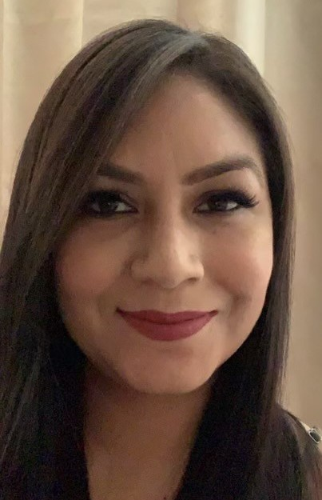
Connecting Students to the community
Diana Alcala
RSP Educational Advisor
(661) 395-
dialcala@bakersfieldcollege.edu
Unite Us- Network that connects students to organizations and provide services to individuals in need.

Slide 12
Faculty Needs
Anthropology Instructor Needed to teach ANTH B1, ANTH B1L and ANTH B3
Philosophy Instructor Needed for Philosophy Pathway (PHIL B18, PHIL B12, PHIL B6A, PHIL B7) and to teach PHIL B35 for Area F
Foreign Language Instructor Needed for IGETC Pathway
Political Science Instructor Needed for Political Science Pathway (POLSI B1, POLSI B2, POLS B3)
Sociology Instructor Needed Sociology Pathway (SOCI B28, SOCI B1, SOCI B45, and SOCI B2)
Geology/Earth Science Instructor Needed for all pathways

Slide 13
If you are interested in teaching or collaborating with the Rising Scholars Program please reach out to us!
Angelica Perez, Program Director angelica.perez@bakersfieldcollege.edu
Sabrina Aguilar, Program Manager sabrina.aguilar@bakersfieldcollege.edu
Diana Alcala, RSP Educational Advisor
bryan.hirayama@bakersfieldcollege.edu

