Slide 1
Overview of the Student Centered Funding Formula
Chancellor’s Office
August 10, 2018

Slide 2
Current Challenges
While the system has made significant strides in improving student success, serious challenges remain.
Most students who enter a community college never complete a degree or certificate or transfer.
Students who do reach an educational goal take a long time to do so.
Achievement gaps persist (across student groups and across regions).
Discussions about a new funding formula began more than a year ago, given concerns among system stakeholders that enrollment—the traditional driver of funding—has been stagnant in many districts.
August 10, 2018

Slide 3
Principles for Reform
In reforming funding for community college districts, we aim to do the following:
Encourage progress toward the Vision for Success adopted by the Board of Governors.
Provide groups of students that have faced barriers to success with additional support to meet our goals.
Make resources most useful to community college districts by making them stable, predictable, and flexible.
We want community college finance to further the activities the Chancellor’s Office is undertaking through the Guided Pathways framework.
August 10, 2018

Slide 4
Student Centered Funding Formula
The new formula calculates apportionments generally using three allocations:
Base Allocation—Current factors (primarily credit FTES).
Supplemental Allocation—Counts of low-income students.
Student Success Allocation—Counts of outcomes related to the Vision for Success, with “premiums” for outcomes of low-income students.
Noncredit FTES (and some other FTES) would be funded at current rates.
The rates are calculated to provide a three-year transition.
August 10, 2018

Slide 5
Student Centered Funding Formula
August 10, 2018

Slide 6
Supplemental Allocation
For the supplemental allocation, a district would receive one “point” based on the counts of all of the following in the prior year:
Pell Grant recipients.
California College Promise Grant recipients.
AB 540 students.
August 10, 2018

Slide 7
Student Success Allocation
Student Success Allocation—Measures | All Students | Promise Grant Premium | Pell Grant Premium
Associate degrees for transfer granted | 4 | 4 | 6
Associate degrees granted (excluding ADTs) | 3 | 3 | 4.5
Baccalaureate degree granted | 3 | 3 | 4.5
Credit certificates (16 units or more) granted | 2 | 2 | 3
Completion of transfer-level mathematics and English courses within first academic year of enrollment | 2 | 2 | 3
Successful transfer to four-year university | 1.5 | 1.5 | 2.25
Completion of nine or more CTE units | 1 | 1 | 1.5
Attainment of regional living wage | 1 | 1 | 1.5
August 10, 2018

Slide 8
Point Values
 | 2018-19 | 2019-20 ^{/1} | 2020-21 ^{/1}
Base Allocation
Dollars per Credit FTES | $3,727 | $3,387 | $3,046
Basic Allocation | See Note | See Note | See Note
Supplemental Allocation—Dollars per Point | $919 | $919 | $919
Student Success Allocation—Dollars per Point | $111 | $167 | $222
^{1/} These totals will also be adjusted by the changes in the cost-of-living in those years.
Note: These amounts will be calculated based on the numbers of colleges and comprehensive centers consistent with the current formula.
August 10, 2018

Slide 9
Funding Formula Allocation
2 Caveats
Uses 2017-18 P2 320 data for simulation. Data to be updated with final 320 data
Data is provided in aggregate by the Chancellor’s Office, College data is estimated based on MIS data
All Charts can be found online at KCCD IR Tableau Public Profile
https://public.tableau.com/profile/kccdir

Slide 10
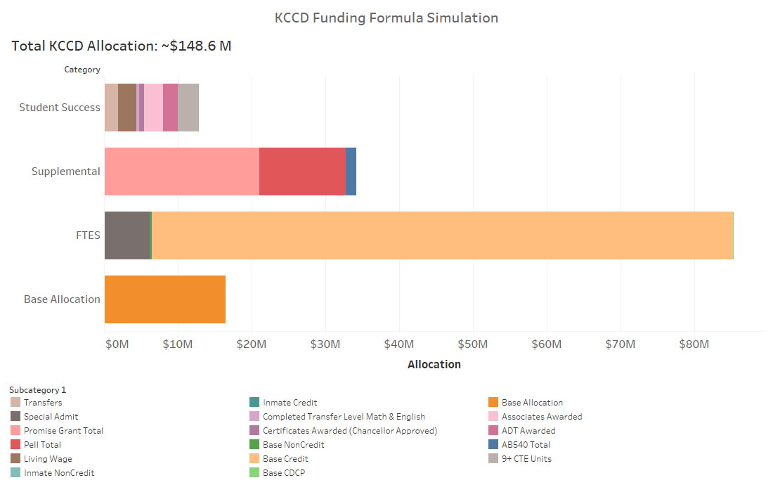

Slide 11
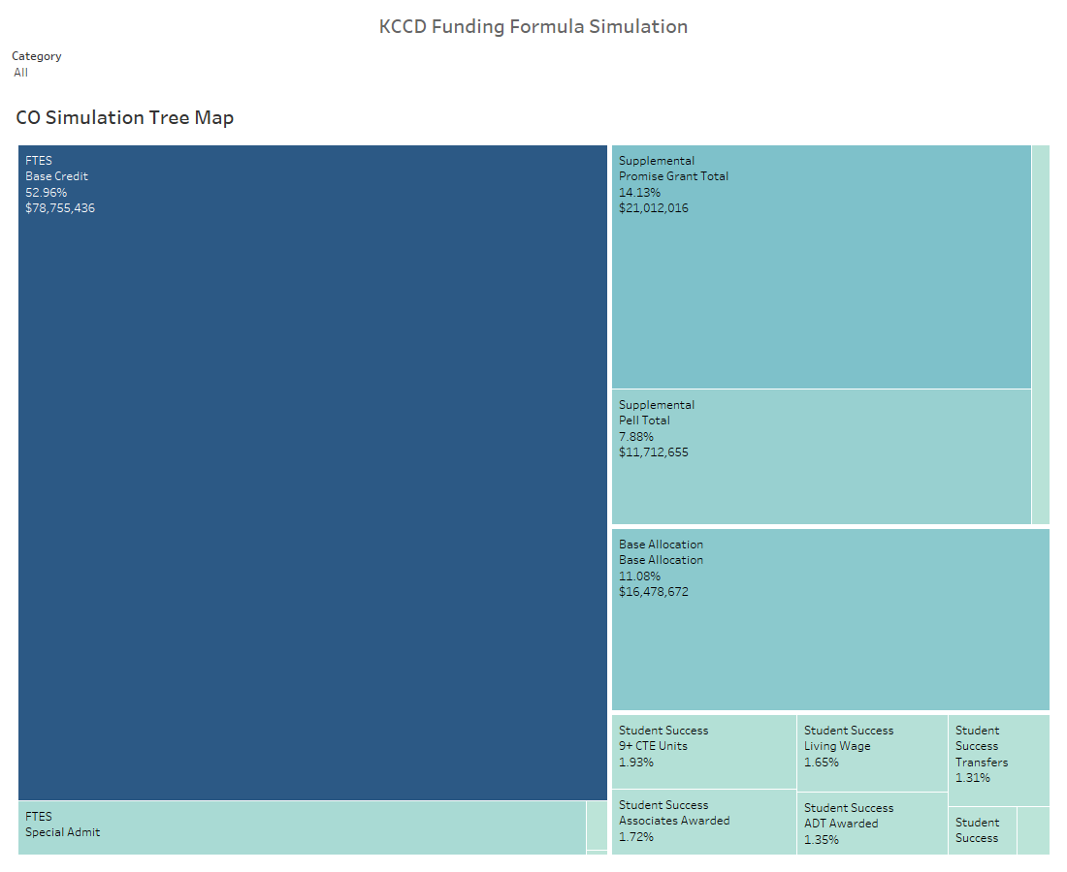

Slide 12
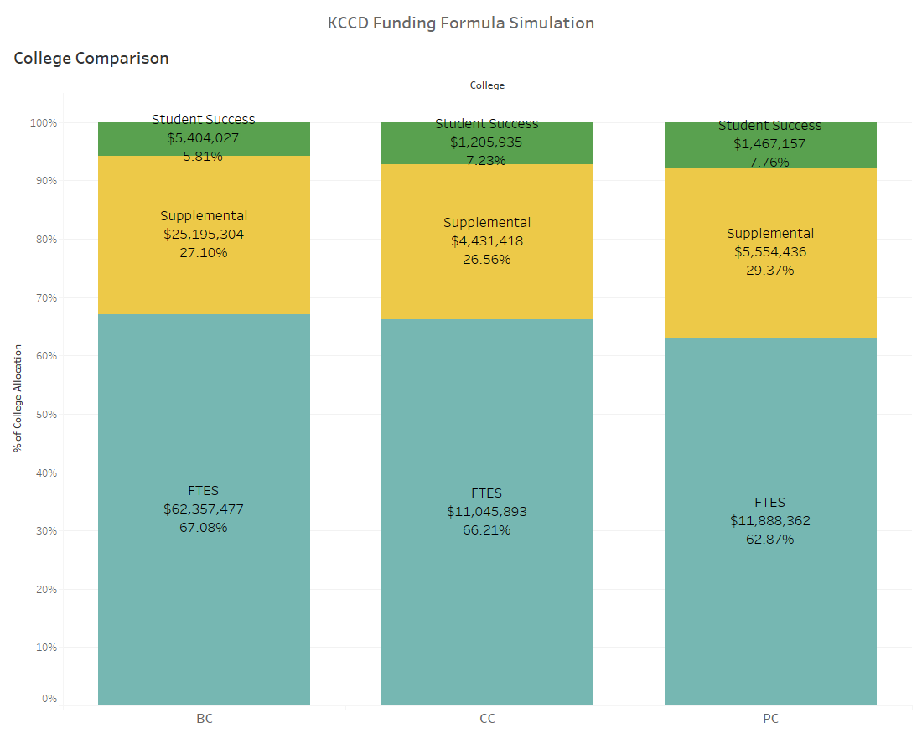

Slide 13
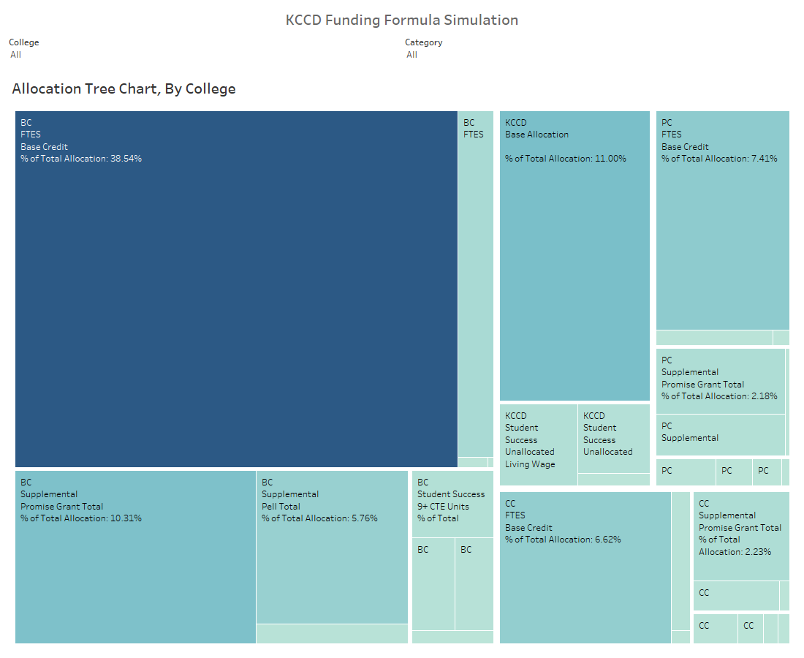

Slide 14
For consideration
Inmate population needs to be input into MIS correctly
MIS data integrity issues make these projections volatile
Traditional FTE has taken ~30% discount
Student Success is projected to account for less than 10% of allocation
Student Success is the least rigid part of the funding formula – Each FTE can be leveraged if that FTE achieves a student success outcome

Slide 15
Implementation
In 2018-19, 2019-20, and 2020-21, a district would receive the greater of the formula total or the amount the district received in 2017-18, adjusted by the changes in the cost-of-living.
The formula includes a “stability” provision that delays any decreases in revenues by one year.
Further, the bill would require the following of districts:
Goals—Adoption, by January 1, 2019, of goals that are aligned with the Vision for Success.
Comprehensive Plans—Alignment of comprehensive plans with those goals and alignment of annual budgets with the comprehensive plans.
Capacity—If directed by the chancellor (with approval by the Board of Governors), use of funds for technical assistance or professional development.
August 10, 2018

Slide 16
More Information
To receive responses to questions or to provide comments on implementation, please email SCFF@cccco.edu.
To Chancellor’s Office will post updates, including responses to frequently asked questions, at http://extranet.cccco.edu/Divisions/FinanceFacilities/StudentCenteredFundingFormula.aspx.
August 10, 2018

