Slide 1
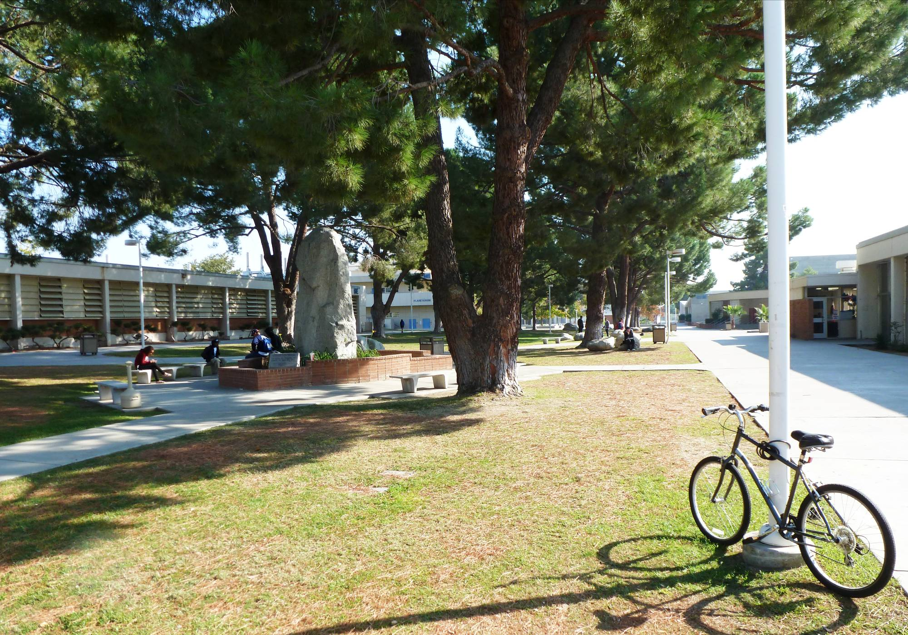

Bakersfield College
March 21, 2014

Slide 2
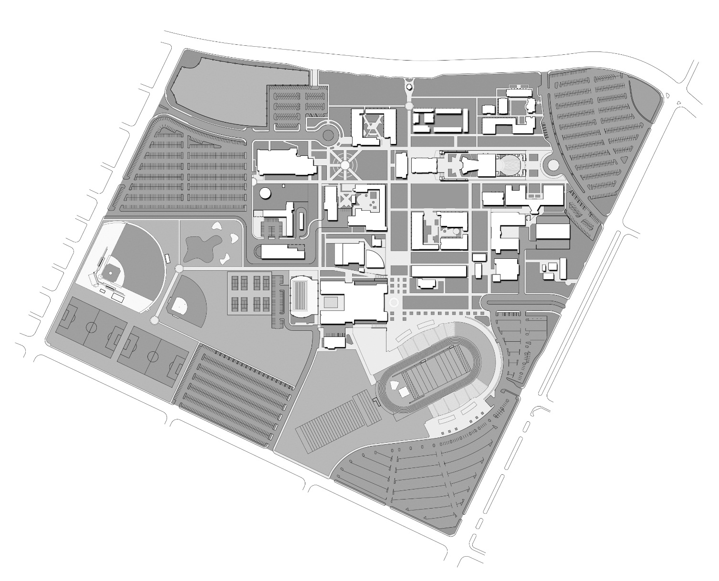
STEM Neighborhood
Panorama Dr.
Haley St
Mt. Vernon
University Ave

Slide 3
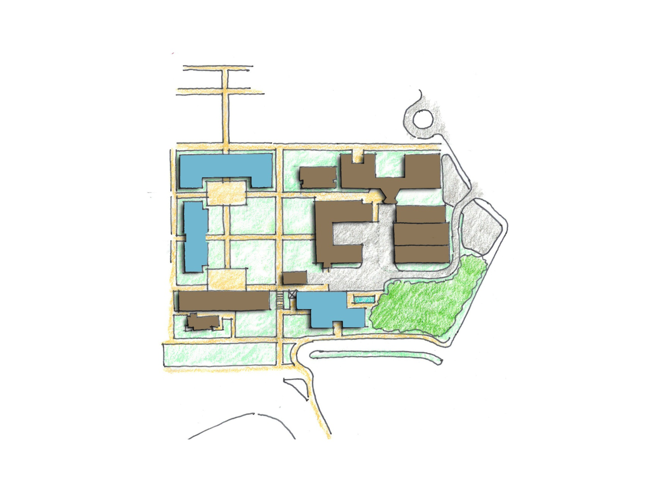
The STEM Neighborhood at BC
PROS
No Swing Space Required
Mitigates Building Scale
Creates Strong STEM Neighborhood
Improves Pedestrian access / campus connection (To Industrial & Auto Technologies – Buildings 3 &5)
Enhances North / South pedestrian connection between campus & parking
Mitigates grade issues / accessibility (C)
Minimizes pedestrian & service movement conflicts
Significant visual impact on core of campus
CONS
Requires Relocation of Stem Center ($)
A1
4
4
E
3
A2
B
5
Existing Buildings
Planetarium / Allied Health / Classroom Building
Allied Health
Industrial Technology
Fine Arts
Auto Technology
Chillers
Proposed Buildings
A1. Math / Science / Engineering
(Phase 1)
A2. Math / Science / Engineering
(Phase 2)
STEM Courtyard
AG Engineering / Horticulture
Horticulture Field Lab
New Service Access
6
1
C
D
Mt. Vernon
2

Slide 4
Student Services: option 1
Panorama Dr.
Haley St
Mt. Vernon
University Ave

Slide 5
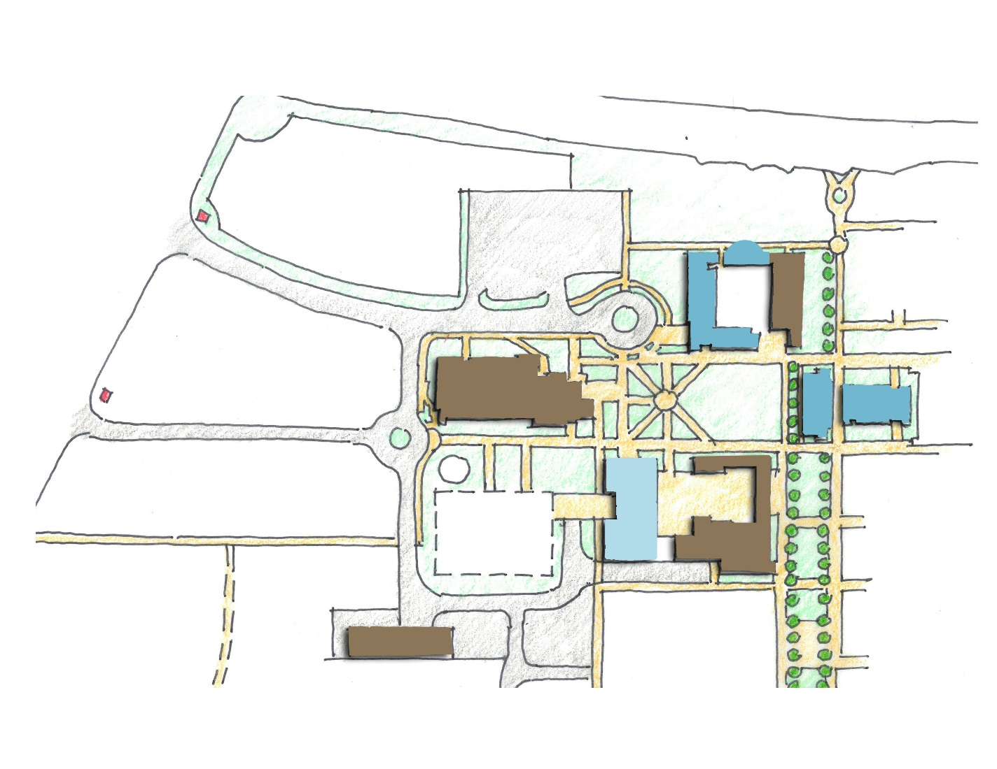
Student Services: Option 1
PROS
Consolidate student services
Front end services convenient to parking / edge of campus
Leven Hall becomes available as an Assessment Center
Expanded space accommodates growth for Basic Skills allocation
Allows for phasing of Student Services (limited swing space?)
Project qualifies for State Funding
Student Services engages Library Quad / Green
Synergies:
Culinary / Conference
Conference / Campus Center
Conference / Administration
CONS
Swing Space Required
Requires relocation of Administration to alternate location
Panorama Dr.
(E)
(E)
Haley St
A
2
1
5
A
Existing Buildings
Library
Business
Campus Center
Future M&O
Existing Student Services
  (Future Basic Skills Center)
Proposed Buildings
Student Services
Bookstore, Culinary Arts, Conference Center, Administration, Archive
Future Building Pad
B
C
3
4

Slide 6
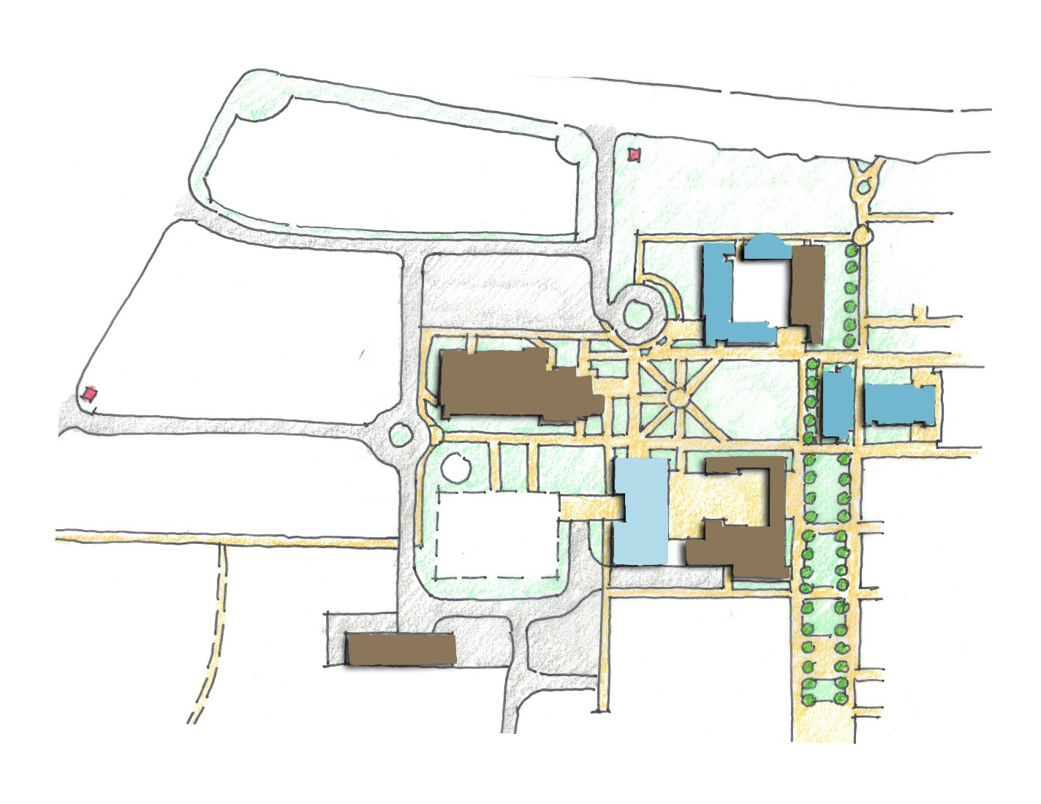
Student Services: Option 1 w/ new entry
Panorama Address
Convenience Parking
  Front Services
  Culinary Arts
  Conference
  Administration
A
Panorama Dr.
Haley St
B

Slide 7
Student Services: option 2
Panorama Dr.
Haley St
Mt. Vernon
University Ave

Slide 8
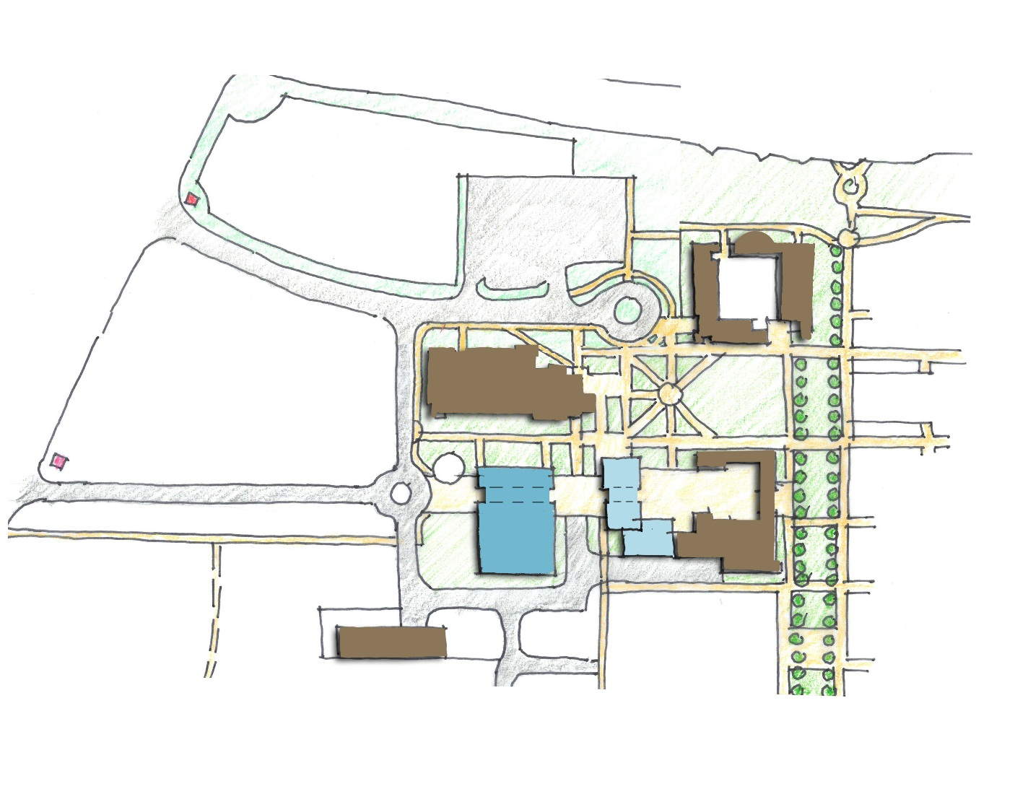
Student Services: Option 2
PROS
Consolidates Student Services
Student Services convenient to parking
Project qualifies for State Funding
Relocation of Administration is not required
Allows for visual and physical connection from Panorama Drive/Transit Drop Off to Campus Core
Synergies:
Culinary / Conference
Conference / Campus Center
CONS
Not visually accessible from campus perimeter
Swing Space Required for Bookstore
Limits student engagement at Library / Campus Quad
Panorama Dr.
(E)
(E)
Haley St
2
3
1
C
Existing Buildings
Library
Administration
Business
Campus Center
Future M&O
Proposed Buildings
Student Services
Bookstore, Culinary Arts, Conference Center, Archive
Future Building Pad
A
B
4
5

Slide 9
Student Services: option 3
Panorama Dr.
Haley St
Mt. Vernon
University Ave

Slide 10
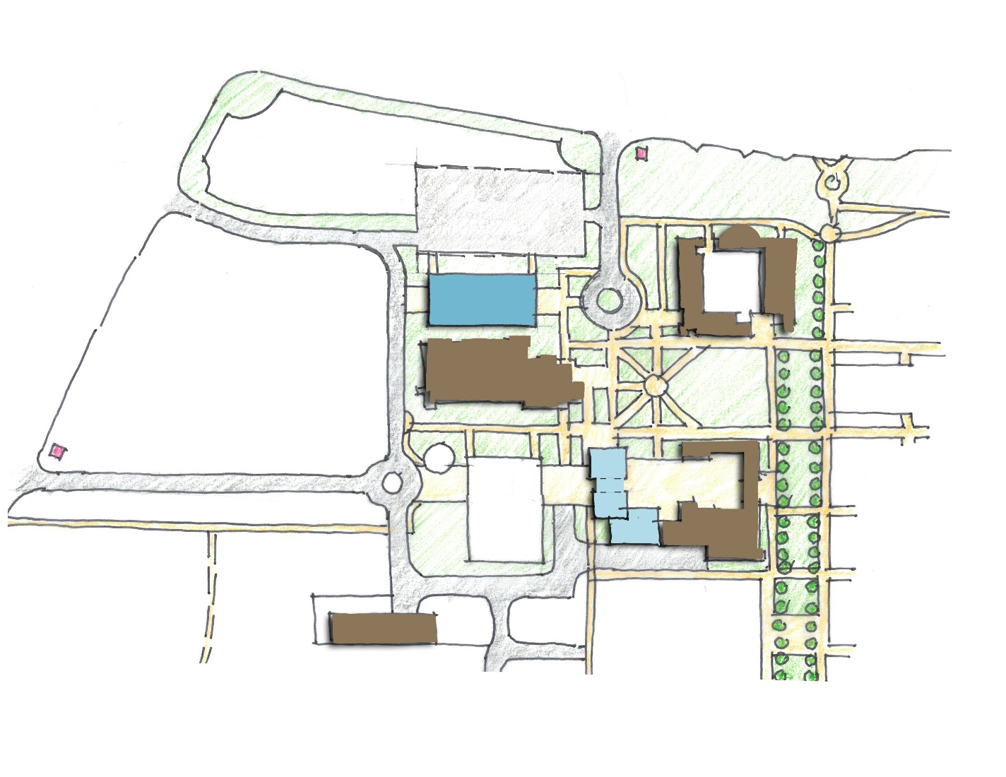
Student Services: Option 3
PROS
Consolidates Student Services
Student Services convenient to parking / visual from campus edge
Project qualifies for State Funding
Relocation of Administration is not required
Allows for visual and physical connection from Panorama Drive/Transit Drop Off to Campus Core
Synergies:
Culinary / Conference
Conference / Campus Center
CONS
Swing Space Required for Bookstore
Limits student engagement at Library / Campus Quad
Panorama Dr.
Haley St
2
3
A
1
C
Existing Buildings
Library
Administration
Business
Campus Center
Future M&O
Proposed Buildings
Student Services
Bookstore, Culinary Arts, Conference Center, Archive
Future Building Pad
C
B
4
5

Slide 11
Athletics: Field House / Club House
Panorama Dr.
Haley St
Mt. Vernon
University Ave

Slide 12
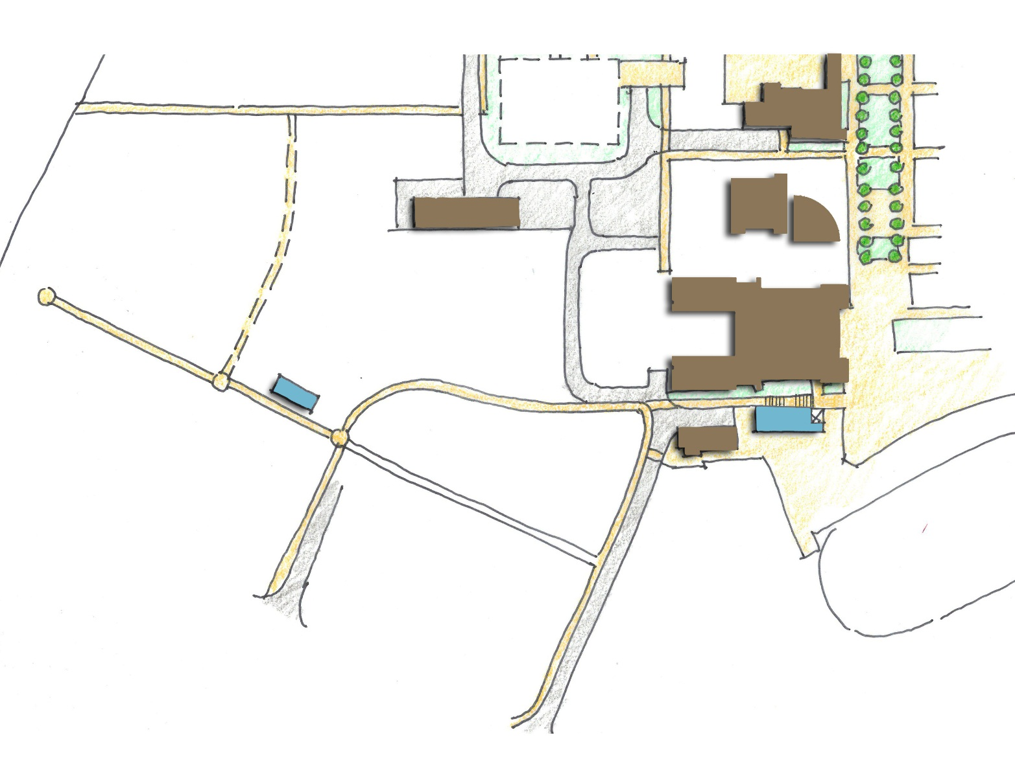
Athletics: Field House / Club House
Existing Buildings
Future M&O
Language Arts
Forum
Gym
Field House (Men's)
Proposed Buildings
Club House
Field House
Haley St
1
2
3
4
A
B
5
University Ave

Slide 13
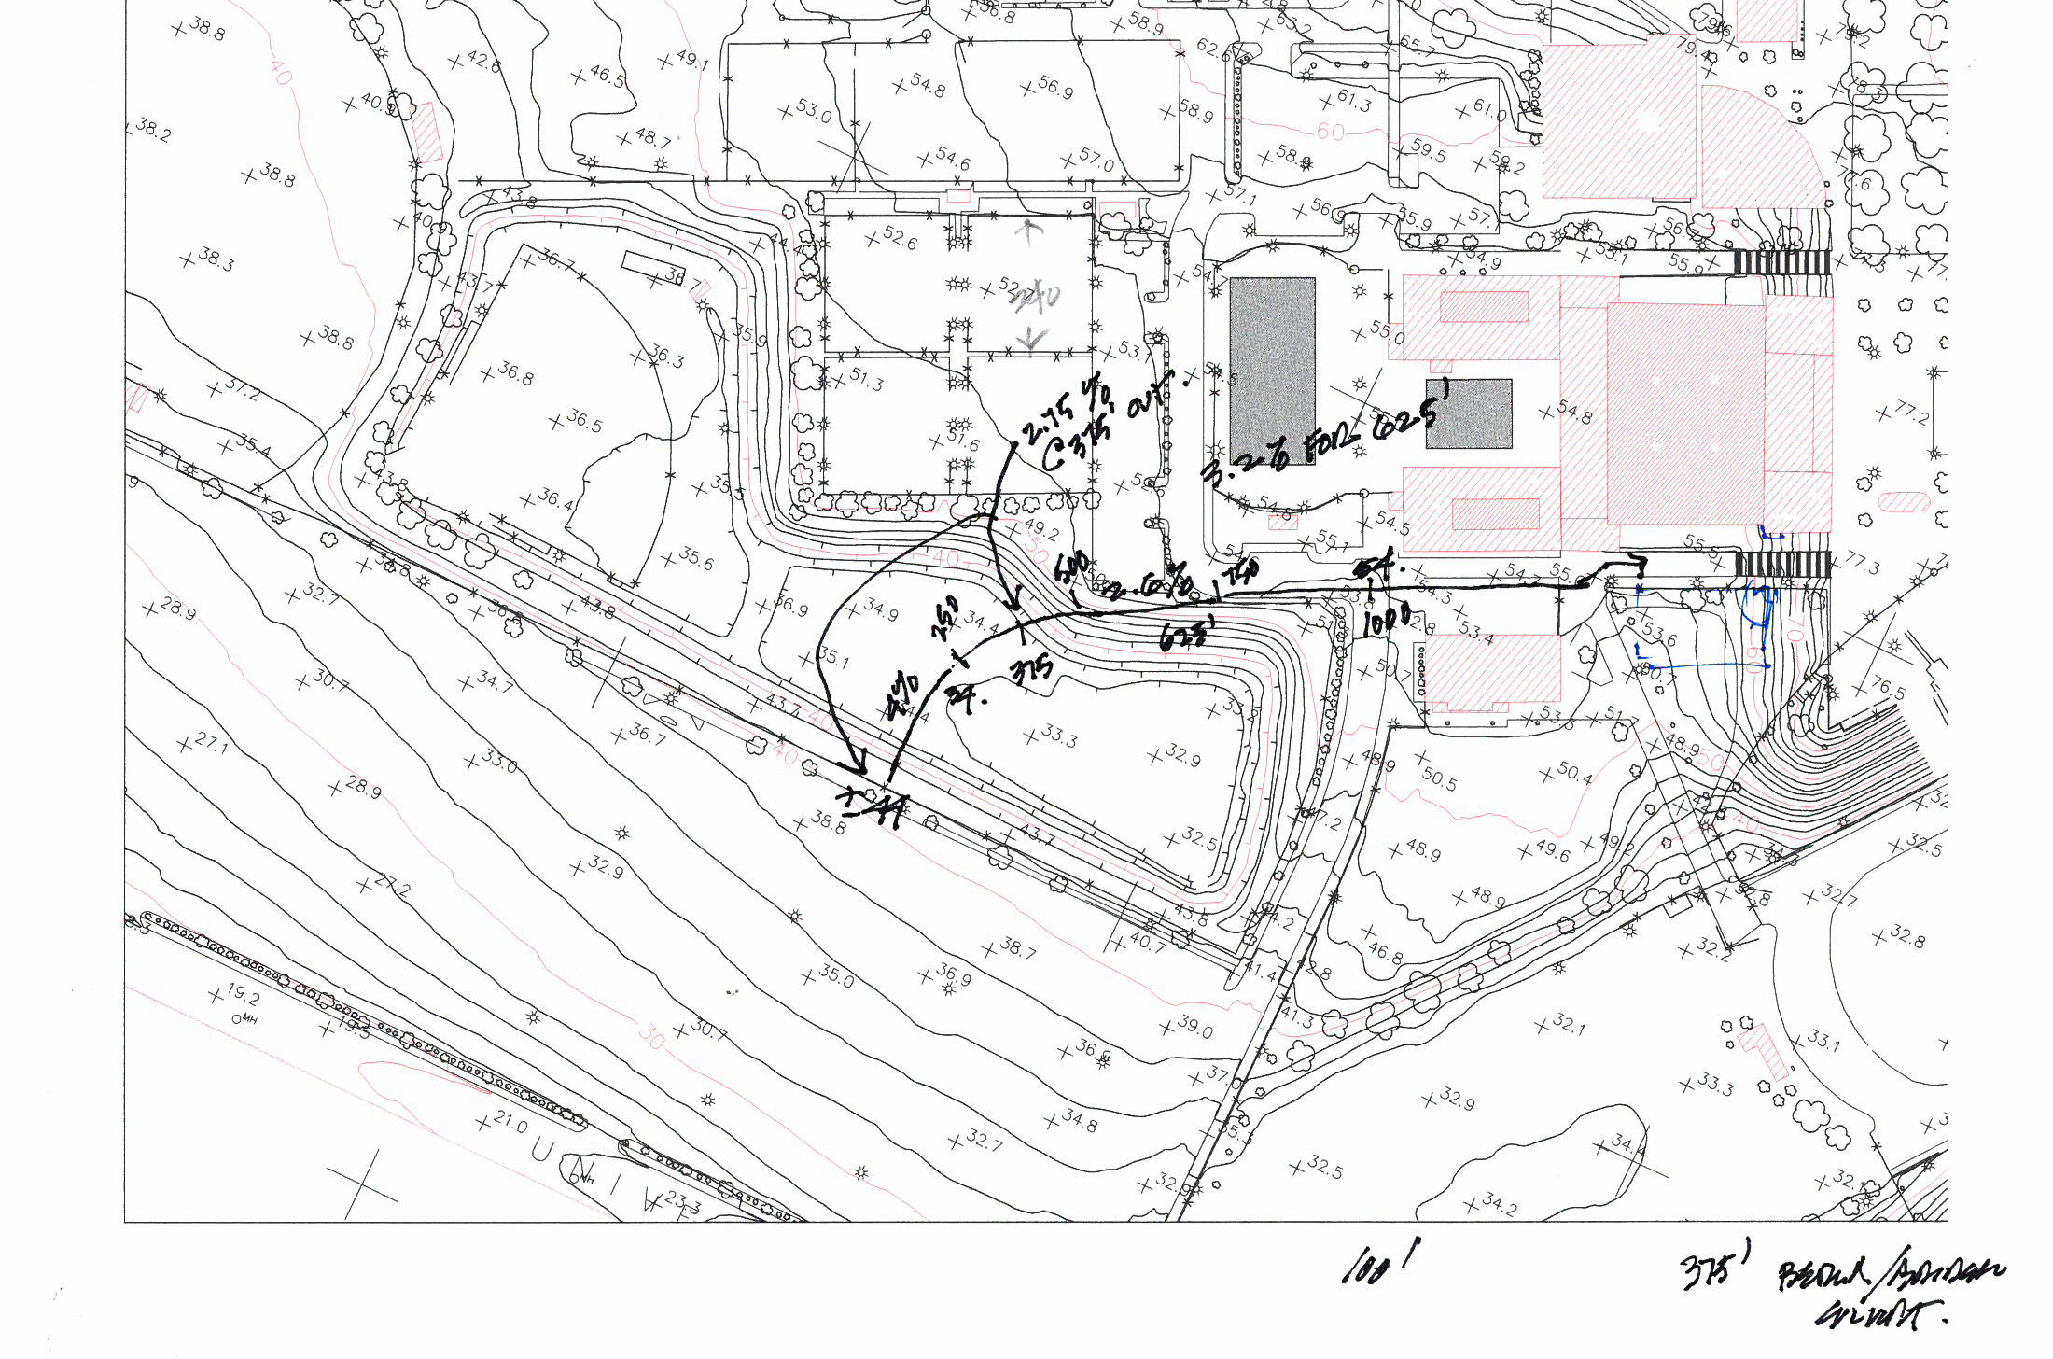

Slide 14
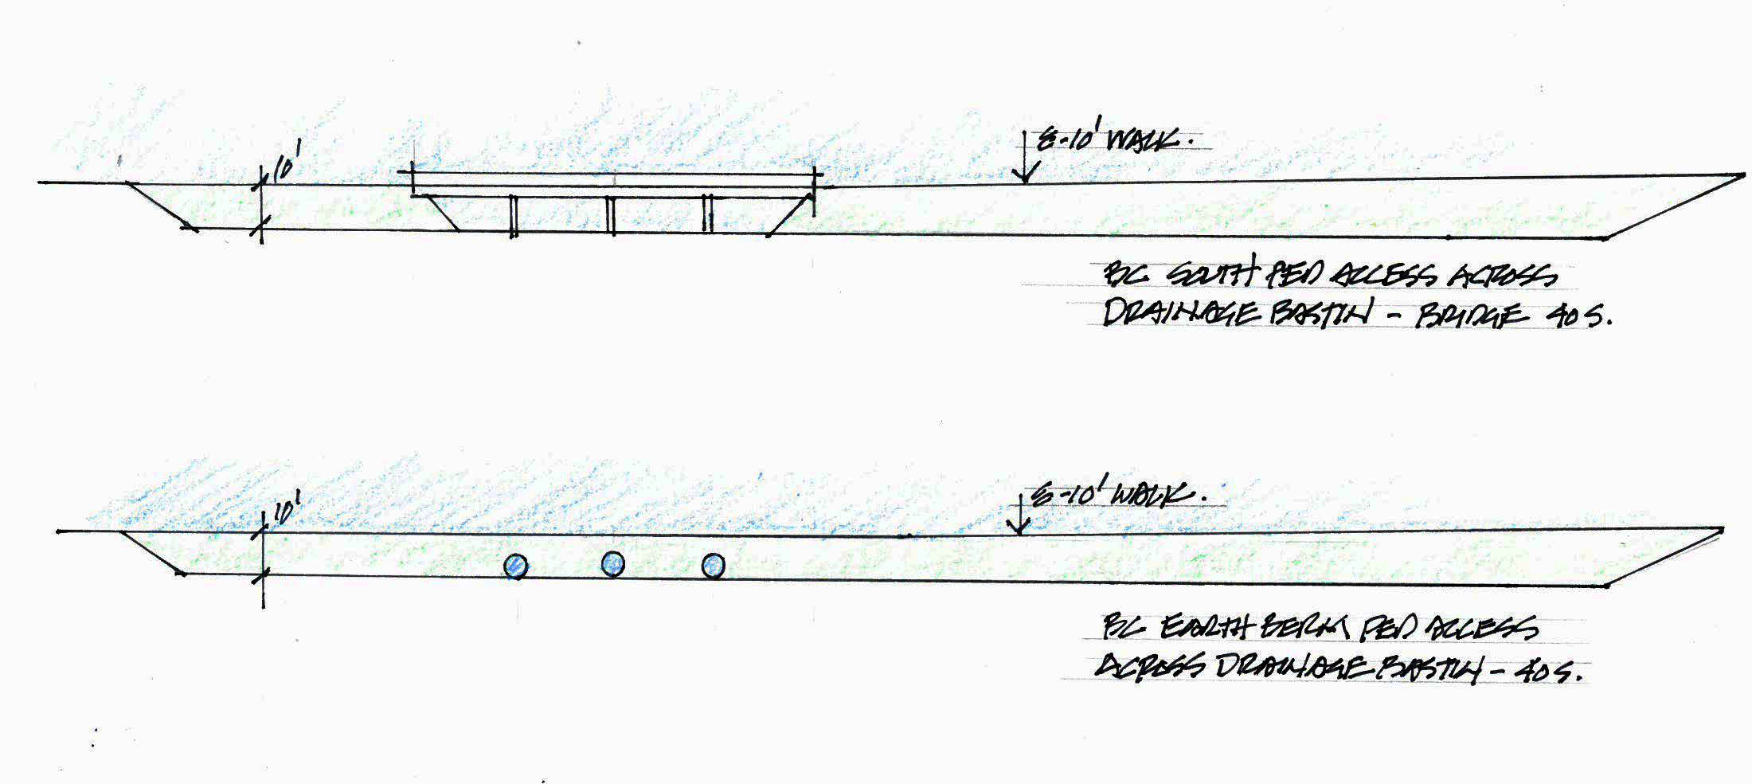

Slide 15
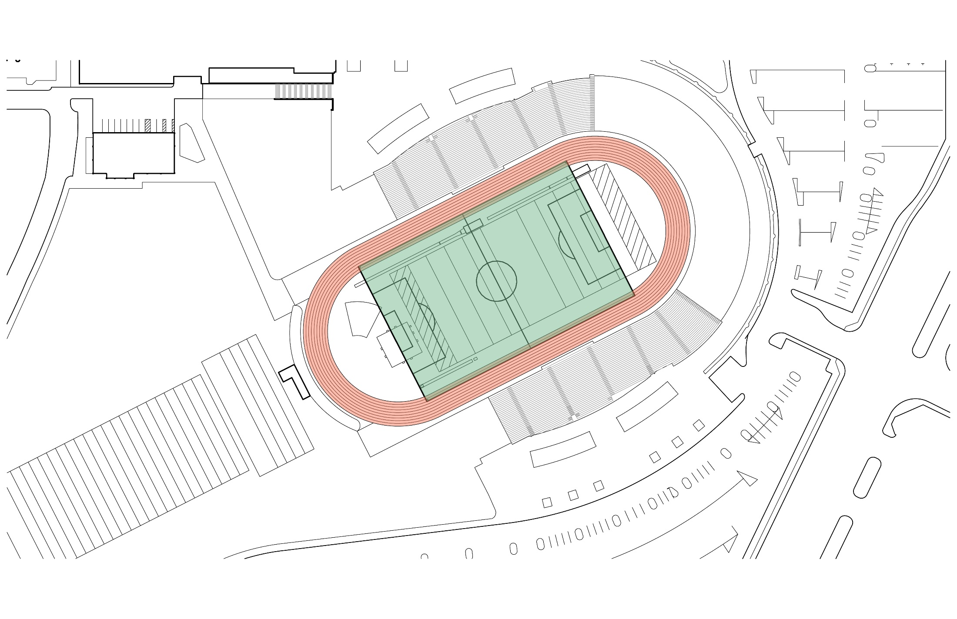
Soccer Field Addition
 | LENGTH | WIDTH
MAX. | 360’ | 240’
MIN. | 345’ | 210’
PREF. | 360’ | 225’

Slide 16
Thank You
Q / A
Comments
Preferred Alternatives

Slide 17
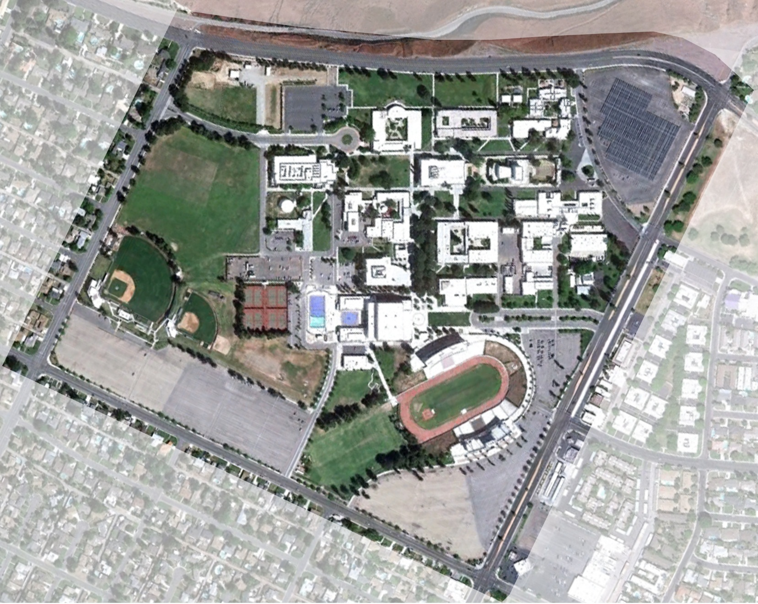
Panorama Dr.
Haley St
Mt. Vernon
University Ave

Slide 18
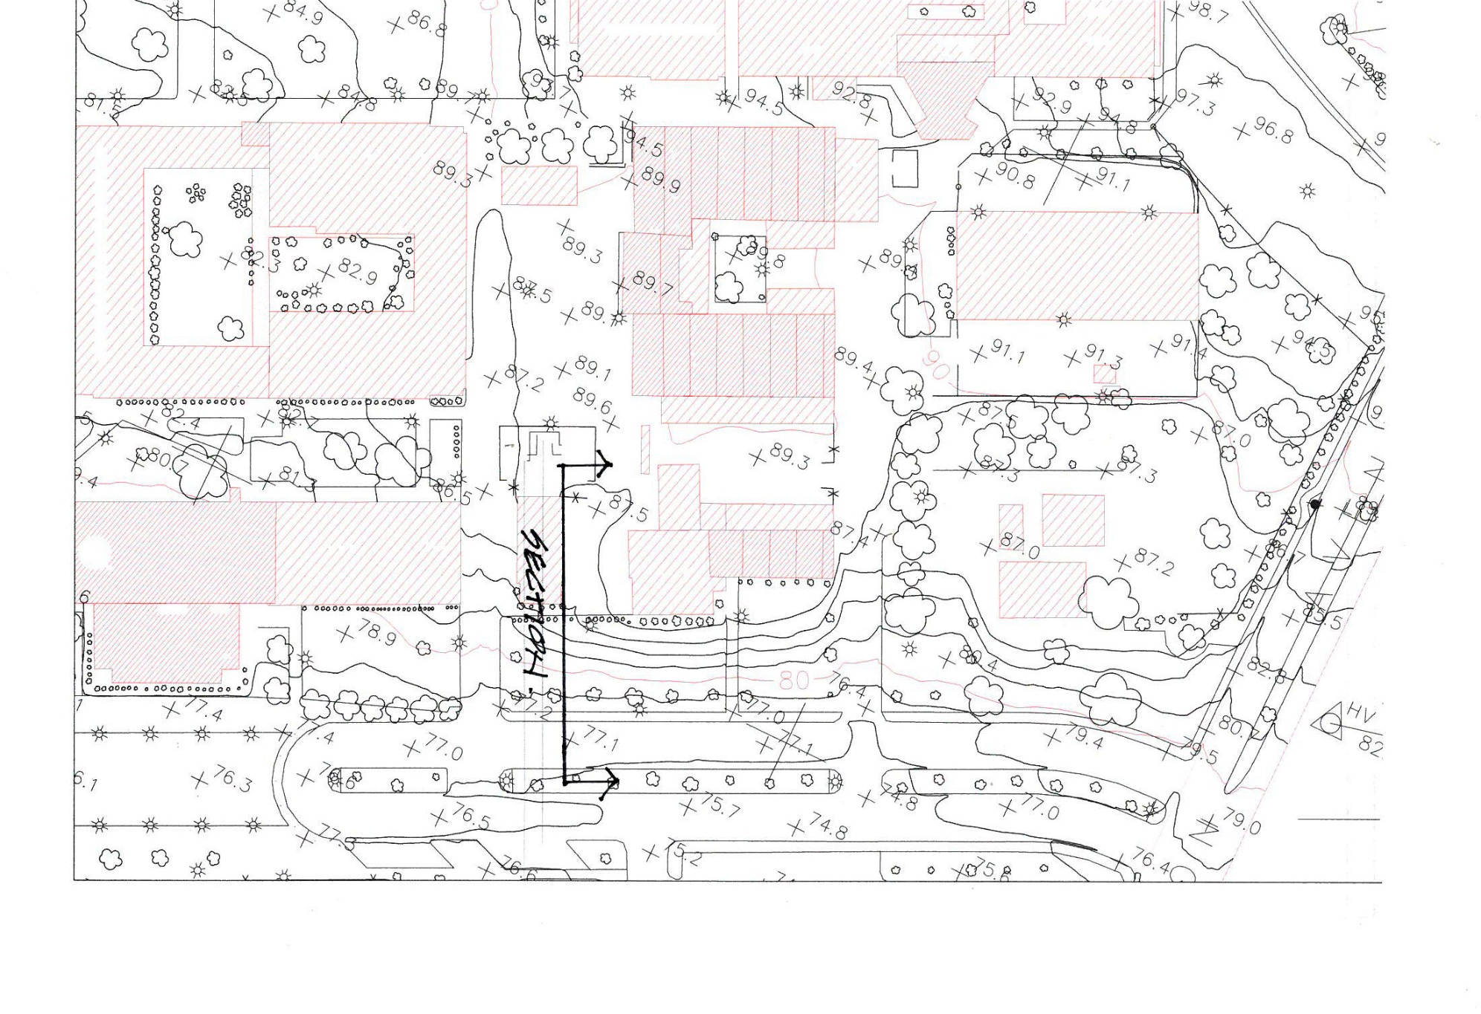
Science / Engineering
Math / Science
Allied Health

Slide 19
