Slide 1
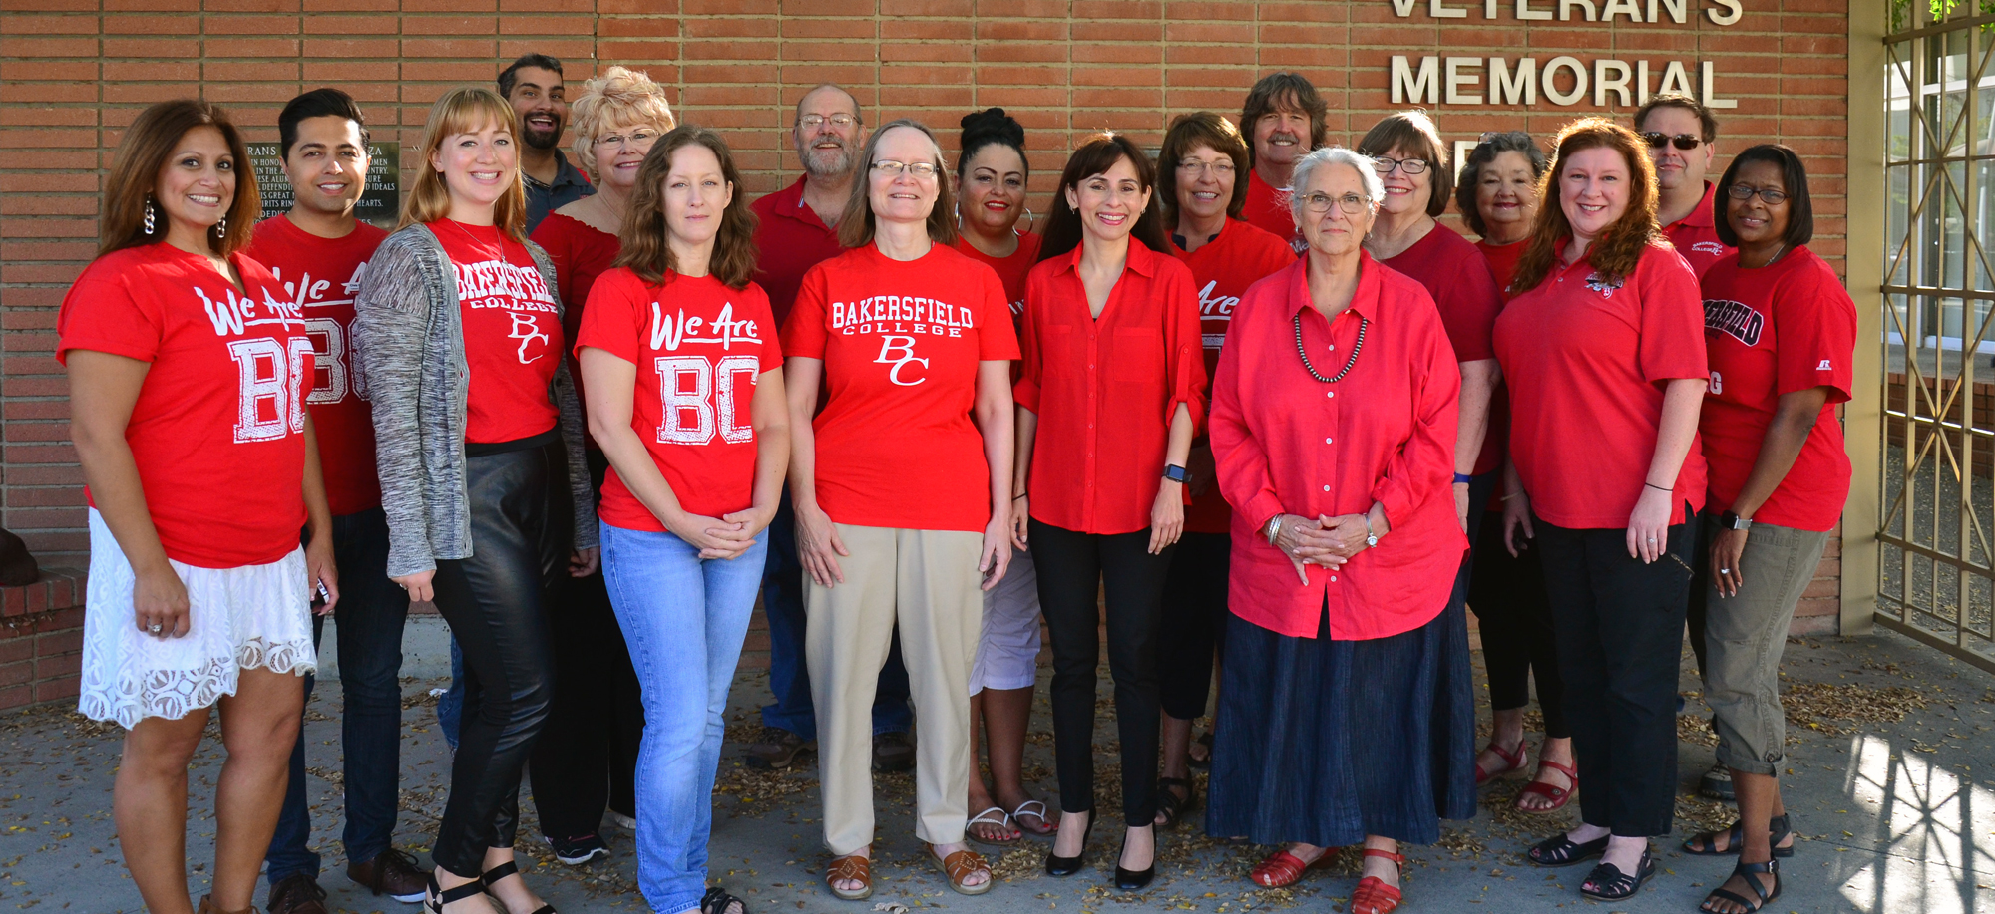
Guided Pathways
Presentation to College Council
November 18, 2016
October 7, 2016

Slide 2
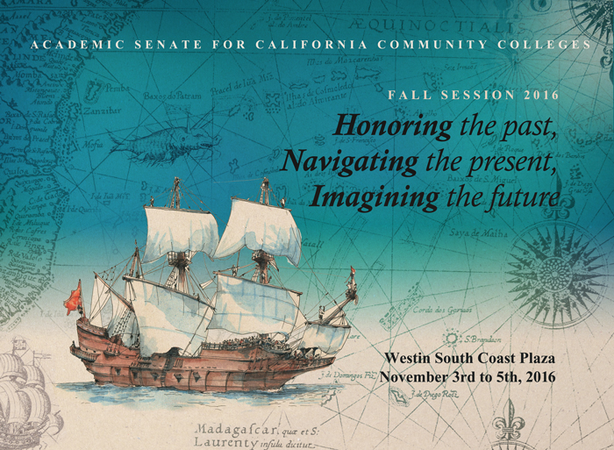
Guided Pathways
Presented by:
October 7, 2016

Slide 3
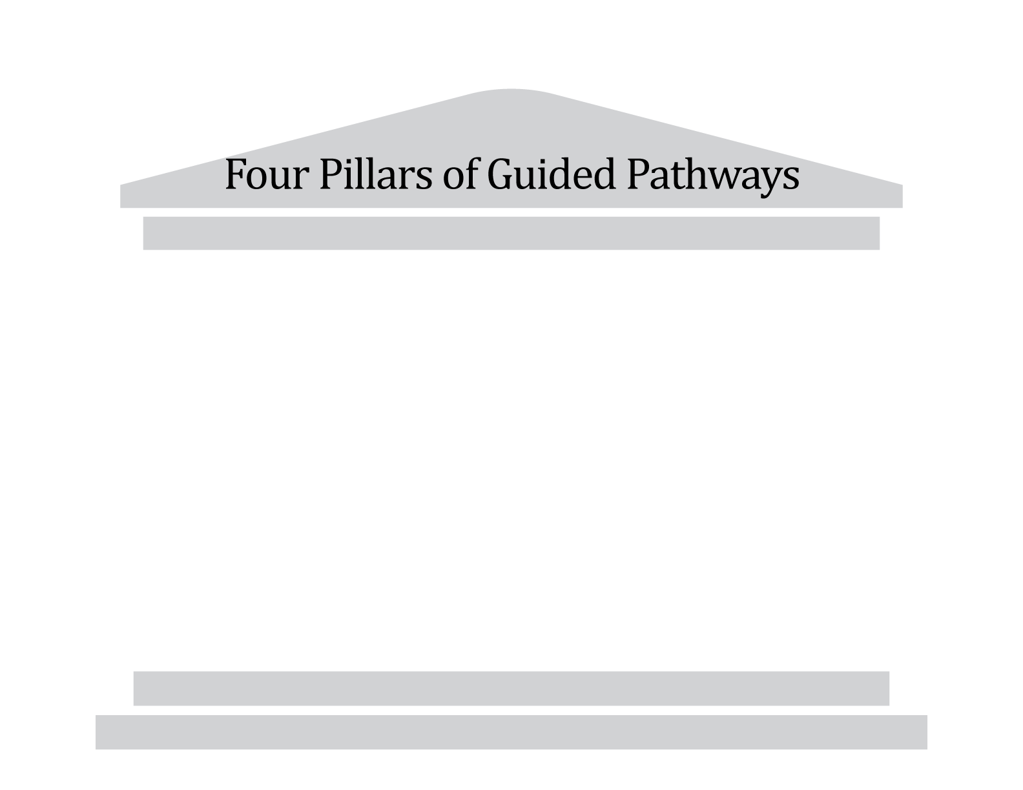
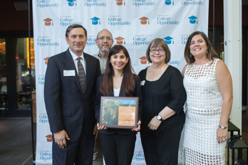
Guided Pathways
California Career
Pathways Trust (CCPT)
Equity, Social Mobility, Economic Health
California Pathways – Redesigning California’s Community Colleges

Slide 4
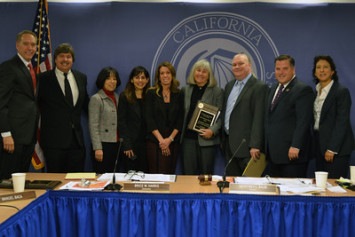
SSSP
Guided Pathways
Making It Happen (MIH)
CAI
Equity, Social Mobility, Economic Health
California Pathways – Redesigning California’s Community Colleges

Slide 5
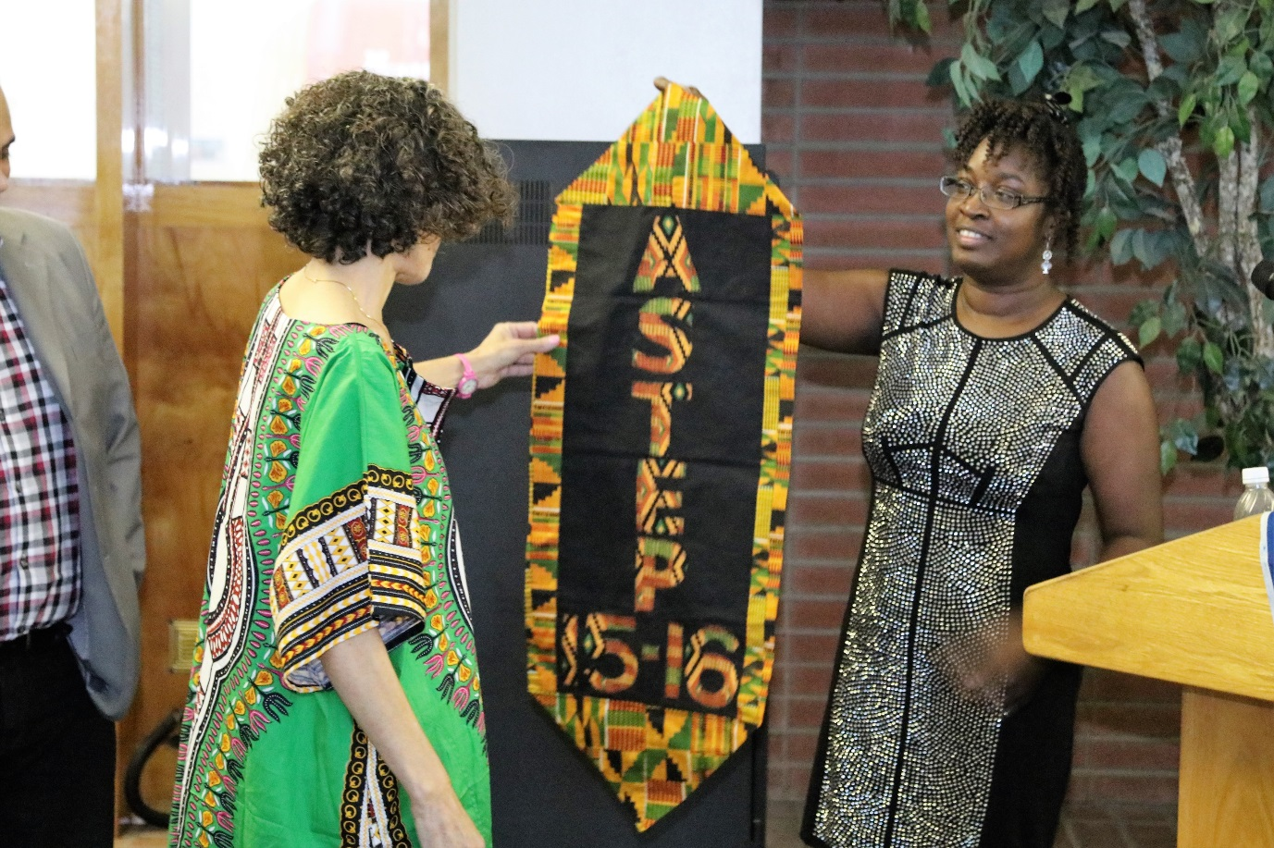
Guided Pathways
Tutoring
Writing Center
Supplemental Instruction
Extend the Classroom
Equity, Social Mobility, Economic Health
California Pathways – Redesigning California’s Community Colleges

Slide 6
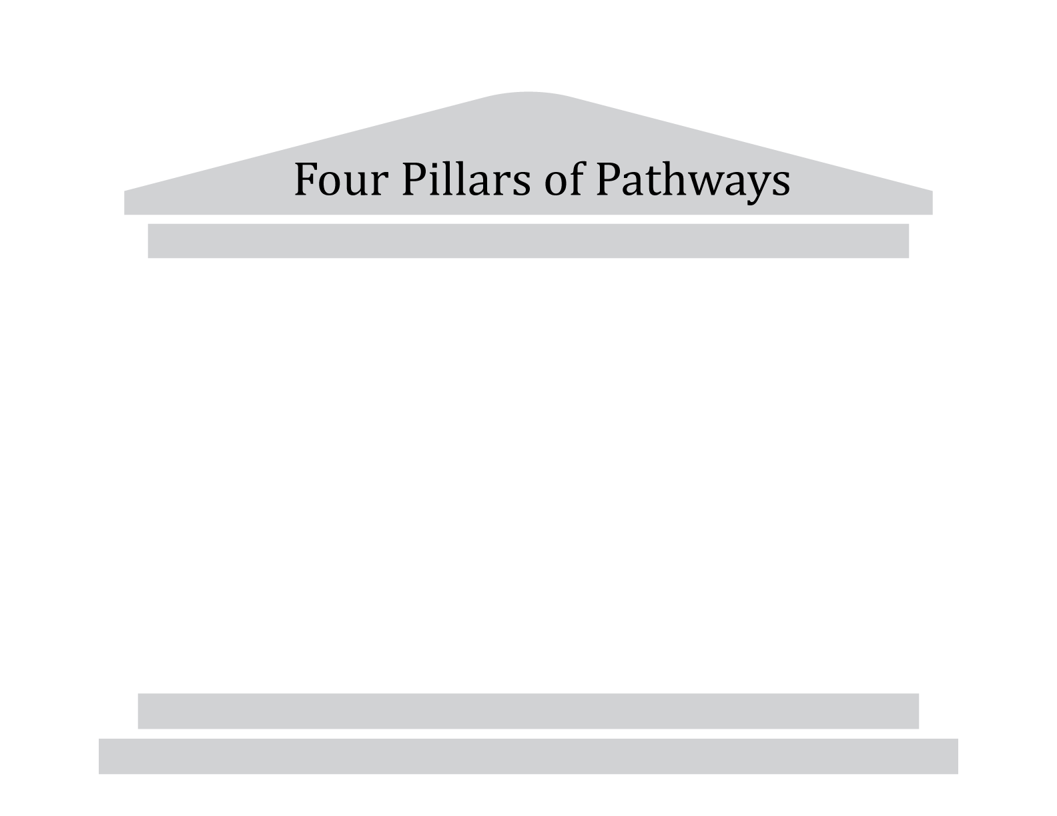
Guided Pathways
PLOs
ILOs
Equity, Social Mobility, Economic Health
California Pathways – Redesigning California’s Community Colleges

