Slide 1
Achieving the Desired Outcomes
BC Counseling and Advising
Clarify – Commit – Complete

Slide 2
Updating BC Guided Pathways Completion Coaching Teams
Learning and Career Pathways
Departments
Programs of Study
# Students (currently enrolled excludes spec. admit)
Department Chairs
Spring 2018 Faculty Lead
2019-20 Faculty Lead
Counseling & Advising Expert(s)
SOC Intern
Data Coach
Admin Lead
Admin Team
Admin Support
Faculty Lead
Discipline Faculty Expert(s)
Financial Aid Expert(s)
Peer Mentors
Student Support Experts: (Library(LIB), Math Center (MC), Writing Center (WC), Supplemental Instruction (SI), Tutoring (TC), Admissions & Records (A&R), Outreach (Out))
Career Experts (where necessary)
Agriculture, Nutrition, & Culinary Arts | Arts, Communication, & Humanities | Business | Education | Health Sciences | Industrial Technology & Transportation | Public Safety Training | Social & Behavioral Sciences | STEM | Personal & Career Exploration
Agriculture, Nutrition, and Culinary Arts | Art, Performing Arts, Foreign Languages, English | BMIT | Family and Consumer Education | Allied Health, Biology, Kinesiology, Nursing, Radiology, & Athletics | Industrial Technology, Engineering, & BSIA | Fire Tech & Behavioral Sciences | Social Sciences & Behavioral Sciences | Biology, Physical Sciences, Math, BMIT, & Engineering | Undecided
• Agriculture Business (AS-T) • Agriculture Business Management (CA) • Animal Science (AS, AS-T, CA) • Culinary Arts (AS, CA) • Dietetic Services Supervisor Program (CA) • Environmental Horticulture (CA) • Foodservices Management Option (AS) • Forestry (AS, AA, CA) • Mechanized Agriculture (AS) • Heavy Equipment Technician (CA) • Plant Science (AS-T, AS, CA) • Pre-Veterinary Medicine • Registered Veterinary Technician (JSC) | • American Sign Language (AA) • ASL Interpreter Program (CA) • Art History (AA-T) • Communication Studies (AA-T, CA) • Commercial Music (CA) • English (AA-T) • Graphic Design (CA) • Japanese (AA) • Journalism (AA-T) • Media Arts (CA) • Music (AA-T) • Philosophy (AA-T) • Photography (CA) • Spanish (AA-T) • Studio Arts (AA-T) • Theater Arts (AA-T) | • Accounting (AA) • Administrative Assistant (AA) • Bookkeeping (CA) • Business Administration (AS-T) • Economics (AA-T) • Information Technoloy (CA) • Office Assistant (CA) • CompTIA (CA) | • Child Development Assistant Teacher (JSC) • Child Development Associate Teacher (JSC) • Child Development Master Teacher- Infant Toddler (CA) • Child Development Master Teacher-Special Education (CA) • Child development Teacher (CA) • Early Childhood Education (AA-T) • Elementary Teacher Education (AA-T) • Paraprofessional I, II, & III (CA) | • Health Information Technology (AS) • Health Navigator (CA) • Human Biology (AS) • Kinesiology (AA-T) • Public Health Sciences (AA-T) • Radiology Technology (AS) • Registered Nursing (AS) • Vocational Nursing (CA) • LVN to Associate Degree Nursing Program (AS) • LVN to non-Degree Nursing (CA) • Nurse Assistance (CNA) (JSC) • Primary Care Physician Assistant • Principles of Fluroscopy (JSC) • Principles of Venipuncture (JSC) | • Architecture/Architectural Drafting (AS, AA) • AutoCAD (JSC) • Automatic Transmissions (CA) • Automotive- HVAC (CA) • Automotive Management (CA) • Automotive Technology (AS) • Baccalaureate Degree Program in Industrial Automation (BS) • Basic Machine Tool Operations - Lathe, Mill (JSC) • Brakes Systems (CA) • Blueprint reading and layout for Welders (JSC) • Cabinet making (CA) • Carpentry Apprenticeship (AS, CA) • Computer Numerical Control Program (JSC) • Construction Management (AS) • Construction Technology (CA) • Electrical and Electronic Systems (CA) • Electrician Apprenticeship (AS, CA) • Electronics Technology (CA) • Electronics - Industrial Automation (JSC) • Electronics - Industrial Communication (JSC) • Electronics - Industrial Maintenance (JSC) • Electronics - Manufacturing Automation (JSC) • Engine Overhaul and Repair (CA) • Engine Performance (CA) • Engineering Technology (AS) • Gas Metal/Tungsten/Flux Core Arc Welding (JSC) • Heavy Equipment Technician (CA) • HVAC Technology (AS, CA) • Industrial Automation (AS) • Industrial Drawing (AA, CA) • Industrial Technology – Electronics (AS, CA) • Industrial Technology – Industrial Drawing (AS) • Industrial Technology – Manufacturing Tech. (AS, CA) • Industrial Technology – Welding (AS, CA) • Industrial Technology – Woodworking and Cabinetmaking (AS) • Light Duty Diesel Performance (CA) • Manual Drive Train and Axles (CA) • Manufacturing Technology (CA) • Manufacturing Metal Fabrication Technology (AS) • Occupational Safety and Risk Management, Agriculture (AS) • Occupational Safety and Risk Management, Business (AS) • Occupational Safety and Risk Management, Health Sciences (AS) • Occupational Safety and Risk Management, Industrial Technology (AS) • Operating Engineer Apprenticeship (AS, CA) • Plumbers & Steamfitters Apprenticeship (AS, CA) • Process Technology (AS, CA) • Sheet Metal Apprenticeship (AS, CA) • Shielded Metal Arc Welding (JSC) • Suspension and Steering (CA) • Welding Certification (JSC) • Woodworking and Cabinetmaking (CA) | • Administration of Justice (AS-T) • Executive Chief Fire Officer (CA) • Correctional Administration (AA) • Criminal Justice (AA) • Fire Technology (AA) • Fire Academy (JSC) • Emergency Medical Technician (EMT-1) (JSC) • Paramedic Program (AS, CA) • Wildland Fire Technology (AS) • Firefighter 1 Academy (CA) | • Anthropology (AA-T) • History (AA-T) • Human Services (AA) • Political Science (AA-T) • Psychology (AA-T) • Sociology (AA-T) • Pre-Law | • Biology – General Biology (AS-T) • Chemistry (AS-T, AS) • Computer Science (AS-T) • Engineering (AS) • Environmental Science (AS-T) • Geology (AS-T) • Mathematics (AA-T) • Physics (AS-T) • Web Design and Development (CA) | • Liberal Arts (AA)
860 | 1353 | 1783 | 1367 | 3705 | 1127 | 1282 | 1994 | 1955 | 507
Heather Baltis (Ag) Suzanne Tangeman (Culinary) | Pam Boyles (English) David Neville (Foreign Languages) Kris Tiner (Performing Arts) Kris Stallworth (Art) Helen Acosta (Communication) Michael McNellis (Philosophy) Michael Westwood (EMLS) | Harold Mendoza (BMIT) | Kimberly Bligh (Education) | Alisha Loken (Nursing) Jacelyn Hill (RADT) Heather Shaffstall (HIT) Carl Dean (Athletics & KINS) | Jason Dixon (Engineering & Systems) Andrew Haney (Applied Sci & Tech) Klint Rigby (Industrial Technology) | Christian Zoller (Public Safety Training) | Krista Moreland (Behavioral Science) Jason Stratton (Social Science) | Joe Saldivar (Biology) Kenward Vaughan (Physical Sciences) Kathleen Rush (Math) Jason Dixon (Engineering & Systems) | Victor Diaz (Counseling)
LeAnn Riley, Matt Riley | Helen Acosta | ** Vacant ** | Erica Menchaca | Ayon Hill | Andrew Haney | Brent Burton | Krista Moreland | Eddie Rangel | Jonathan Schultz
LeAnn Riley | Anna Collins (Philosophy) | Rudy Menjivar | Bill Chapman | Lisa Harding | Andrew Haney | Brent Burton | Christina Howell (Psychology) | James McGarrah
Aneesha Awrey (Counselor) Juan Manzano (Ed Advisor) | Keri Kennedy (Counselor) Savannah Andrews (Ed Advisor) Lucy Perez-Dykes (Ed Advisor) | Jonathan Schultz (Counselor) Tania Burgos (Ed Advisor) Evette Lara (Ed Advisor) | Brynn Schock (Counselor) Veronica Lucas (Counselor) Jessica Garcia (Ed Advisor) | - Nursing, Rad Tech, Etc. Dinorah Castro (Counselor) Venessa Reyes (Ed Advisor) Jesus Cardenas (Ed Advisor) Abraham Castillo (Ed Advisor) - KINES, Human Bio, PBHS, & HIT Ryan Hyunh (Counselor) Giovanni Garcia (Ed Advisor) | Steve Agard (Counselor) Cynthia Quintanilla (Counselor - BDP only) Dylan Jensen (Ed Advisor - CTE) | Fabiola Johnson (Counselor) Dominica Rivera (Ed Advisor) Jeff Laforce (Ed Advisor) | Sarah Villasenor (Counselor) Jo Ann Acosta (Ed Advisor) Lupe Aguirre (Ed Advisor) | Laurel Mourtzanos (Counselor) Jesse Oropeza (Counselor) Josh Shackelford (Advisor) Merrisa Paulson (Adj Coun - MESA_ASEM) | Jonathan Schultz (Counselor) Aneesha Awrey (Counselor)
Vanessa Nunez (vanessa.nunez@intern.bakersfieldcollege.edu) | Christine Dinh-O Dell (christine.dinh-odell@intern.bakersfieldcollege.edu) | Michelle Leigh (michelle.leigh@intern.bakersfieldcollege.edu) | Michelle Leigh (michelle.leigh@intern.bakersfieldcollege.edu) | Vanessa Nunez (vanessa.nunez@intern.bakersfieldcollege.edu) | Michelle Leigh (michelle.leigh@intern.bakersfieldcollege.edu) | Tianna Belcher (tianna.belcher@intern.bakersfieldcollege.edu) | Christine Dinh-O Dell (christine.dinh-odell@intern.bakersfieldcollege.edu) | Tianna Belcher (tianna.belcher@intern.bakersfieldcollege.edu) | Christine Dinh-O Dell (christine.dinh-odell@intern.bakersfieldcollege.edu)
Juan Manzano (Ed Advisor) | Savannah Andrews (Ed Advisor) | Evette Lara (Ed Advisor) | Erica Menchaca (EDU) Jessica Garcia (Ed Advisor) | Ricardo Garza (Delano - Math Faculty) | Dylan Jensen (Ed Advisor - CTE) | Dominica Rivera (Ed Advisor) Kalina Hill (TAPC) | Christina Howell (Psychology) | Jonathan Brown (Math) Nigie Shi (Math) | Ashlea Ward (Outreach)
Jessica Wojtysiak (L) | Rebecca Farley (L) Jennifer Jeff (L) | Bill Moseley (L) | Bill Moseley (L) | Carla Gard (L) | Tony Cordova (L) | Derek Robinson (L) | Richard McCrow (L) | Steve Waller (L) James Mcgarrah (L) | Marisa Marquez (L)
Raquel Lopez | Kevin Lohmann |  |  | Reggie Bolton Keith Ford | Stephanie Baltazar Martin Perez | Mary Jo Pasek |  | Connie Gonzalez | Michael McClenic
Yolanda Aguilera | Renee Robertson | Anita Karr | Anita Karr | Michelle Burton | Mary Webb | Karen Mattox (Fire Tech) | Michelle Puentes | Janet Thomas/Veronica Hathaway | Luz Mendoza
Anna Melby (2021-22) | Gloria Dumler (2021-22) |  |  | Lisa Harding (2021-22) | Rony Recinos (2021-22) | Brent Burton (2021-22 | Christie Howell (2021-22) | Travis Steele (2021-22)
Lindsay Ono (Horticulture) | Gloria Dumler (English) | Michael Harvath (Economics) (Pending) | Erica Menchaca (EDU) | Katherine Ganster (Biology) | Andrew Haney (Automotive) | Pat Smith (Criminal Justice) | Sara Manuel (Psychology) | Donna Starr (Math)
Chris McCraw (Ag Business) | Qiu Jimenez (Spanish) | Michael Ivy (BMIT) | Teresa McAllister (EDU) | Milena Lilles (Biology) | Darren Willis (Industrial Drawing) | Christine Harker (Paramedics) | Jason Stratton (History) | Janet Tarjan (Math)
Heather Baltis (Agriculture) | Keri Wolf (English) | Richard Miles (Comp Science & Engineering) | Bill Chapman (EDU) | Carl Dean (KINE) | Lidia Torres (Architecture) |  | Krista Moreland (Anthroplogy) | Jonathan Brown (Math)
Greg Cluff (Plant Science) | Helen Acosta (Journalism) | Eddie Rangel (Computer Science) |  | Heather Shaffstall (Heath Information Technology) | Jeremy Staat (Welding) |  | David Riess (Sociology) | Joe Saldivar (Biology)
Billy Barnes (Animal Science) | Jaclyn Krause (ASL) | Valerie Robinson (Business Admin) |  | Jacey Hill (RAD) | Josh Ralls (Welding) |  | Jordan Rude (Psychology) | Kenward Vaughn (Chemistry)
Matt Riley (Agriculture) | Kristopher Stallworth (Studio Art) | Phil Whitney (Business Admin) |  |  | Robert Stewart (Manufarcturing) |  | Karimeh Amin (Human Services) | Kathleen Rush (Math)
Suzanne Tangeman (Culinary) | Joshua Ottum (Commercial Music) |  |  |  | Justin Flint (Auto) |  | Eleonora Hicks (Sociology) | Nick Strobel (Astronomy)
Alex Gomez (Culinary) | John Gerhold (Music) |  |  |  | Vic Posey (Auto) |  | Lynn Knaggs (Human Services) | Scott Peat (Biology)
Leah Carter (Nutrition) | Brian Sivesind (Theatre Arts) |  |  |  | Roy Allard (Electronics) |  | Ginger LeBlanc (Psychology) | Julie Lowe (Chemistry)
LeAnn Riley (Agriculture) | Yuki Takeuchi (Japanese) |  |  |  | Thomas Rush (Electronics) |  | Matthew Garret (History) | Gilbert Ayuk (Physics)
Renaldo Arroyo (Forestry & Natural Resources) | Maribel Montelongo (Span-Adj) |  |  |  | Paul Murray (INDA) |  | Allen Bolar (Poli Sci) | Jack Pierce (Geology)
 | Jeff Huston (Media Arts) |  |  |  | Manuel Fernandez (INDA) |  | Michael Huerta (Adj - Anthropology) | Deborah Rosenthal (Chemistry)
 | Ronnie Wrest (Art History) |  |  |  |  |  |  | Margret Crim (Biology)
(Dietetic Services Supervisor) | Angela Bono (Communication) |  |  |  |  |  |  | William Rockey (Biology)
(Food Services Management) | Christina Touchstone (English - Adjunct) |  |  |  | (Woodworking) |  |  | Isabel Stierle (Biology)
 | Mike McNellis (Philosophy) |  |  |  | (Engineering Tech) |  |  | Nigie Shi (Math)
Guy Chidgey | Roberta Ayala (FinAid Tech) | Connie Garza (FinAid Tech) | Gina Hunter (Fin Aid Tech) | Vanesa De La Madrid (i.e. Vanesa Hernandez) | Lysander Ramos | Victoria Koiyan (FinAid Tech) | Heather Skibinski (FinAid Tech) | Rebecca Bumpous (FinAid Tech)
 |  |  | Evelyn Torres
 | Miguel Cuate (WC) | Juan Estrada (Assessment) | Eileen Pierce (SI) | Barry Ramirez | Sonia Avila (TC) Bradley Cramer (TC) | Kim Arbolante (WC) | Hilda Rodriguez (A&R) | Jonathan Brown (Support Specialist) | Laraine Rosema (WC)
Domenica Trinidad (Job Development) |  | Freddie Rodriguez (Job Development) | Jessica McGrath (Job Development) |  | Carlos Medina (Job Development) | Jessica McGrath (Job Development) |  |  | Stephanie Baltazar

Slide 3
Pathways Action Plans

Slide 4
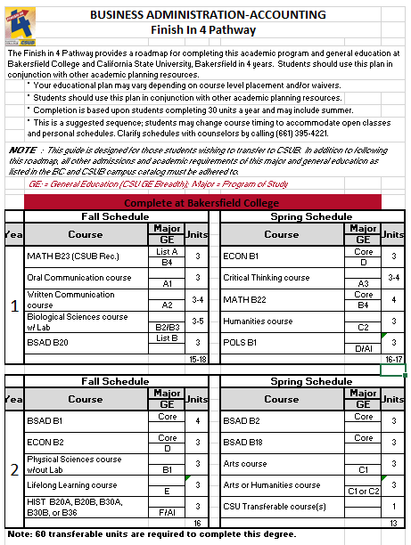
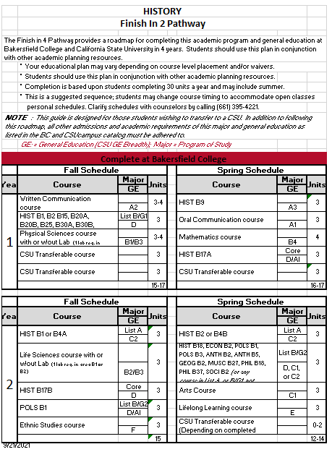
Communication/Engagement/Campus Partners
Finish-In-4
Transfer-In-2
BC-CSUB Program Maps Team
BC-CSUB Semester Convenings
BC-UC Merced Program Maps
BC-UC Merced Convenings
BC-University Articulation Agreements
Kern High School District Counselor Training
Kern College Night

Slide 5
Angelica Caudillo
Program Manager, Counseling
Angelica.caudillo@bakersfieldcollege.edu

