Slide 1
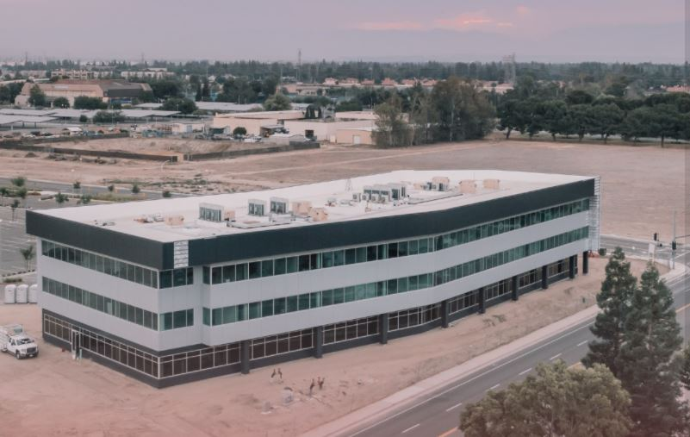
Bakersfield College SouthWest Center Update
Mike Giacomini
Jessica Wojtysiak
College Council
Notes:
Transfer oriented, co-located with CSUB, center application ongoing

Slide 2
Center Status: Title V & CA Education Code
Educational Center: a postsecondary operation established and administered by an existing college or district at a location away from the campus of the parent.
(1) the center:
(A) is planned to continue for ten or more years;
(B) generates at least 500 full-time equivalent student (FTES) annually.
(C) has an on-site administrator;
(D) offers programs leading to certificates and/or degrees conferred by the parent institution; and
(E) has been approved by the Board of Governors pursuant to this article.
Or grandfathered in

Slide 3
Why establish a Center?
Meet specific population needs
Selected Instruction programs not yet available in the area
Support services
Overcome location-based obstacles
Additional College Funding
Base Allocation of SCFF
$1.35 million per center (2 current centers)

Slide 4
Status Update
Board of Trustees Approved Application Process
Working with consultants Cambridge West to complete the application process

