Slide 1
Agriculture, Nutrition, and Culinary Arts (ANCa) Pathway
JEFF LA FORCE, TORI FURMAN, LAURA MILLER & JESSICA WOJTYSIAK
COLLEGE COUNCIL

Slide 3
ANCA Pathway Background
CERTIFICATES
Agriculture Business Management (COA)
Animal Science (COA)
Culinary Arts (COA)
Diesel Engine Systems (CC NC)
Dietetic Services Supervisor Program (COA)
Edible Education Garden (CC NC)
Environmental Horticulture (COA)
Environmental Resource Management (COA
Equipment Technician Level 1 (CC NC)
Food Science & Technology (COA)
Forest Resource Management (COA)
Forestry (COA)
Heavy Equipment Technician (COA)
Kitchen Techniques for New Culinarians (CC)
Mobile Equipment Electrical Systems (CC NC)
Mobile Equipment Hydraulic Systems (CC NC)
Natural Resource Management (COA)
Pest Control Advisor Preparation (COA)
Plant Science (COA)
Registered Veterinary Technician (JSC)
School Food Service (CC NC)

Slide 4
ANCA Pathway Background
DEGREES
Agriculture - Animal Science (AST)
Agriculture - Business (AST)
Agriculture - Plant Science (AST)
Animal Science (AS)
Culinary Arts (AS)
Environmental Horticulture (AS)
Environmental Resource Management (AS)
Food Science and Technology (AS)
Food Service Management (AS)
Forest Resource Management (AS)
Forestry (AA & AS)
Hospitality Management (AS)
Mechanized Agriculture (AS)
Natural Resource Management (AS)
Plant Science (AS)
Nutrition (AST)

Slide 5
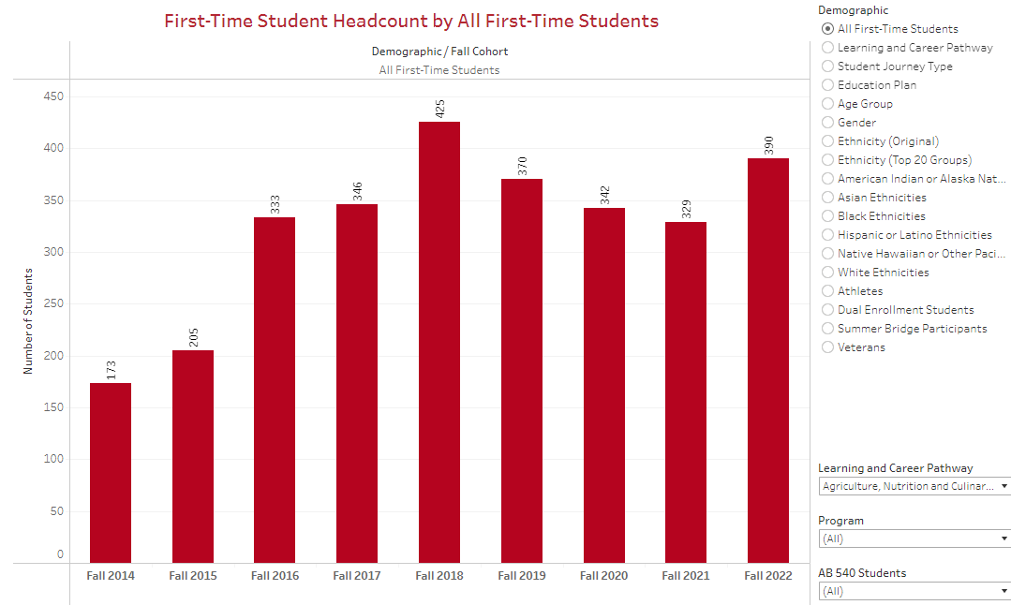

Slide 6
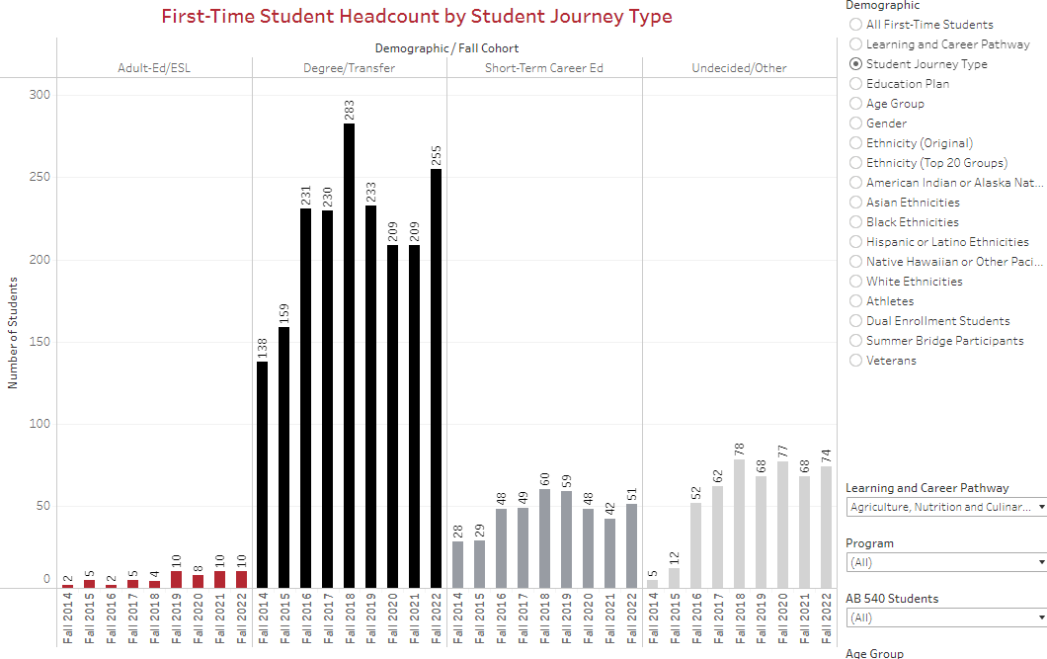

Slide 7
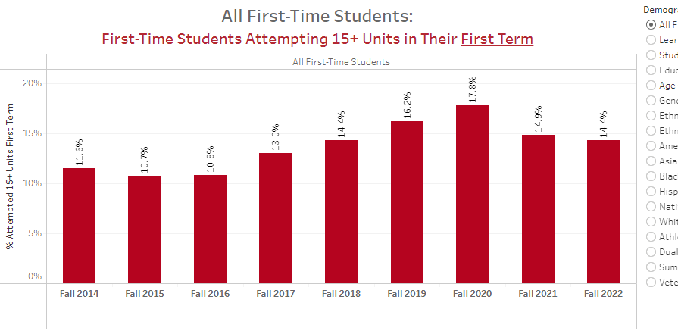

Slide 8
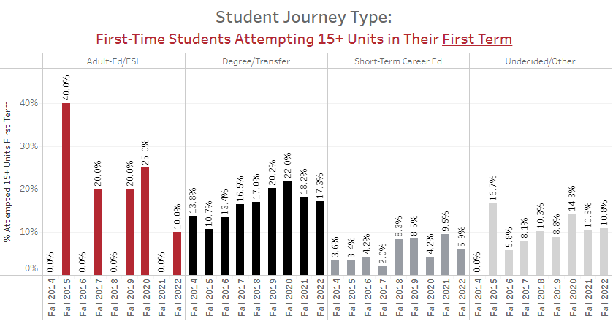

Slide 9
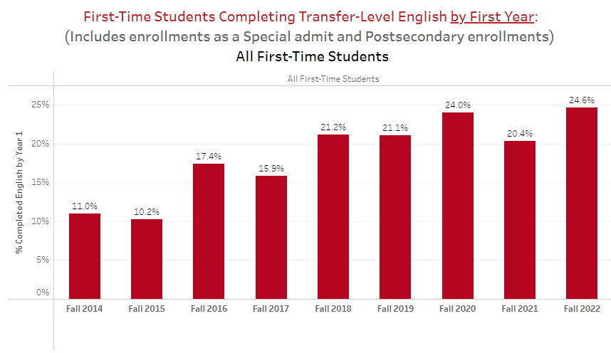
ISS Transfer English Achievement in Year 1: 17%
ANC Pathway Degree/Transfer Seekers: 24.6%

Slide 10
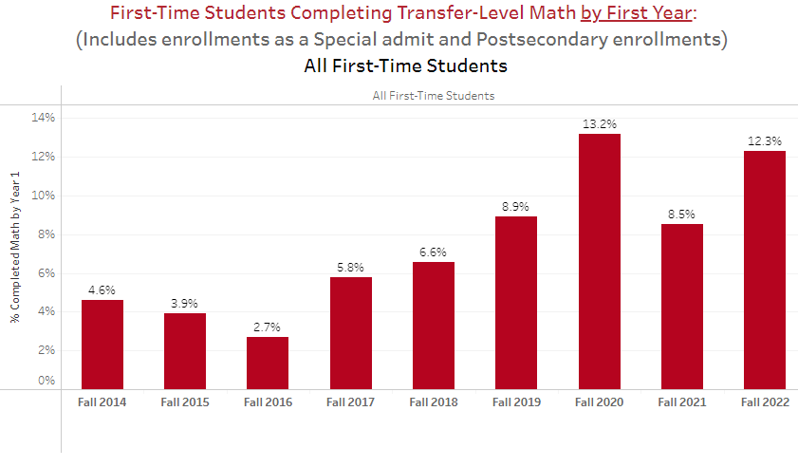
ISS Transfer Math Achievement in Year 1: 12%
EDUC Pathway Degree/Transfer Seekers: 12.3%

Slide 11
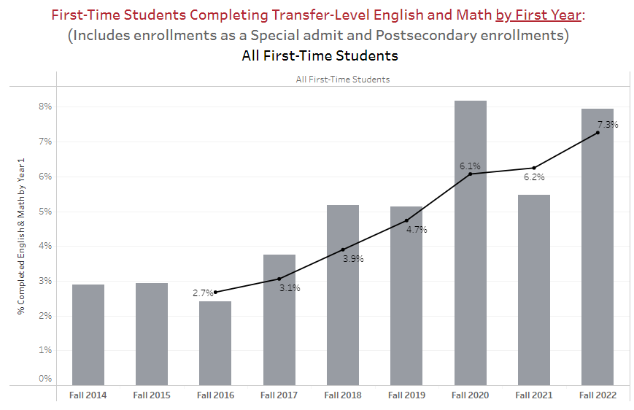

Slide 12
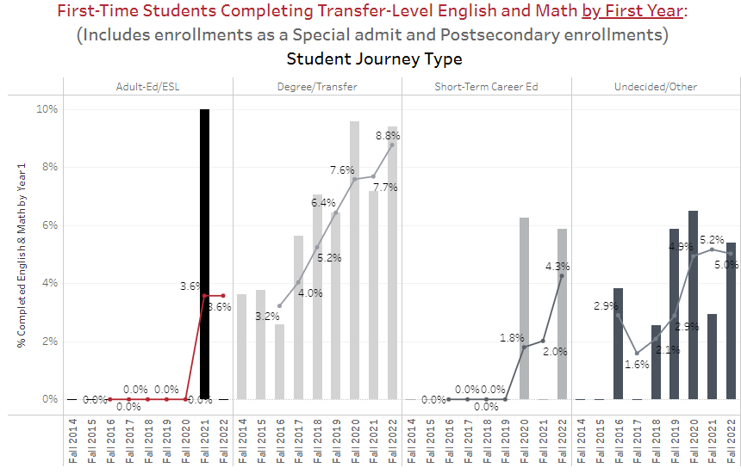
ISS Transfer English & Math Achievement in Year 1: 7%
ANC Pathway Degree/Transfer Seekers: 8.8%

Slide 13
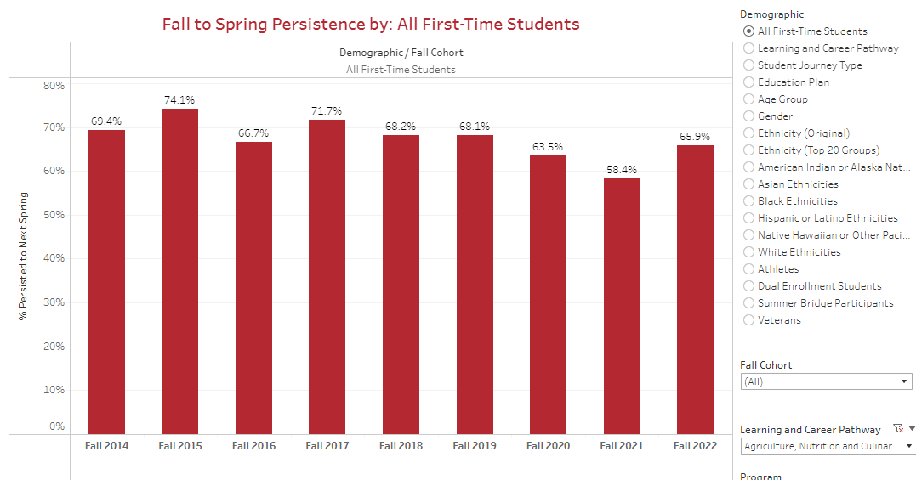

Slide 14
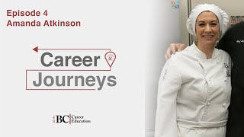
Culinary Careers in the Community
Success Story : Meet Amanda a former BC Culinary student

Slide 15
Growing the Culinary Pathway
Expansion of new space
Proposed Demonstration classroom in FACE room 23
Possible Cafe style dining opportunity along Mt. Vernon

Slide 16
Nutrition AST and DSS Certificate
The Nutrition AST offers students the ability to stay in Kern County while completing their first 2 year requirement towards a Bachelors in Nutrition.
Traditionally, Kern County has had a shortage of registered dietitians in the community. Providing this local degree option may help.
The Dietary Services Supervisor (DSS) Certificate is a State of California Department of Health Services (DHS) certificate program that once completed, student can seek employment in healthcare foodservice operations.

Slide 17
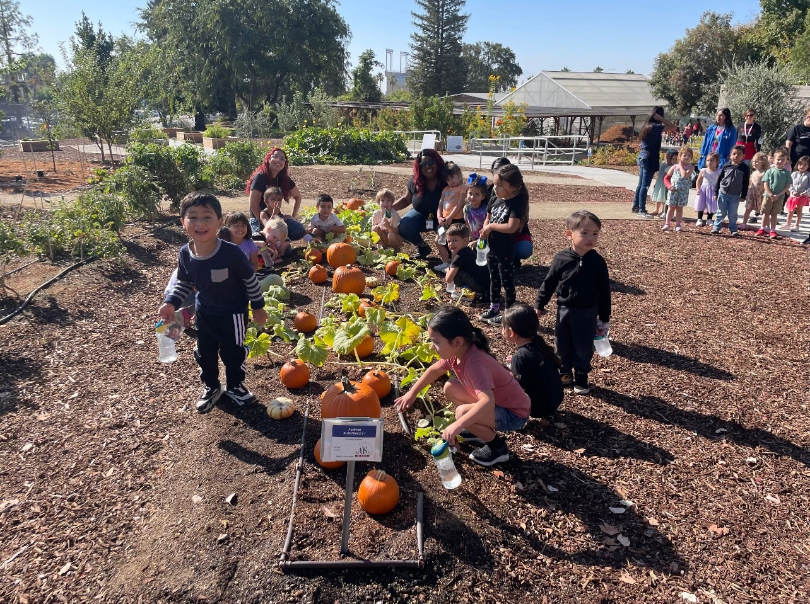
Agriculture
Agriculture supports our community by offering an array of
degree and certificate options.
Regenerative Farm Ribbon Cutting 11/14 (Delano)
Used to teach students about paper plot planting systems,
commercial and home hydroponics, and traditional seasonal crops.
New Ag Building on BC Campus (groundbreaking 11/30)
Edible Garden / CDC students field trip
BC Rodeo Team hosted the 1st Rodeo 11/11
BC Ag Expo 10/20, over 270+ High School/Middle School students attended
Hosted multiple volunteer clean-up days in the garden with BC Ag Club

Slide 18
BC is Focused on the Health of Our Community
The ANCa pathway offers solutions to Kern County’s food security rates
Non credit courses in all 3 disciplines help educate the community
Ornamental Horticulture
Nutrition Basics (coming soon)
Healthy Eating from the Garden (coming soon)

Slide 19
Staying Connected
Classroom Visits
How to navigate Starfish
Program Mapper
Staying on the path to completion
Math
English
Complete 15 units
Complete Financial Aid Application & Scholarships
Update Form Completion
Confirm Correct Major
Introduction of Job Development Specialist
Resume
Interview Skills
Searching / Applying for Jobs
Ocelot Pathway Messaging
Student Appointments Each Semester (Twice)

Slide 20
Major Verification Pilot Program
In order to accurately capture specific groups of students for various reasons, students must have a correct major in the system. Reports of student majors is retrieved from Banner; if Banner is inaccurate then the reports are inaccurate.
Ocelot messaging
Without accurate majors, vital messages are not reaching all of our targeted students.
Tableau
Without accurate majors, the data being reviewed is not as accurate as it could be.
Counseling/Advising
Without accurate majors, students are not getting counseling/advisement from their specific pathway representatives, which can lead to misinformation or missing information specific to their path. (i.e. CHEM B1A for Nutrition majors)

Slide 21
Any Questions?

