Slide 1
College Council
Vernon Valenzuela Veterans Resource Center Update
October 18, 2019

Slide 2
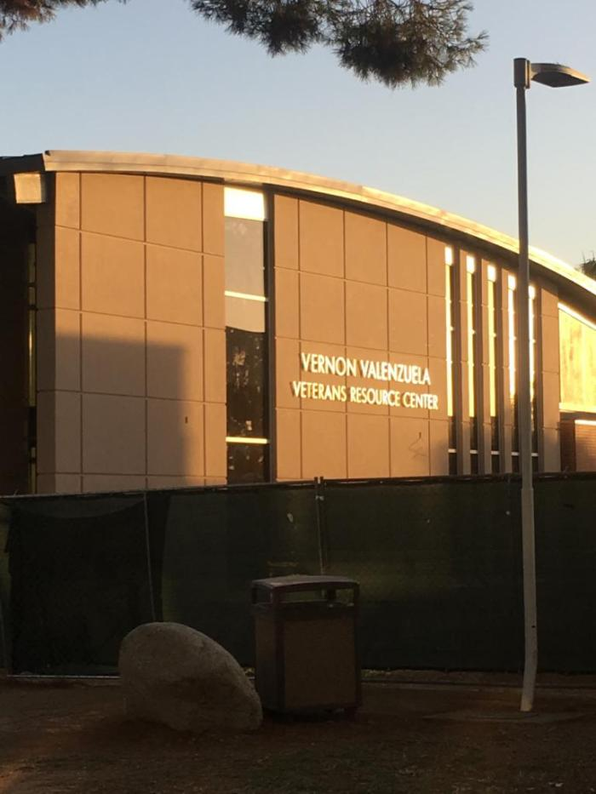
Bakersfield College Vernon Valenzuela Veteran’s Resource Center
Improving study area, computer labs, counseling, lounge and other services for student veterans
Program Value: $7 Million
Square Footage: 4,715
Contractor: JTS Construction
Architect: IBI Architect
Construction Schedule:
November 2018 – December 2019
Notes:
October 2019:
Construction Phase is 90% complete.
Coordination of the final moving schedule has been initiated and furniture has been ordered.
The estimated construction completion date is 11/27/19.
Ribbon cutting on December 10

Slide 3
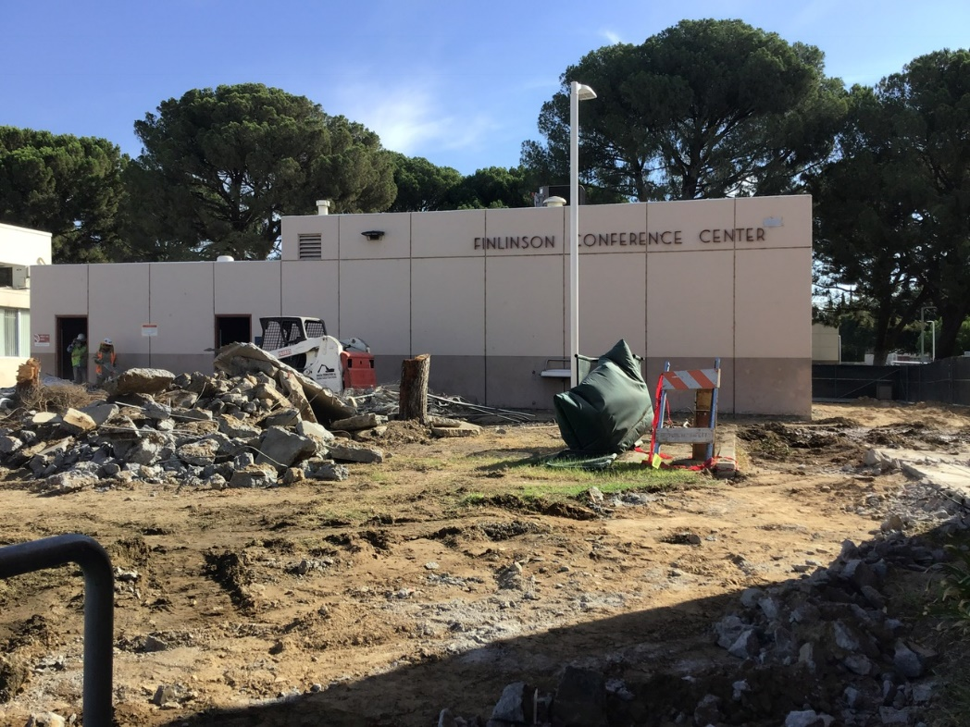
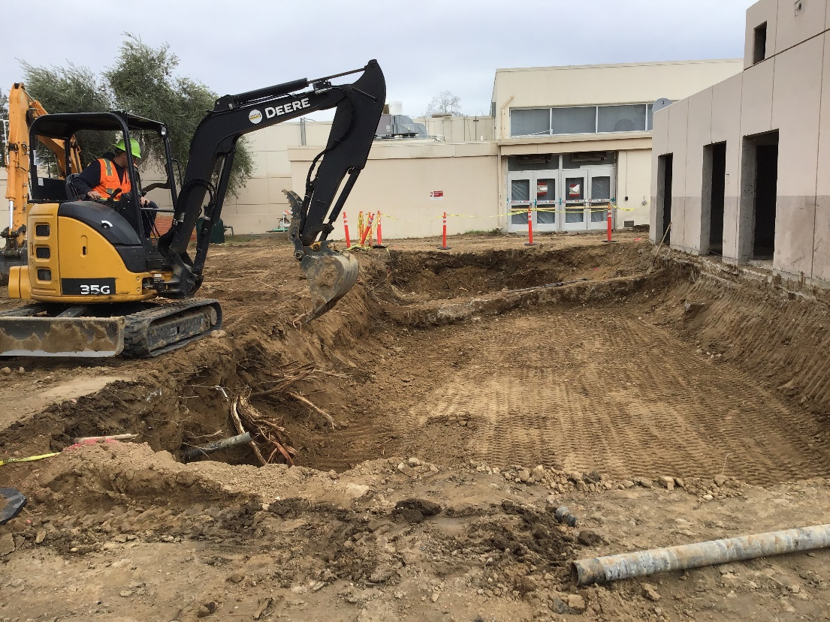
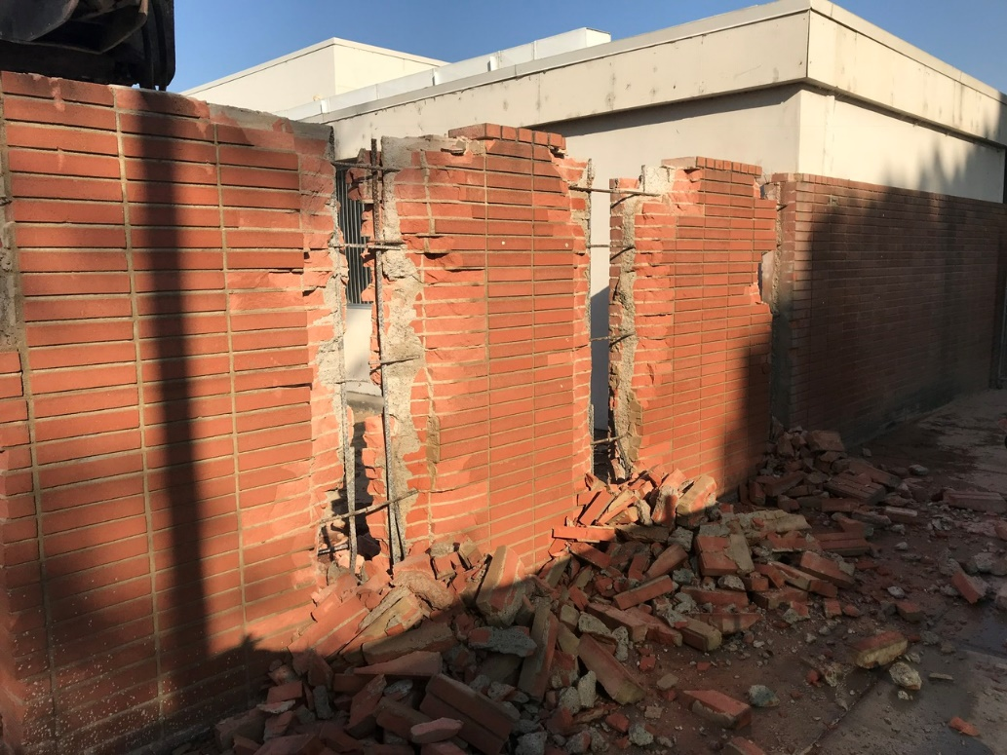
Formerly Finlinson Center
Notes:
October 2019:
Construction Phase is 89% complete.
Coordination of the final moving schedule has been initiated and furniture has been ordered.
The estimated construction completion date is 11/27/19.
Ribbon cutting on December 10

Slide 4
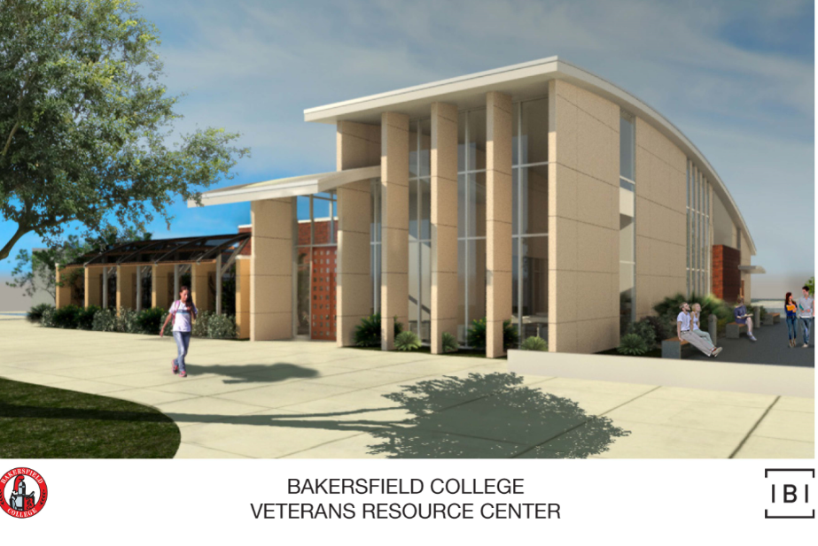
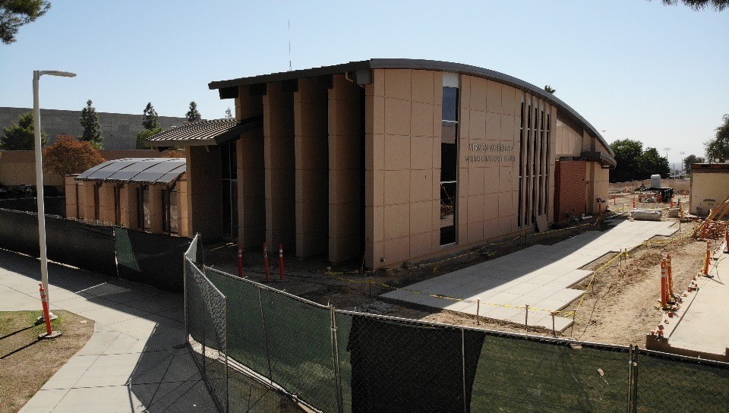
Rendering vs. Reality
Notes:
October 2019:
Construction Phase is 89% complete.
Coordination of the final moving schedule has been initiated and furniture has been ordered.
The estimated construction completion date is 11/27/19.
Ribbon cutting on December 10

Slide 5
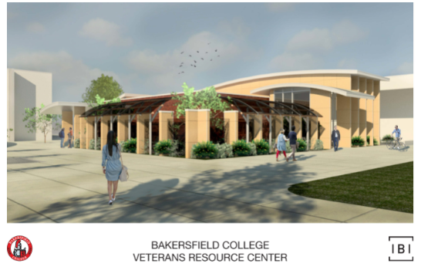
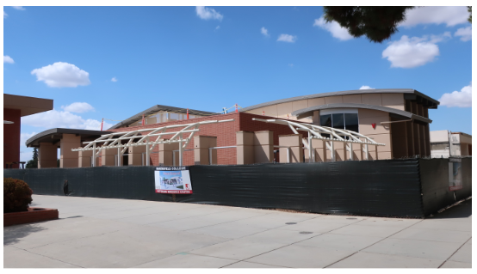
Rendering vs. Reality
Notes:
October 2019:
Construction Phase is 89% complete.
Coordination of the final moving schedule has been initiated and furniture has been ordered.
The estimated construction completion date is 11/27/19.
Ribbon cutting on December 10

Slide 6
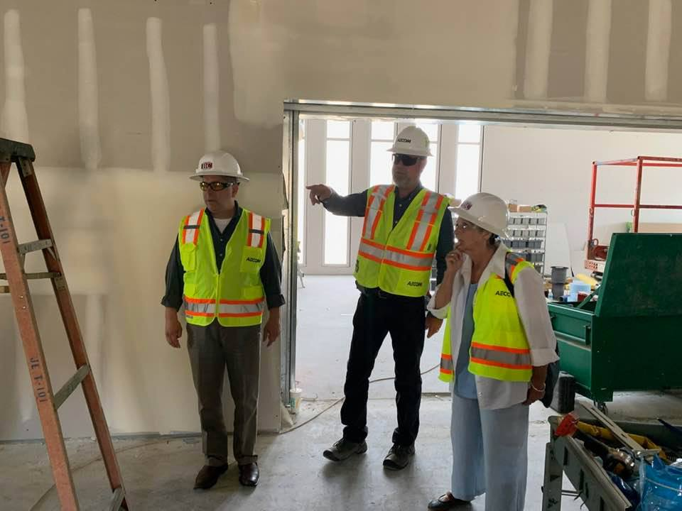
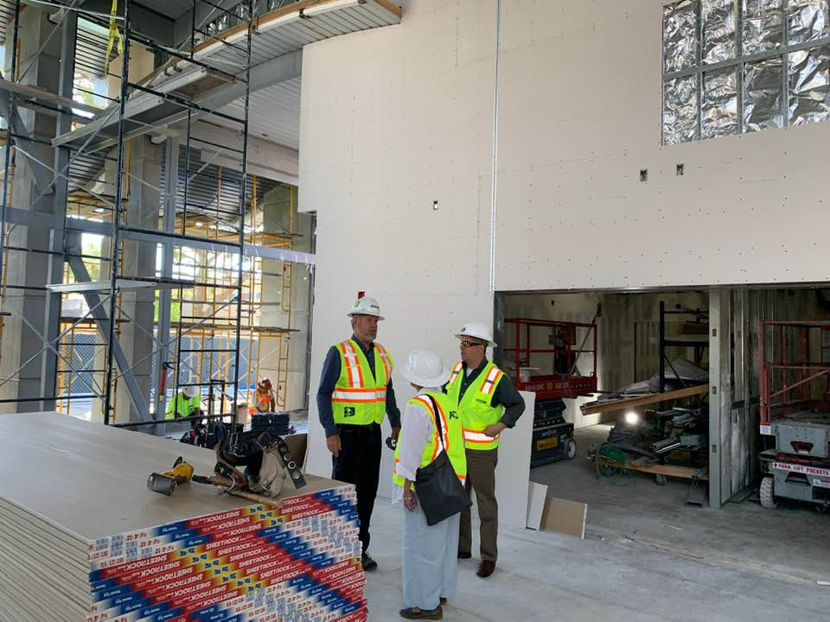
Touring the Facility
Notes:
October 2019:
Construction Phase is 89% complete.
Coordination of the final moving schedule has been initiated and furniture has been ordered.
The estimated construction completion date is 11/27/19.
Ribbon cutting on December 10

Slide 7
Video Tour: VRC & Campus Center
Notes:
https://www.youtube.com/watch?v=99vl5umUaY0

Slide 8
Touring the Facility
Notes:
October 2019:
Construction Phase is 89% complete.
Coordination of the final moving schedule has been initiated and furniture has been ordered.
The estimated construction completion date is 11/27/19.
Ribbon cutting on December 10

Slide 9
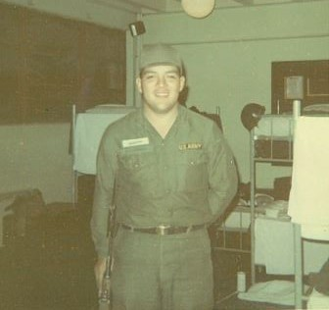
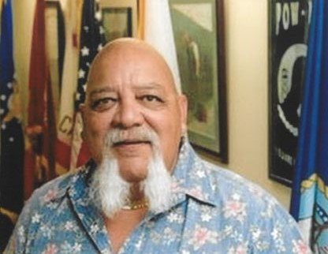
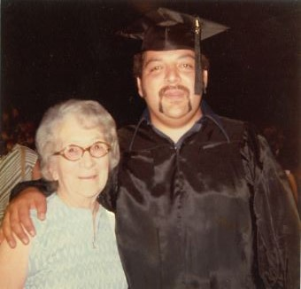
Who is Vernon Valenzuela?

Slide 10
Who Are Our Student Veterans?
400 Total Student Veterans
24 First Generation Veterans
Data as of Fall 2018

Slide 11
Student Veteran Ethnicities
Data as of Fall 2018

Slide 12
Degrees Awarded
Data as of Fall 2018

Slide 13
Types of Degrees Awarded
Data as of Fall 2018

Slide 14
Follow BC Social Media Channels
@BAKCollege
@ABetterBC2016
@YesOnJ
@SonyaChristian
@bakersfieldcollege
@BakersfieldCollege
@ABetterBC
www.youtube.com/channel/UCcnx7SF6RqUXmzE4bYsyYrQ
#ABetterBC

