Slide 1
Learning and Career Pathways
PERSONAL AND CAREER EXPLORATION PATHWAY
The Personal and Career Exploration (PCE) Pathway is designed to provide additional assistance to all students who have not yet declared a major.

Slide 2
Students can explore the various pathways at Bakersfield College as it relates to a program of study, based on personal career counseling and informed decision making.
In collaboration with Pathways, Affinity Groups, campus/sites, Early College, and Probation/Dismissal.
Empower students how program of study relates to career decision making.
Increased accessibility to counseling resources.

Slide 3
Learning and Career Pathways
In the explorative phase: 1551 students
May still be unsure about what they are are good at and what fields they might enjoy working in.
May know what interests them, but be unsure about the careers that align with those interested or what education is needed to successfully get a job in that industry.
May know exactly where they’re headed and what major they want, but have not gone through the process to formally declare the right major here at BC.

Slide 4
Learning and Career Pathways
In the explorative phase

Slide 5
Learning and Career Pathways
Student Centered: High-Tech, High-Touch
Steps for Success…
Step 1: Learn about self!
Strong Interest Inventory
Helps identify their work personality
Exploring their interests in six broad areas: realistic, artistic, investigative, social, enterprising, and conventional
On the horizon…
Career Assessment, Pathways Planning Tool: Learn – Plan- Succeed!

Slide 6
Learning and Career Pathways
Student Centered: High-Tech, High-Touch
Steps for Success…
Step 2: Explore Careers That Fit!
Set aside time to research careers that interest you and the education needed to be hired in the industry. Answer these questions:
Does the career require an Associate's Degree or a Bachelor's Degree?
Does it require on-the-job experience, such as an internship, in addition to a degree?
How much does the career pay?
What are the benefits and drawbacks?

Slide 7
Learning and Career Pathways
Student Centered: High-Tech, High-Touch
Steps for Success…
Step 3: Declare a Major!
The biggest step they can make towards their future.
Create a Comprehensive Academic Plan.
Map the correct classes for the pathway to completion/graduation.
Connect Faculty and Staff from the new Learning & Career Pathway.
Support is tailored for their area of study.

Slide 8
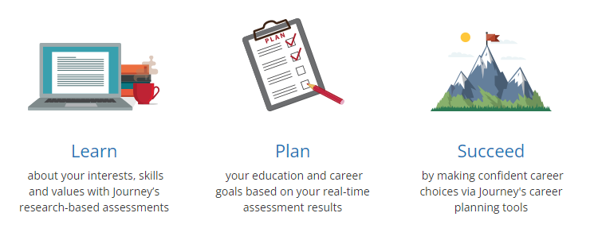
Learning and Career Pathways
Student Centered: High-Tech, High-Touch
MEET WITH A COUNSELOR: Aneesha Awrey
Take the right classes to meet education and career goals at BC.
Create a Comprehensive Student Education Plan (CSEP) with the Counselor.

Slide 9
Learning and Career Pathways

