Slide 1
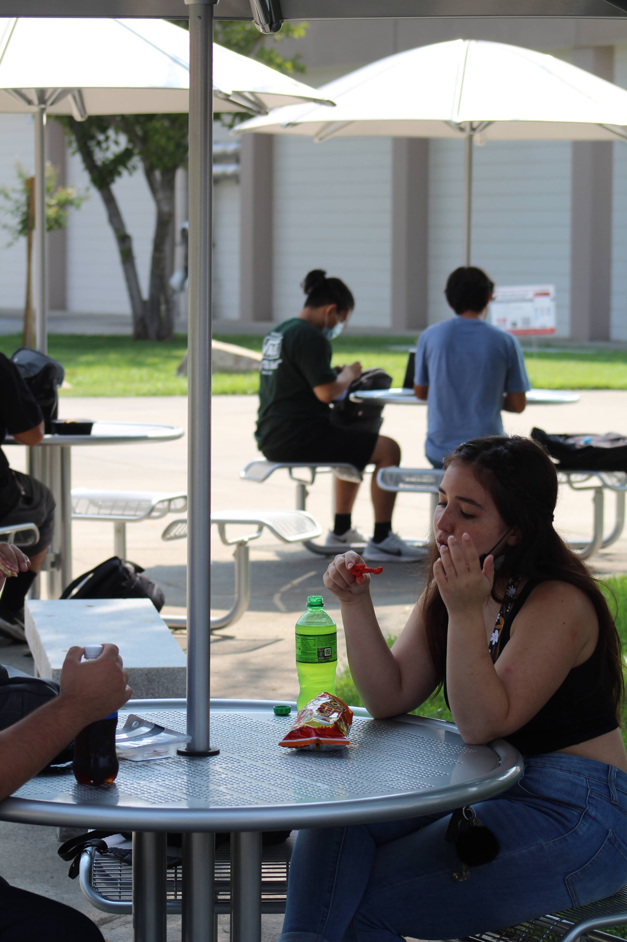
Student Housing Project
October 18, 2021
Mike Giacomini

Slide 2
Higher Education Student Housing Grant Program
On September 23, 2021, the Governor signed Senate Bill 169, which established the Higher Education Student Housing Grant Program to increase the current stock of affordable student housing across the three public higher education segments in California, for purposes of supporting low-income students and addressing the most significant non-tuition aspect of students’ total cost of attendance.
This program provides one-time grants to applicants for the construction of student housing or for the acquisition and renovation of commercial properties into student housing. This program is intended to provide a total of $2 billion General Fund over a three-year period, with $500 million available in fiscal year 2021-22. Of the total amount provided over the three-year period, 50 percent is available for the California Community Colleges; 30 percent is available for the CSUs; and 20 percent is available for UCs.
In addition, California community colleges may submit requests for planning grants for campuses that are exploring or determining if it is feasible to offer affordable student housing. Up to $25 million of total program funding is available for this purpose.

Slide 3
BC Student Housing Project Schedule Analysis
Accelerated Project Schedule (Aggressive Approach)
This approach commences conceptual design immediately and preliminary plans/working drawings on November 18, 2021 with BOT approval of a design agreement. This approach DOES NOT wait for award of grant by the Department of Finance. This approach DOES produce a construction award to BOT for approval in Dec 2022 within DOF Dec 31, 2022 target date.
Advantages to Aggressive Approach
First Mover Advantage - State is funding 100% of project cost to projects that are “shovel ready” and can begin construction by December 31, 2022.
Less Competition for Construction funds in Funding Round I.
Avoid DOF’s certain SH Program changes and constraints in Rounds II and III.
Tangible Results. Will produce affordable student housing to 150 BC students by January 2025. Three (3) years. Most SH projects take 4-5 years from beginning to end.
Disadvantages to the Aggressive Approach
District absorbs fiscal risk by commencing architectural design ahead of DOF grant award assuming no reimbursement will be allowed.

Slide 4
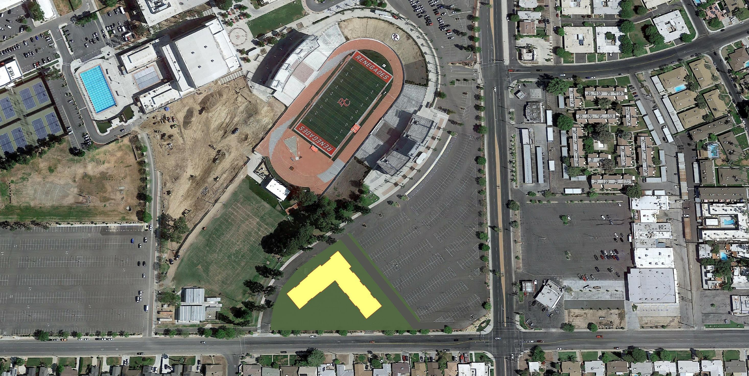
CONCEPT SITE PLAN – 4 STORY FOOTPRINT (150 BEDS)

Slide 5
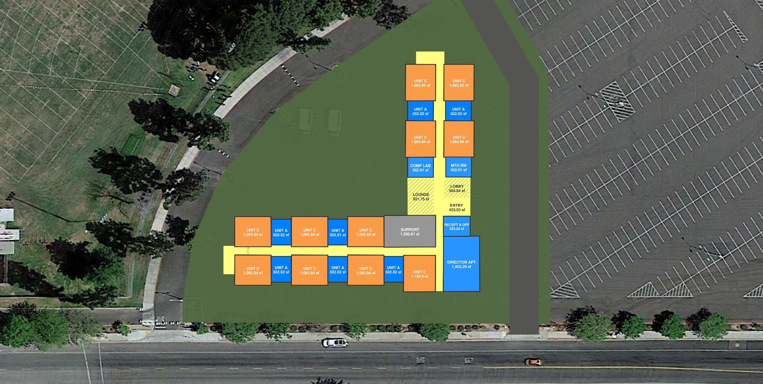
CONCEPT PLAN – FLOOR 1
TARGET QUANTITIES
UNIT A (24%) = 36 BEDS OR 36 UNITS
UNIT C (60%) = 90 BEDS OR 45 UNITS UNIT E (16%) = 24 BEDS OR 6 UNITS TARGET TOTAL = 150 BEDS
PROPOSED QUANTITIES
UNIT A = 34 BEDS OR 34 UNITS UNIT C = 94 BEDS OR 47 UNITS UNIT E = 24 BEDS OR 6 UNITS PROPOSED TOTAL = 152 BEDS
APPROXIMATE TOTAL SF = 104,000 SF
BEDS PER FLOOR
1st Floor = 29 Beds 2nd Floor = 41 Beds 3rd Floor = 41 Beds 4th Floor = 41 Beds

Slide 6
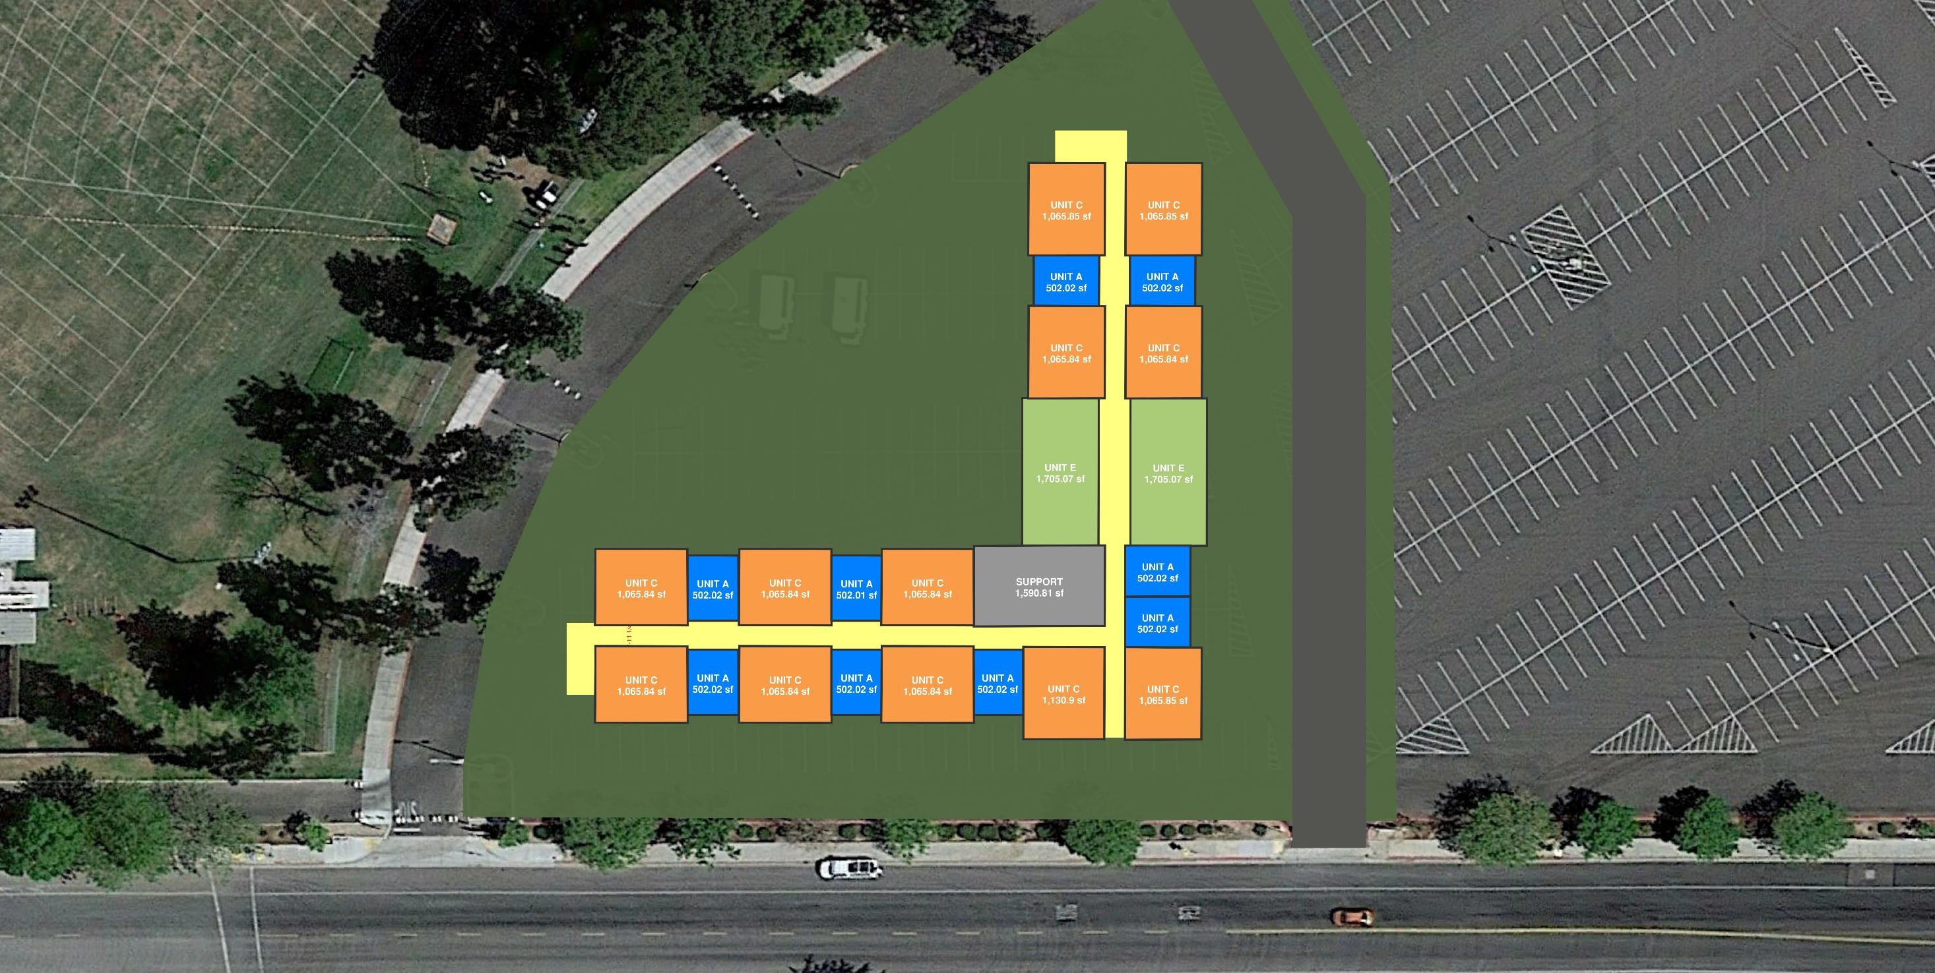
CONCEPT PLAN - FLOORS 2-4
TARGET QUANTITIES
UNIT A (24%) = 36 BEDS OR 36 UNITS
UNIT C (60%) = 90 BEDS OR 45 UNITS UNIT E (16%) = 24 BEDS OR 6 UNITS TARGET TOTAL = 150 BEDS
PROPOSED QUANTITIES
UNIT A = 34 BEDS OR 34 UNITS UNIT C = 94 BEDS OR 47 UNITS UNIT E = 24 BEDS OR 6 UNITS PROPOSED TOTAL = 152 BEDS
APPROXIMATE TOTAL SF = 104,000 SF
BEDS PER FLOOR
1st Floor = 29 Beds 2nd Floor = 41 Beds 3rd Floor = 41 Beds 4th Floor = 41 Beds

Slide 7
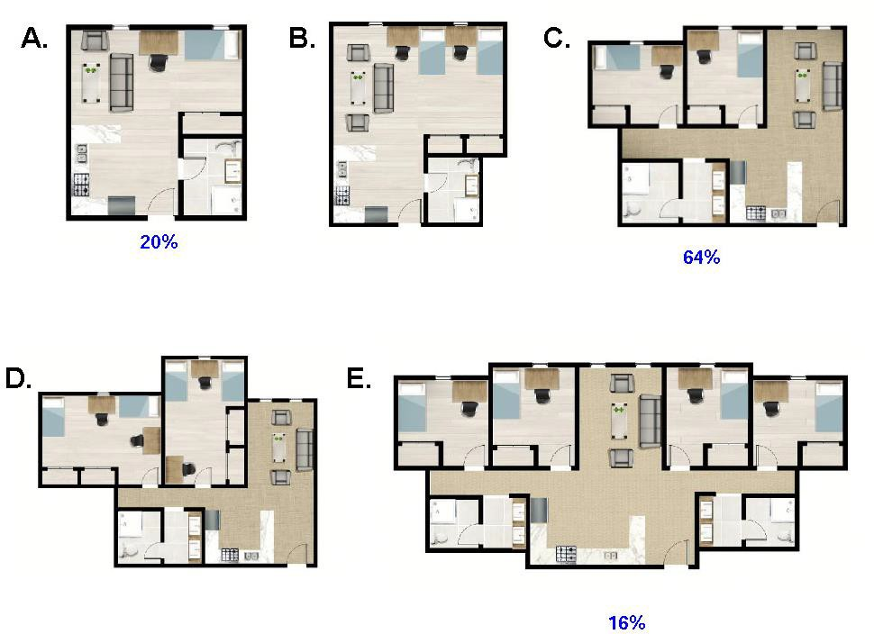
UNIT PLANS
BAKERSFIELD COLLEGE RESIDENCE HALL OCTOBER 11, 2021

