Slide 1
BC at CSUB Planning Group: Update and Next Steps
College Council
Sept. 20, 2019
Jessica W. & Jason S.

Slide 2
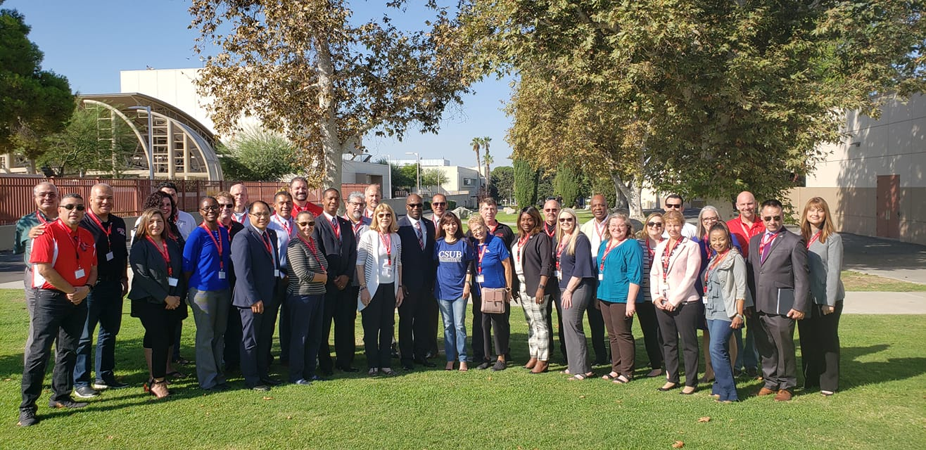
September 13, 2019

Slide 3
Library Services
BC Lead: Kirk Russell
Objectives for 2019-20:
Clarifying Shared services: Use of physical print resources, use of general study space, use of reference service
Identifying Needs: BCSW study space, BCSW open lab, library research support

Slide 4
IT/Technology Support
BC Lead: Todd Coston
Objectives for 2019-20:
Autonomous and coordinated IT support;
Exploring Eduroam
Provision of support to other work groups, including library

Slide 5
Enrollment & Admissions
BC Leads: Michelle Pena & Marisa Marquez
Objectives for 2019-20:
To streamline the transfer admissions process, BC & CSUB enrollment services will work together to:
Create shared prospective student database (EMP Software) – BC will provide names, CSUB will monitor/contact as necessary
Create supplemental application at BC with release of info permission to provide student info to CSUB
Share access to transcripts for transfers and reverse transfers
Establish MOU of data sharing
Quicken ADT verification turnaround rates, allow more time to make contact/resolve degree issues
Offer more CSU application workshops/more comprehensive transfer services.

Slide 6
Student Services & Activities
BC Lead: Zav Dadabhoy
Objectives for 2019-20:
Identify the areas where there are opportunities for student engagement on the CSUB campus in order to give BC students a sense of belonging at CSUB through shared experiences and access to CSUB events and activities
Identify a matrix of services that exist on each campus: where is there overlap or gaps in service? Identify which will be shared or remain individually delivered
Explore needs related to expenses:
Consider an optional fee structure for BCSW students to participate in services
Consider a charge-back fee structure for emergency services (i.e. emergency health services or first responder issues

Slide 7
Parking & Security
BC Lead: Mike Giacomini
Objectives for 2019-20:
Clarify issues to develop MOU to coordinate security needs and assignments, including emergency response protocol
Support CSUB shuttle with service to the BCSW campus
Plan for BCSW parking needs, including permit requirements and faculty allocation

Slide 8
Honors Program
BC Lead: Jason Stratton
Objectives for 2019-20:
Establish procedures for BC students to enter into CSUB Honor Program
Design Pilot of Cohort Program
Explore curricular and other support options, including
interdisciplinary faculty coordination,
learning communities,
research of Presidential Scholars Program and other BC honors program-like designations

Slide 9
Workload and Union Issues
BC Leads: Emmanuel Mourtzanos & Jessica Wojtysiak
Objectives for 2019-2020:
Review faculty contracts at both institutions to identify potential issues
Make recommendations for remediation to the BC-CSUB collaborative groups to preemptively address potential concerns, as well as clarify misperceived concerns
Ongoing Goal: Meeting with unions in response to faculty concerns that arise throughout the course of the BC Southwest transition, and propose a recommendation to the BC-CSUB Planning Group.

Slide 10
General Education
CSUB Lead: Kim Flachmann
BC Lead: ?

Slide 11
Would you like to get involved?
Contact the identified BC lead to join a team
Contact Jason or Jessica for more information

