Slide 1

Facilities Update
Administrative Council Meeting
September 10, 2018

Slide 2
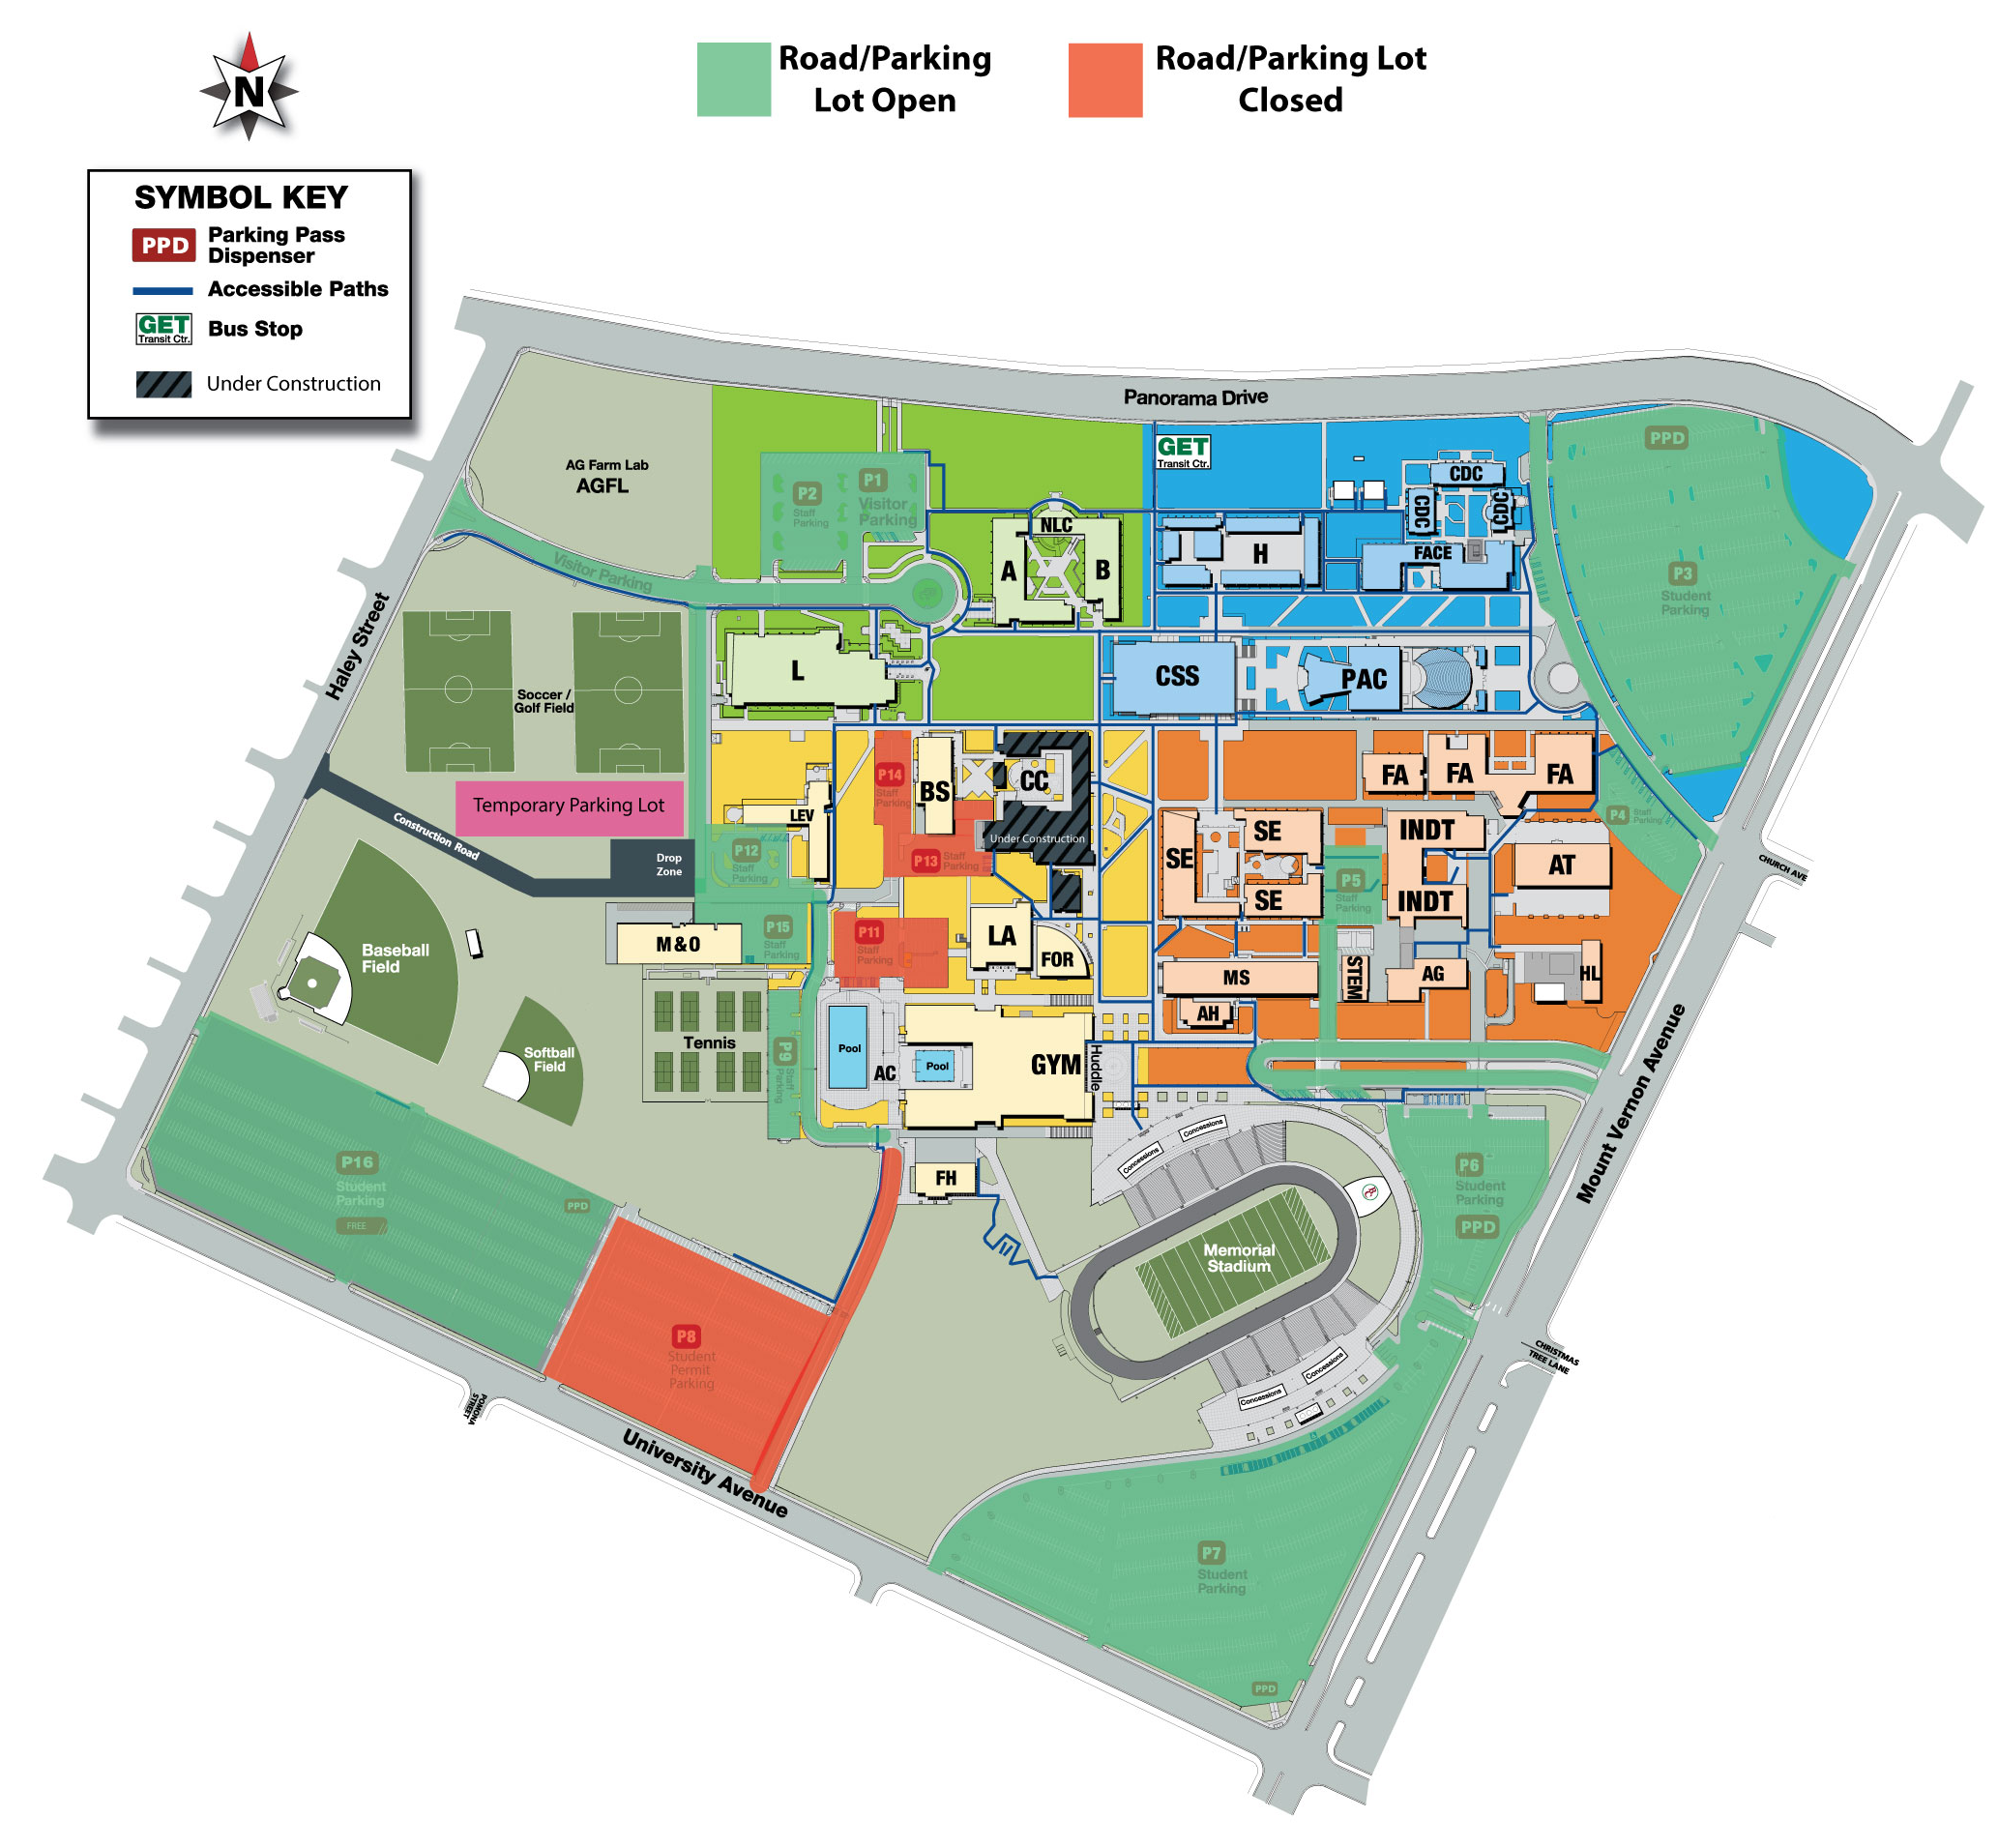
Measure J Projects
Parking
Final phase
P8, P11 closed
P9 closes 10/5
All lots reopen October 15
Overflow parking on grass field

Slide 3
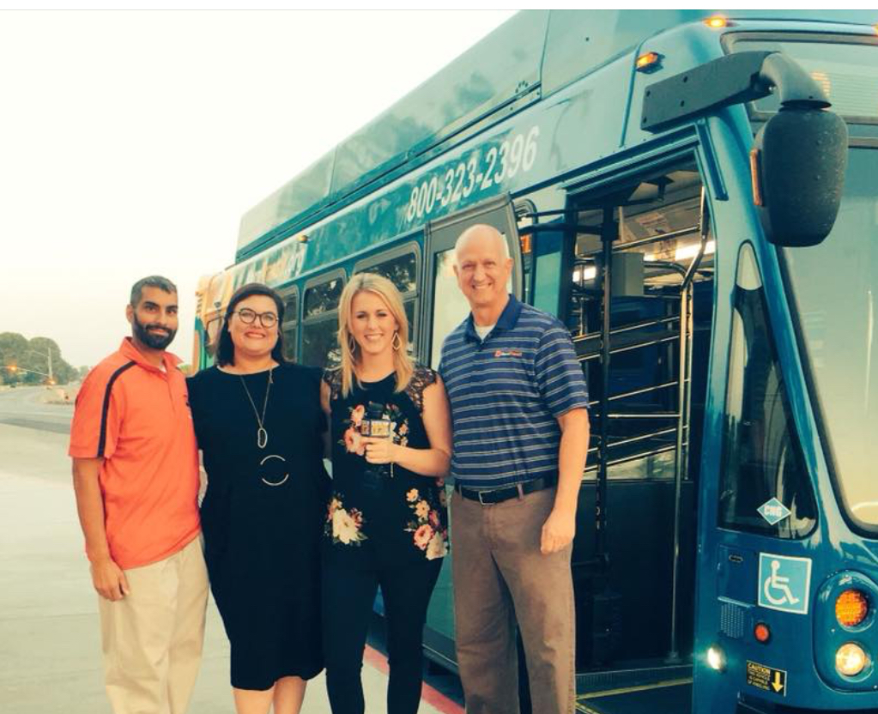
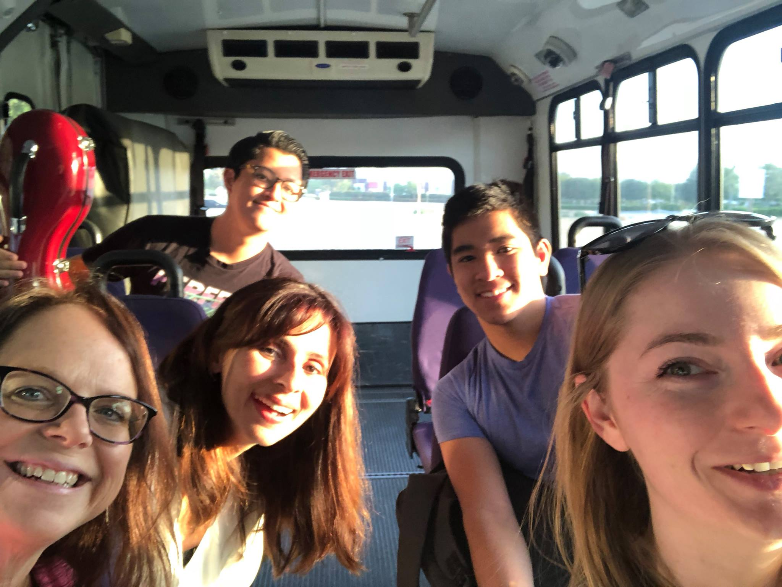
Take the Park Smart Pledge!
Take the Renegade Express Shuttle from SouthWest
Carpool
Ride your bike
Public Transportation
Get dropped off
Notes:
Help to model this behavior
Sonya giving up parking space

Slide 4
Current Measure J Projects
Modifications to LEV for swing space
Huddle and Mount Vernon Commissary (MVC)
  Kitchen moving in December
Demolition of Campus Center begins in December
VRC demolition has begun
  Groundbreaking on November 5
Wireless infrastructure project
  Evening work and will improve interior Wi-Fi on campus
Notes:
Office space is very limited so everyone is sharing. President Christian is will be offering up space in her office. We ask that everyone be understanding. Sharing is caring! ☺

Slide 5
Upcoming Measure J Projects
Science & Engineering Building
  RFQ process right now
    Selecting a Design-Build team now
Gym
  Advertising for a Design-Build team
    Will select that team within the month
Stadium
  December 15, 2018 through August 31, 2019

