Slide 1
Academic Support Services
Presentation to FCDC
March 10, 2017

Slide 2

Support services
Tutoring Center
Supplemental Instruction (SI)
Extend the Classroom Tutors
Writing Center
ACDV B72 Extended the Classroom
Student Success Lab
Math Lab
AERA STEM Success Center

Slide 3
Tutoring Center
Supplemental Instruction (SI)
Extend the Classroom Tutors
Writing Center
ACDV B72 Extend the Classroom
Student Success Lab
Math Lab

Slide 4
Extend the classroom: Breaking down the silos (ENGL B53)

Slide 5
Extend the classroom: Breaking down silos (Math B60)

Slide 7
Completion Coaching Teams

Slide 8
Student Success Model
Student Success
Weekly scheduled developed at entry point
Academic Support Services
Weekly reports to faculty
Lead measures: timely interventions

Slide 9
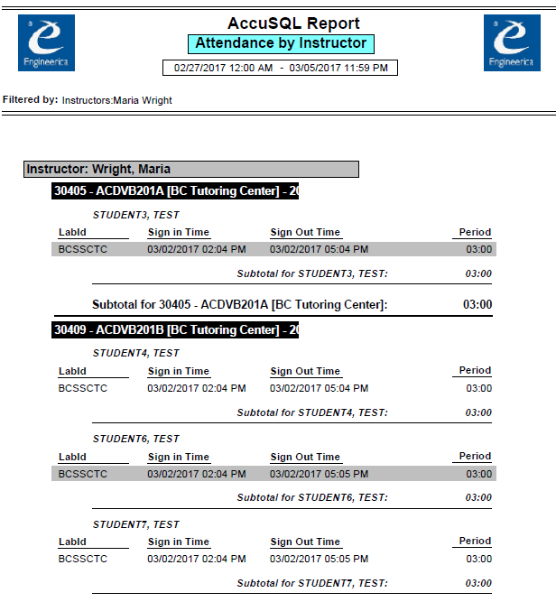
Sample Instructor Reports

Slide 10
Closing the loop for students
Intentional planning for support
Statement of expectation in syllabi
Development of continuing partnership between faculty and support services
Timely interventions for students
Support students from intake to completion

Slide 11
Thank you!
Questions?
Feedback?
Maria Wright
Director, Academic Support Services
maria.wright2@bakersfieldcollege.edu
(661)395-4607

