Slide 1
ISER Update
Academic senate: OCTOBER 25, 2023

Slide 2
What’s the ISER?
Institutional Self-Evaluation Report
An internal evaluation report where an ACCJC member institution engages in comparing itself to Accreditation Standards and develops its own plans for improvement where needed.
Its purpose is to demonstrate how we exemplify academic quality and continue to improve.

Slide 3
BC ISER Timeline
Fall 23
Fall 2023
Form Standard Teams
Spring 24
Spring 2024
Revise/Edit Drafts
Fall 24
Fall 2024
BoT: 1st Read October
AS/CC: 2nd read Sept
AS/CC: 1st read May
Submit by 12/24
Open Forum
Team Trainings and Committee Meetings
Drop-in hours
Committee Updates
ACCJC VP Kevin Bontenbal’s visit- Feb 2nd.
Committee Visits
Produce Drafts

Slide 4
How is the Accreditation Review Conducted?
Internal Evaluation
External Evaluation by Peers
Commission Evaluation
Institutional Self-Improvement
ISER
8 Years Cycle

Slide 5
Accreditation Review Timeline
College
Self-Reflection
ISER
ACCJC Accrediation Team
ISER Review
Standards Validation
Core Inquires
Off-Campus Site
Focused Site Visit
Core Inquires
On-Campus Site
Team Report
Commission Action
(Affirmation)
College
Prep
ISER
Due
12/15/24
Spring
2025
Fall
2025
January
2026

Slide 6
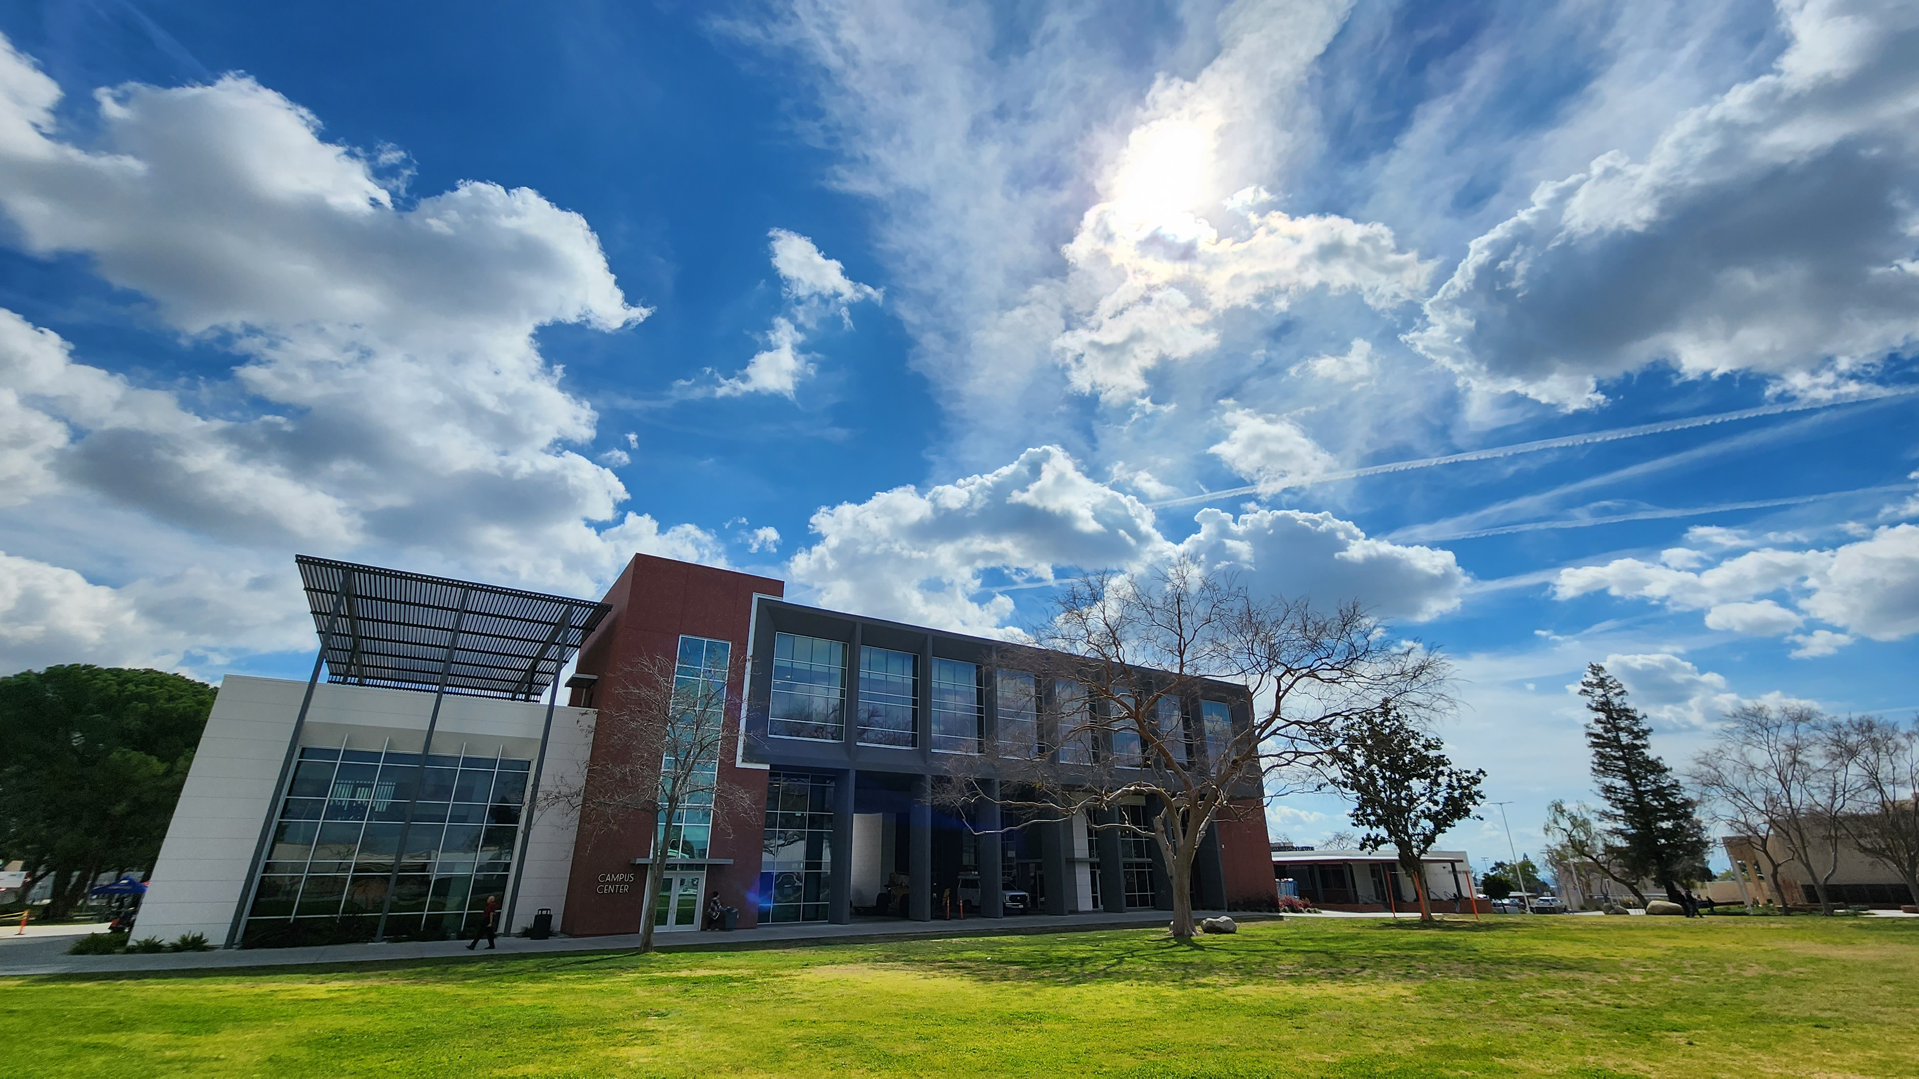
What’s Next?

Slide 7
Research and DRAFTS!!!!
Standard Leads recruiting team members.
Developing team meeting schedule.
Digesting standard review criteria and conducting research for evidence.
Saving evidence in appropriate SharePoint folder.
Composing drafts [1-2 pages] addressing level of success in meeting standard.
Saving drafts in appropriate SharePoint folder.

Slide 8
Drop-In Hours
Need help with drafts or evidence? Drop-In on Zoom!
Thursdays 3:00 - 4:00 p.m.
10/26, 11/2, 11/9, 11/16, 11/30
and December as needed
Calendar invite sent to team leads, complete with Zoom link.

Slide 9
Committee Updates
Committee of Co-Chairs: 8/25/2023
Accreditation & Institutional Quality (AIQ): 9/12/2023
College Council (CC): 9/15/2023
Faculty Chairs and Directors Council (FCDC): 10/6/2023
California Schools Employee Association (CSEA): 10/13/2023
Academic Senate (AS): 10/25/2023
Student Government Association (SGA): 10/25/2023

Slide 10
Kevin Bontenbal Campus Visit
February 2nd, 2024

Slide 11
Any Questions?

Slide 12
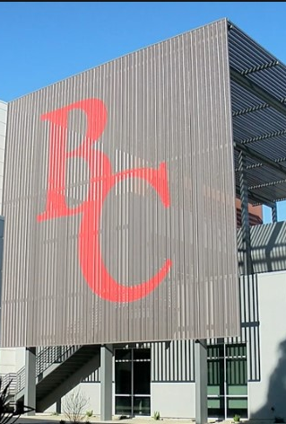
Your ISER Team
Accreditation Liaison Officer: Billie Jo Rice
Faculty Lead: Jason Stratton
Admin Lead: Jessica Wojtysiak
Editor: Talita Pruett
Indexer: Sondra Keckley
AIQ Faculty Chair: Grace Commiso
Classified: Ximena Ortega
Marketing: Monika Scott
And…
You!

