Slide 1
Agriculture, Nutrition & Culinary Arts
Guided Pathways

Slide 2
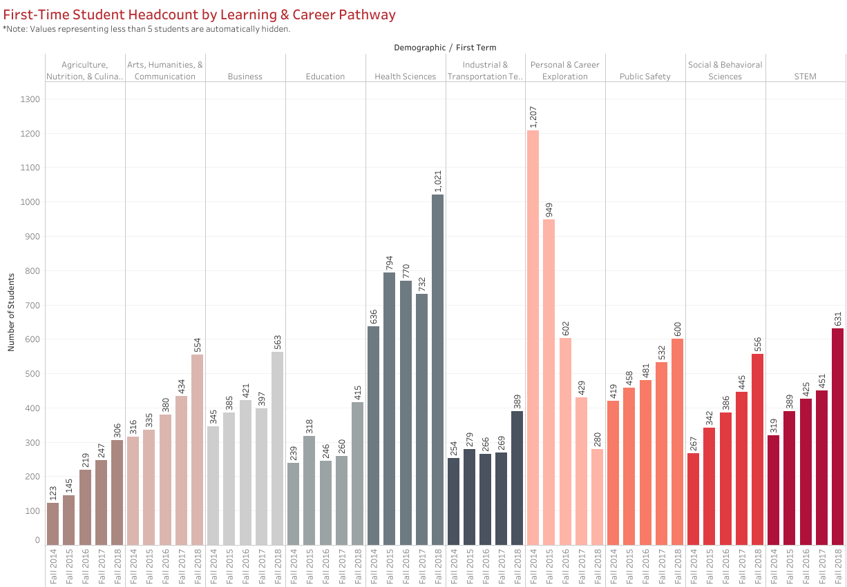
First-Time Students Headcount

Slide 3
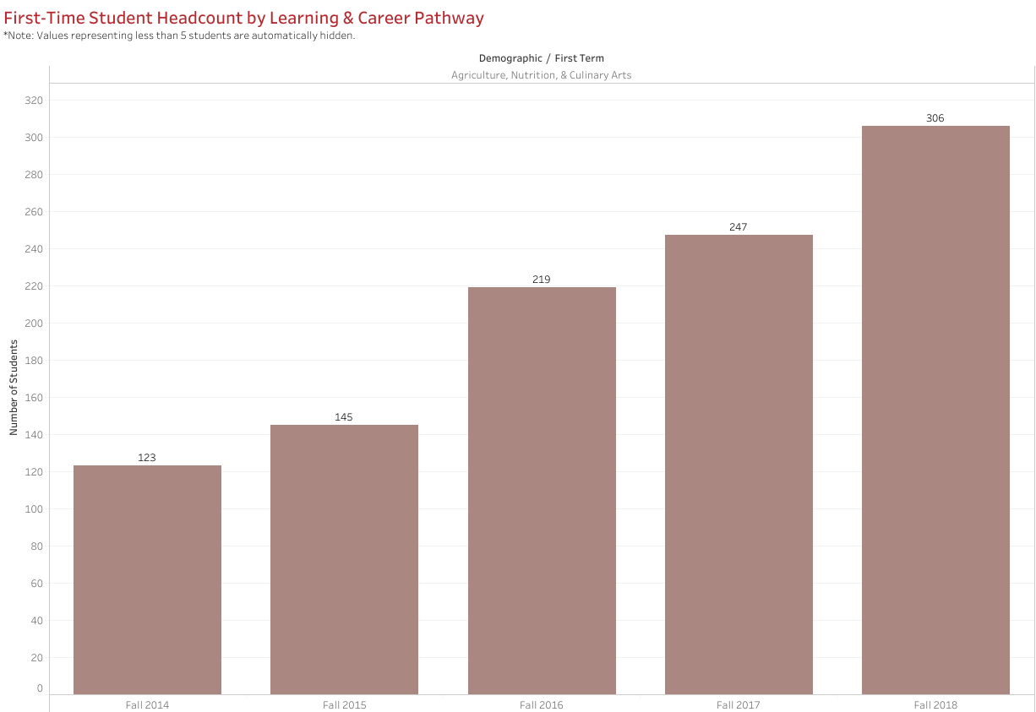
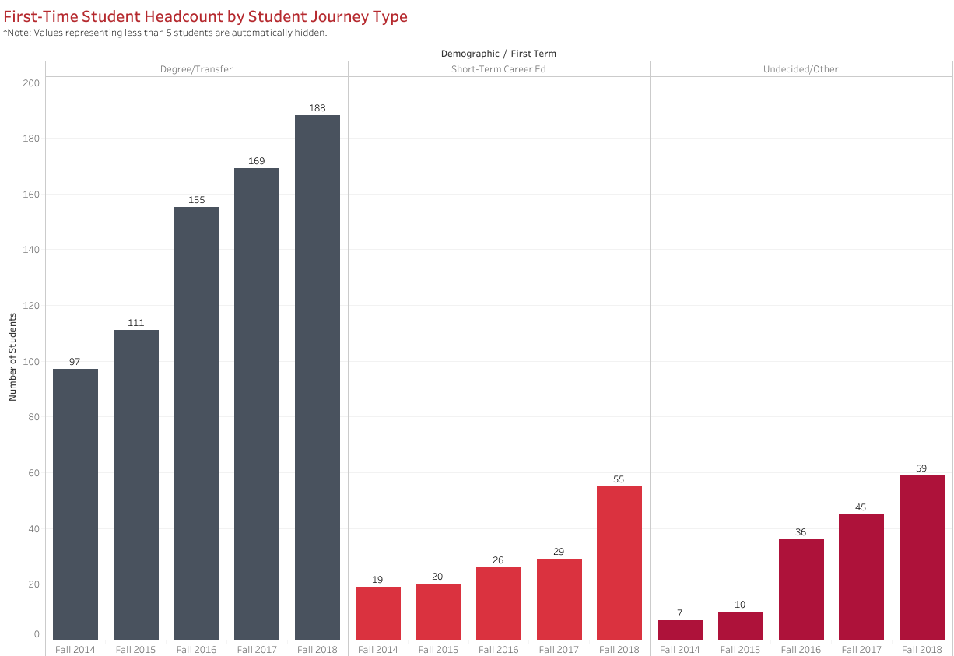
First-Time Students Headcount

Slide 4
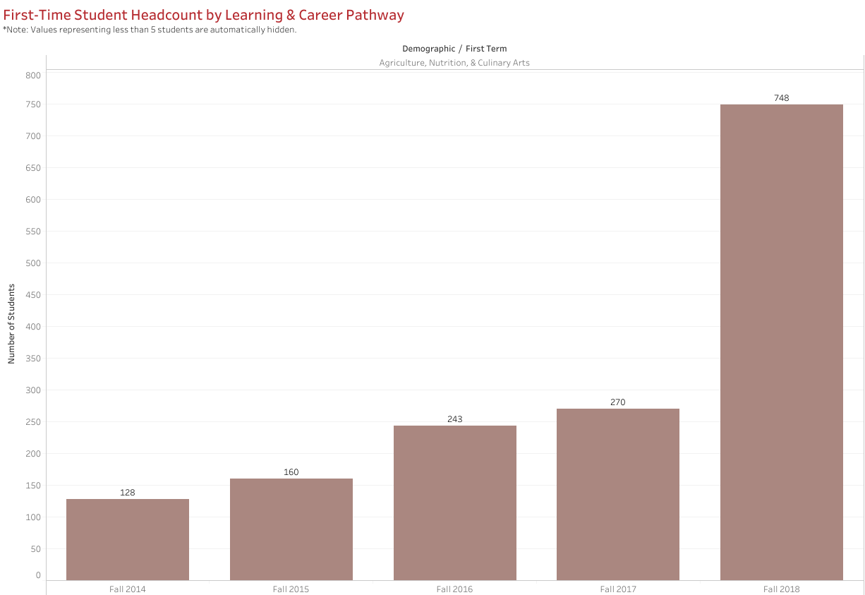
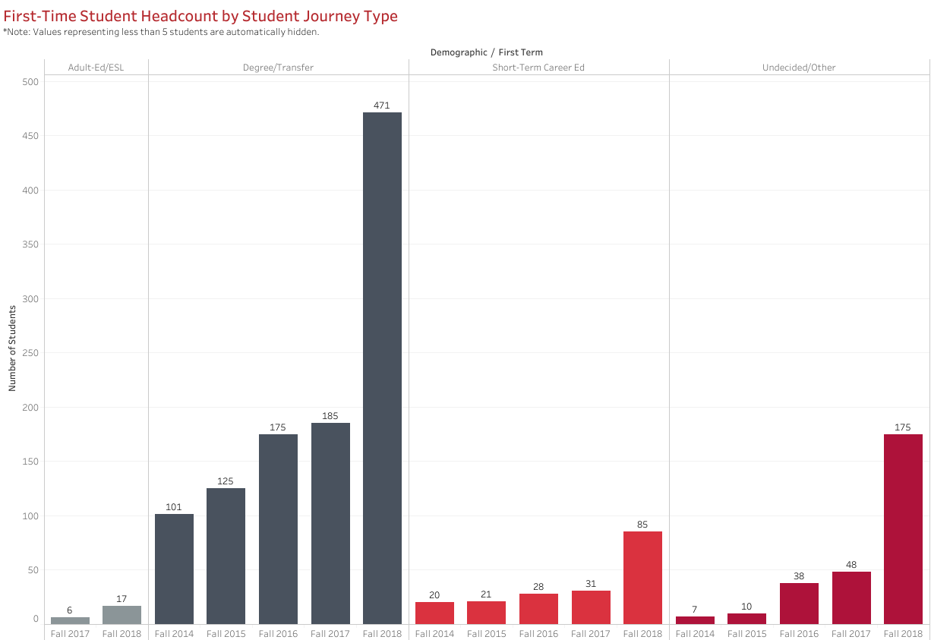
First-Time Students Headcount Including Dual Enrollment

Slide 5
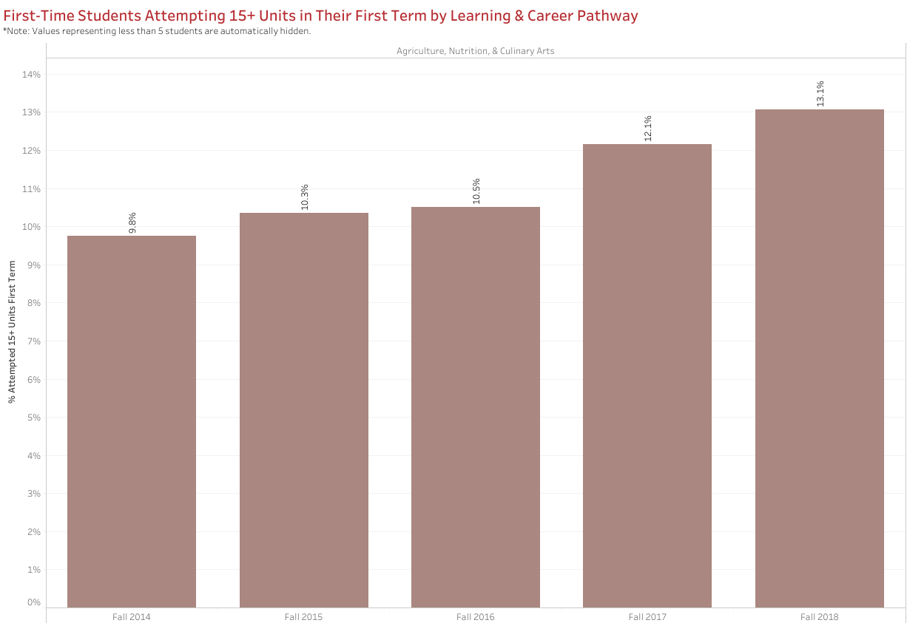
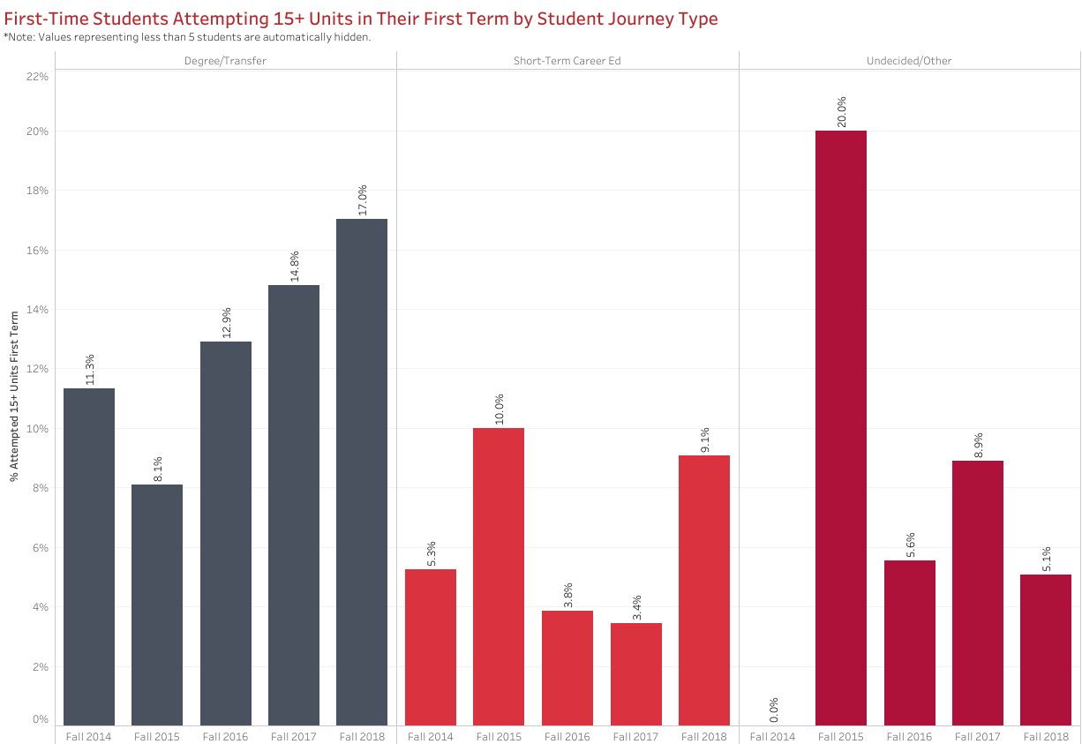
First-Time Students Attempting 15+ Units in Their First Term

Slide 6
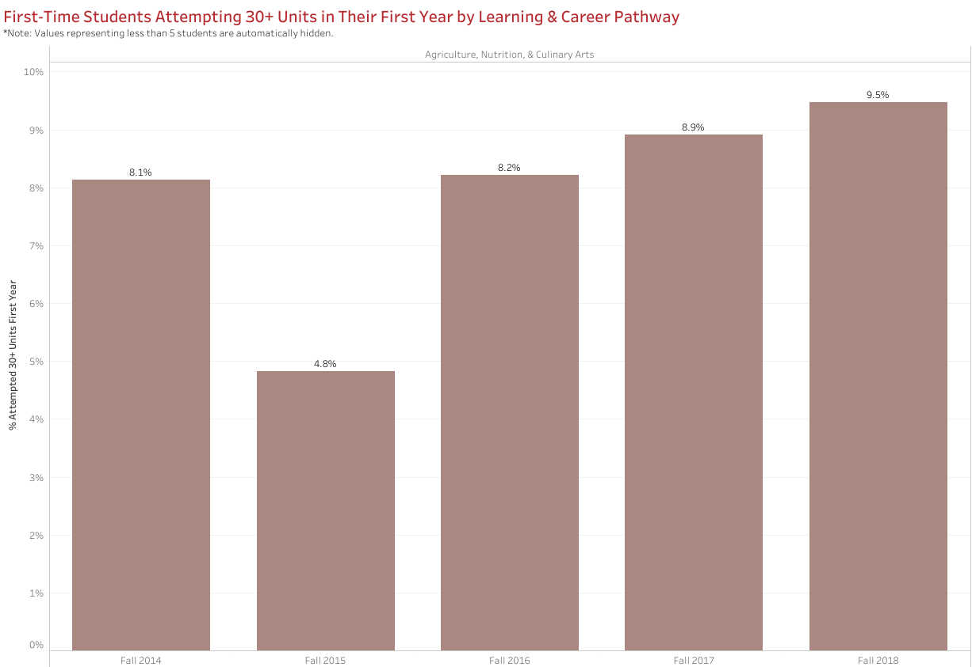
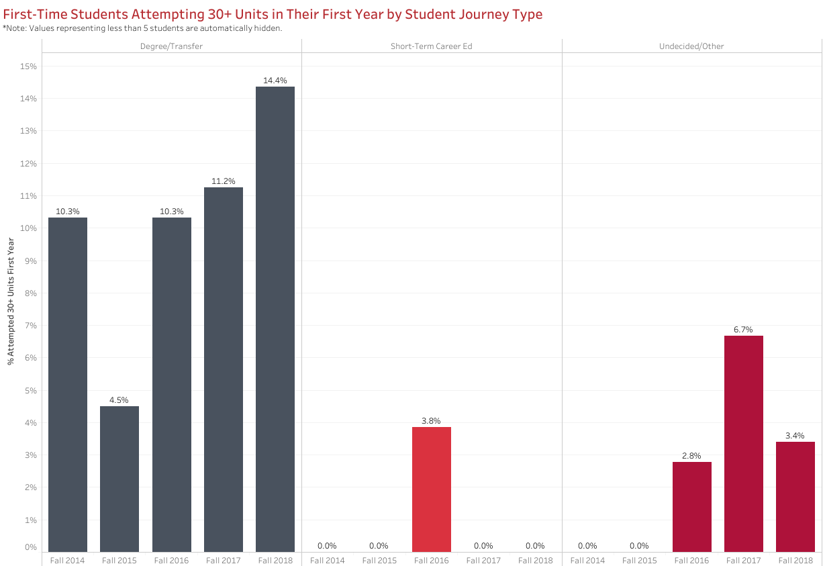
First-Time Students Attempting 30+ Units in Their First Year

Slide 7
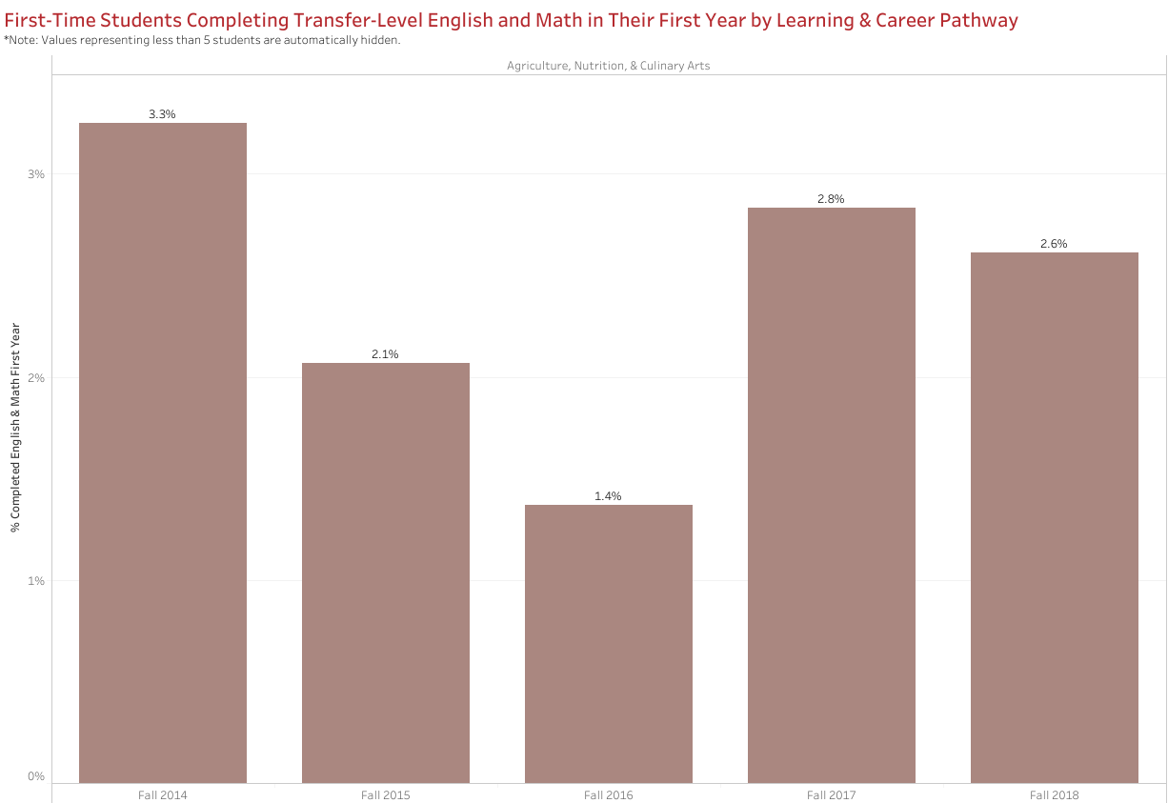
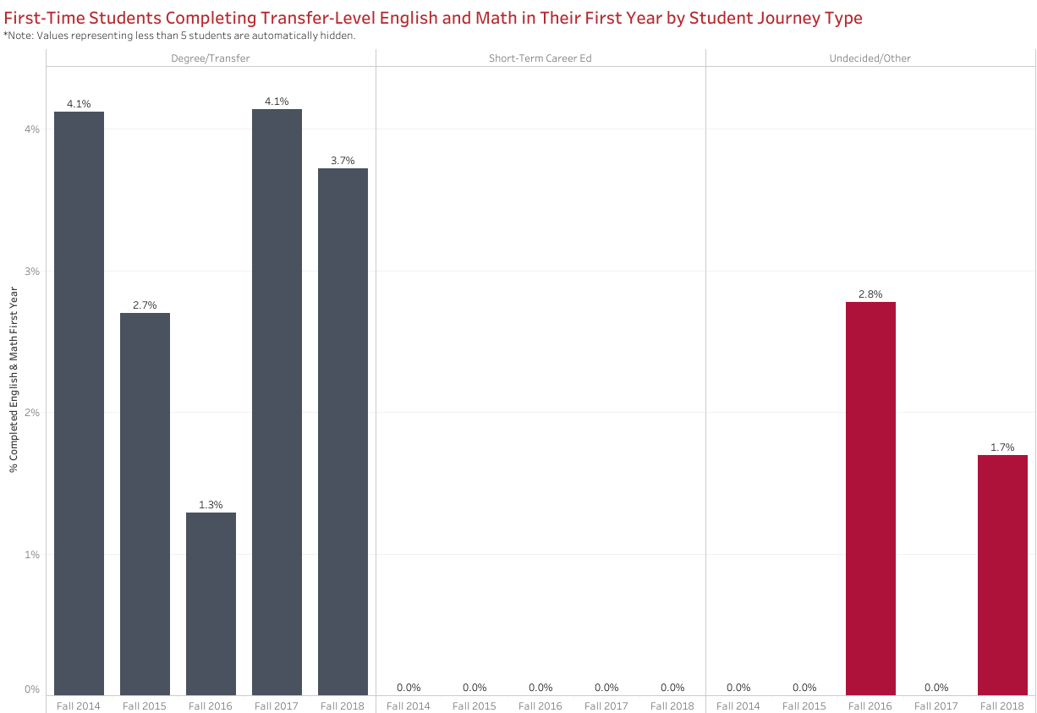
First-Time Students Completing Transfer-Level English and Math in Their First Year

Slide 8
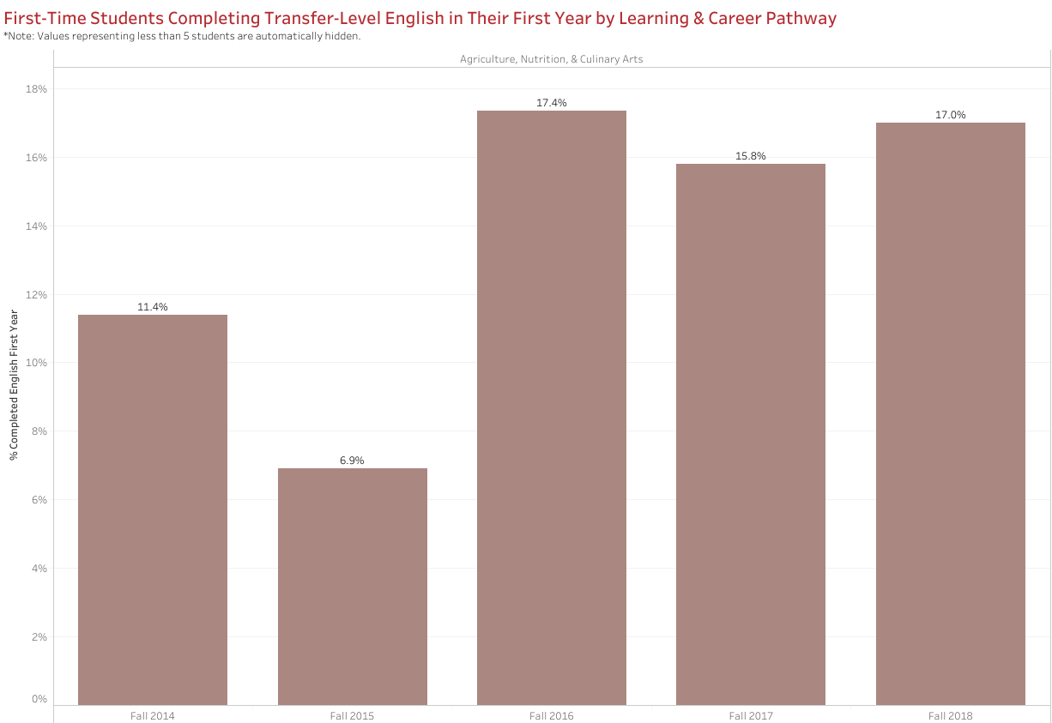
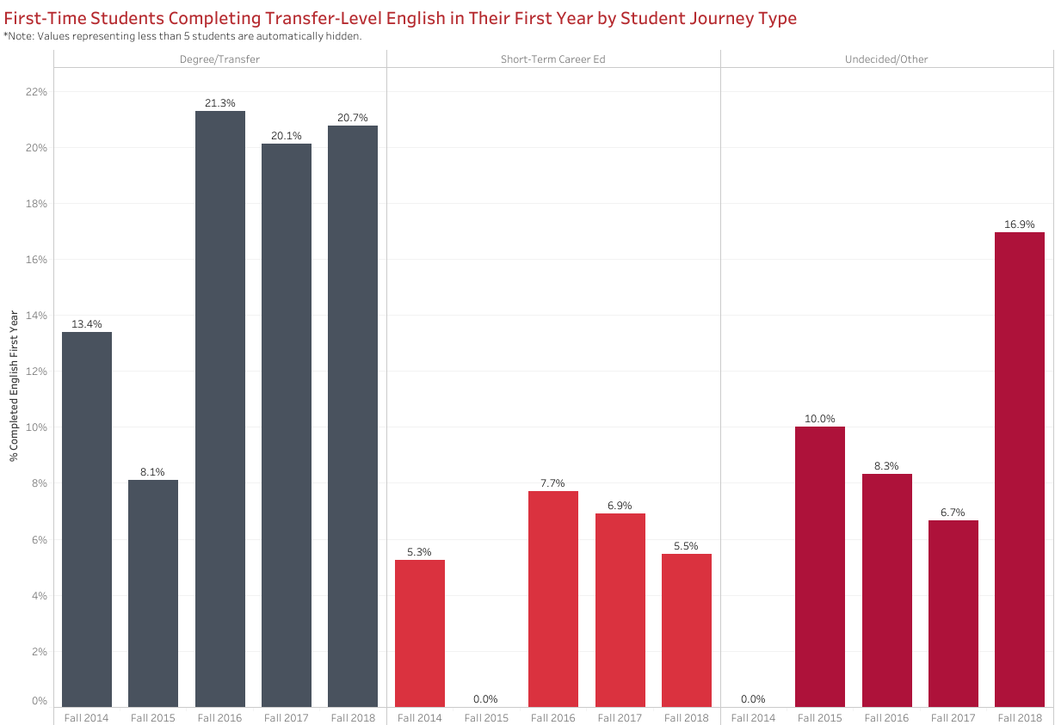
First-Time Students Completing Transfer-Level English in Their First Year

Slide 9
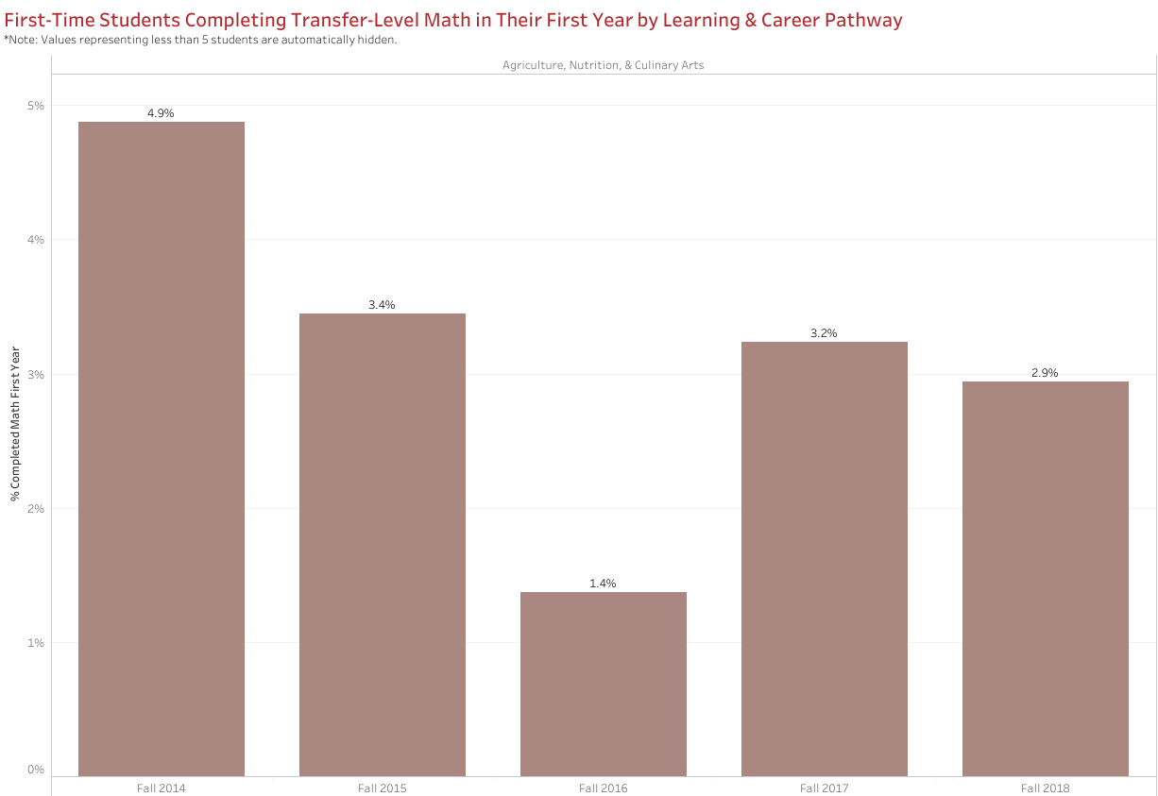
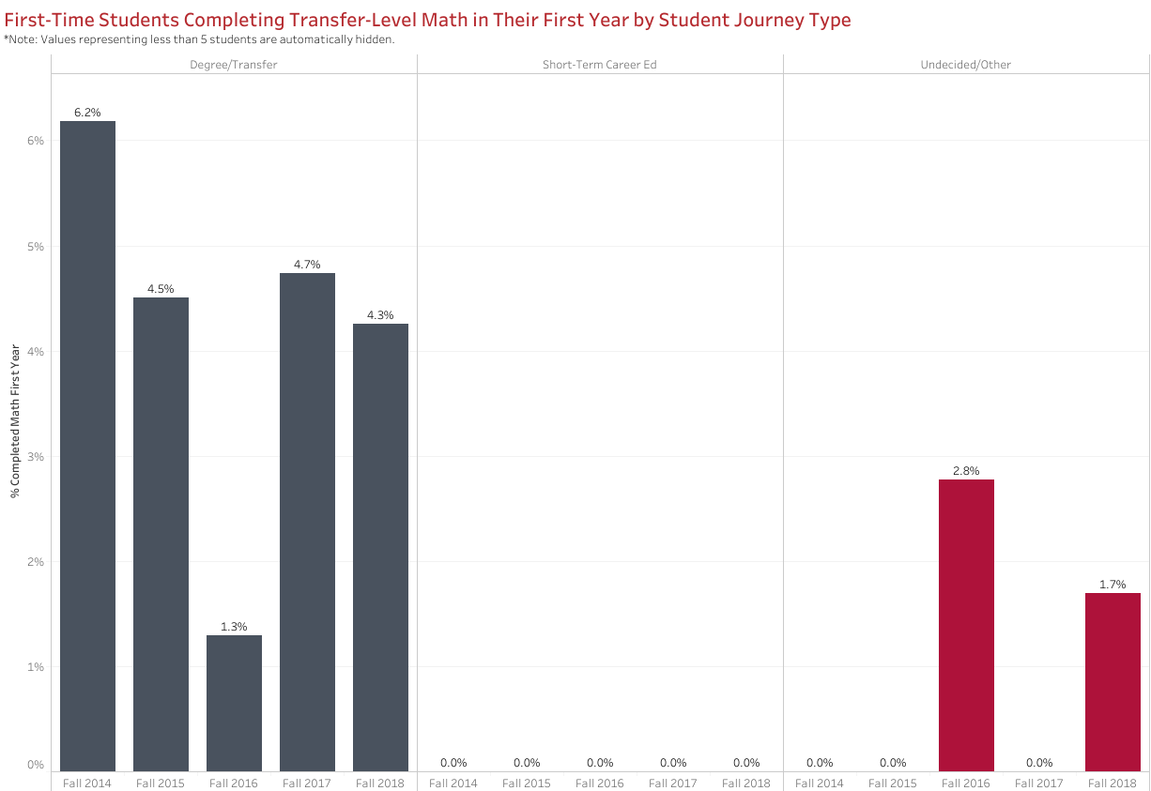
First-Time Students Completing Transfer-Level Math in Their First Year

