Slide 1
BC and KCCD Services and Institutional Quality Survey
For Services rendered in the Fall 2023 Term
November 2023

Slide 2
Survey Information
Survey Summary:
The Accreditation and Institutional Quality survey of BC and KCCD Services rendered in the Fall 2023 Term is an anonymous survey that will be shared and used to improve Bakersfield College
Participants and Active Dates:
All BC Faculty, Staff, and Managers/Administrators were invited to participate using the BC All listserv
An estimated 1,089 Employees received the survey (KCCD Fast Facts on 2022-23 BC Employees)
The anonymous survey was released on 10/04/23 and closed on 10/25/23
Responses Received:
273 total responses were received
268 responses were included in the survey results (24.6% Response Rate)
5 responses were excluded because comments were deemed irrelevant and/or inappropriate

Slide 3
Bakersfield College has established a clearly defined mission. (Standards 1.1, 1.3) (N=258)

Slide 4
Our mission statement appropriately reflects BC’s character, value, structure, and unique student demographics. (Standards 1.1, 1.3) (N=258)

Slide 5
Our mission statement articulates BC’s commitment to ensuring equitable educational opportunities and outcomes for all students. (Standards 1.1, 1.3) (N=257)

Slide 6
Indicate the extent to which you agree that the following Bakersfield College services and departments have collaborated with you effectively. If you do not have any basis to evaluate the service provided by an area, select "N/A" (not applicable). (Standards 2.5, 2.6, 2.7, 2.9, 3.2, 3.8, 3.9)
~0% = 1/238

Slide 7
Indicate the extent to which you agree that the following Bakersfield College services and departments have collaborated with you effectively. If you do not have any basis to evaluate the service provided by an area, select "N/A" (not applicable). (Standards 2.5, 2.6, 2.7, 2.9, 3.2, 3.8, 3.9)

Slide 8
Indicate the extent to which you agree that the following Bakersfield College services and departments have collaborated with you effectively. If you do not have any basis to evaluate the service provided by an area, select "N/A" (not applicable). (Standards 2.5, 2.6, 2.7, 2.9, 3.2, 3.8, 3.9)

Slide 9
Indicate the extent to which you agree that the following Bakersfield College services and departments have collaborated with you effectively. If you do not have any basis to evaluate the service provided by an area, select "N/A" (not applicable). (Standards 2.5, 2.6, 2.7, 2.9, 3.2, 3.8, 3.9)

Slide 10
Indicate the extent to which you agree that the following Bakersfield College services and departments have collaborated with you effectively. If you do not have any basis to evaluate the service provided by an area, select "N/A" (not applicable). (Standards 2.5, 2.6, 2.7, 2.9, 3.2, 3.8, 3.9)

Slide 11
Indicate the extent to which you agree that the following Bakersfield College services and departments have collaborated with you effectively. If you do not have any basis to evaluate the service provided by an area, select "N/A" (not applicable). (Standards 2.5, 2.6, 2.7, 2.9, 3.2, 3.8, 3.9)

Slide 12
Indicate the extent to which you agree that the following KCCD offices and services (located in the downtown office building) are effectively supporting Bakersfield College in achieving its mission. If you do not have any basis to evaluate the service provided by an office, select "N/A" (not applicable). (Standards 2.2, 3.1, 3.6, 3.9, 4.4)

Slide 13
The KCCD Board of Trustees gives the Bakersfield College President full authority to implement board policies and ensure effective operations and fulfillment of the institutional mission. (Standards 4.4, 4.5)

Slide 14
KCCD and Bakersfield College effectively communicate with each other. (Standards 1.5, 4.2)

Slide 15
KCCD clearly delineates their own operational functions from those of Bakersfield College. (Standard 4.2)

Slide 16
KCCD effectively controls its expenditures. (Standards 3.6, 3.7, 4.4)

Slide 17
Bakersfield College's structure for decision-making provides opportunities for stakeholder participation and ensures the inclusion of relevant perspectives. (Standard 4.2)

Slide 18
Bakersfield College's decision-making practices support a climate of collaboration and innovation that advances the mission and prioritizes equitable student outcomes. (Standard 4.3)

Slide 19
The KCCD Board of Trustees functions effectively as a collective entity to promote Bakersfield College's values and mission and fulfill its fiduciary responsibilities. (Standard 4.6)

Slide 20
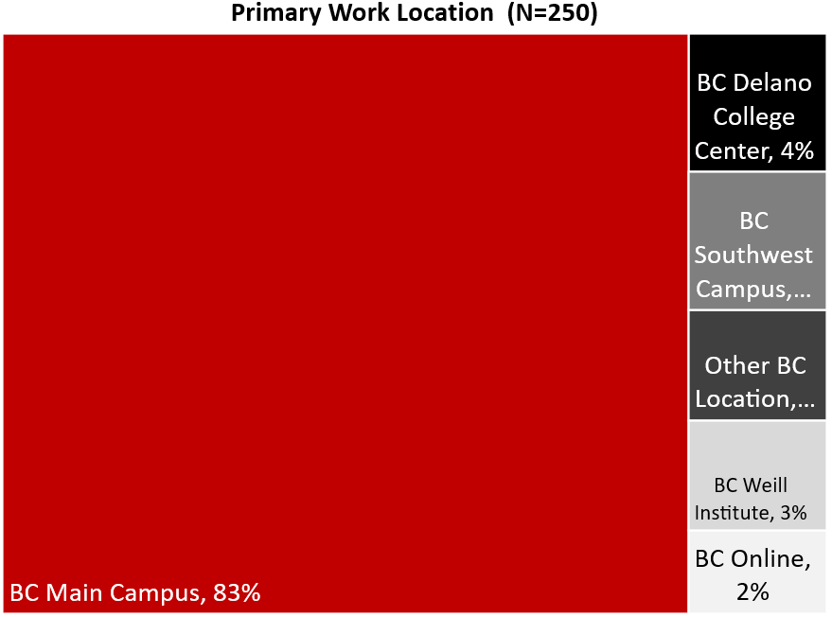
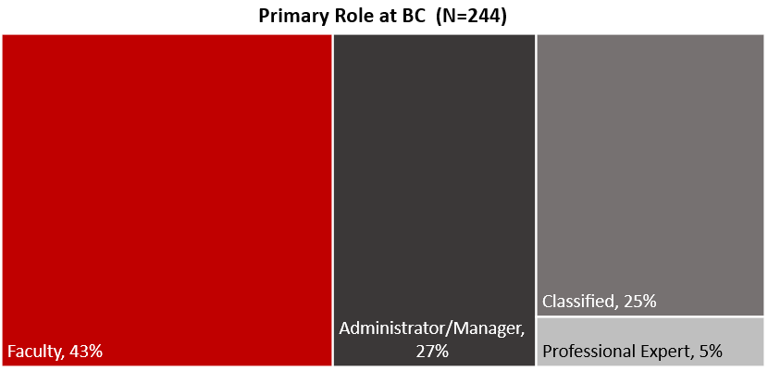
Work Location and Role at BC

Slide 21
Work Status and Years at BC

Slide 22
Committee Participation at BC

Slide 23
Committee Participation by Work Status
• Academic Senate
• Accreditation & Institutional Quality Committee (AIQ)
• Administrative Council
• Assessment Committee
• Budget Committee
• College Council
• Curriculum Committee
• Educational Administrators Council (EAC)
• Equal Opportunity & Diversity Advisory Council (EODAC)
• Facilities & Sustainability Committee
• Faculty Chairs/Directors Council (FCDC)
• Information Services & Instructional Technology (ISIT)
• Professional Development Committee
• Program Review Committee
• Safety Advisory Committee
• Student Affairs Leadership Team (SALT)

Slide 24
Gender Information

Slide 25
Sexual Orientation

Slide 26
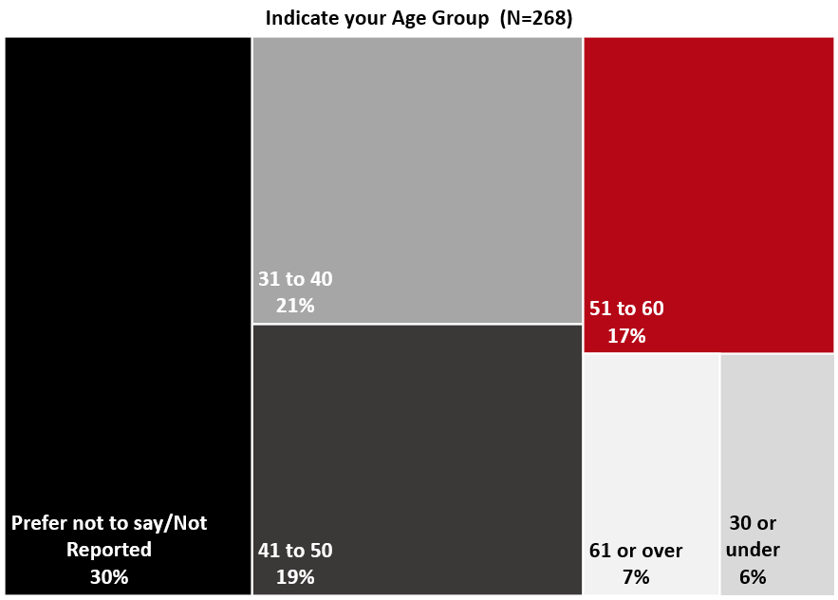
Age Group

Slide 27
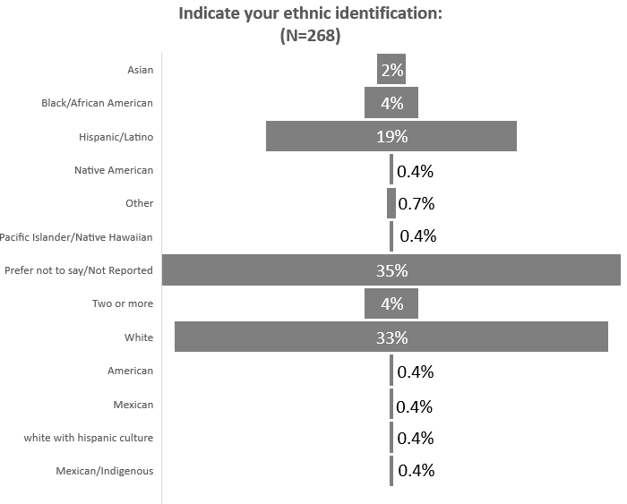
Ethnic Identification

