Slide 1
ACCJC and Bakersfield College's Institutional Self-Evaluation Report Launch and Training!
November 2022

Slide 2
Part One: Accreditation Context
Accreditation Purposes & Processes
ACCJC Expectations & Current Practice
Part Two: Nuts/Bolts Developing ISER
Interpreting the Standards for Self-Evaluation
Developing the ISER: Tips & Resources
After the ISER: What to Expect

Slide 3
Learning Outcomes
Understand the importance and purpose of accreditation
Interpret Standards and apply them to your College/District policies and practices
Engage in the self-evaluation process to document and establish goals for continuous improvement
Write a concise, clear, and evidence-based ISER

Slide 4
Part One: Context for Accreditation

Slide 5
Today’s Goals Accreditation Purposes & Processes ACCJC Expectations & Current Practice

Slide 6
What is Accreditation?
How would you describe accreditation?
Accreditation is….?
?
?
?

Slide 7
What is Accreditation
Accreditation is a practice of academic quality control.
Promotes institutional excellence through application of standards.
Advances meaningful and effective student learning and achievement.
Provides assurance to students, general public, & others of quality of educational offerings.
In the United States we are fortunate that this is a peer review driven process. In many other countries, colleges and universities are recognized by a government education agency, such as the Ministry of Education.

Slide 8
Why Does Your College Seek Accreditation?
Why is accreditation important?
Reasons for accreditation are…?
?
?
?

Slide 9
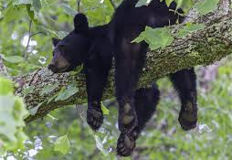
Why Bother?
Access to Title IV (Federal Financial Aid)
Recognition for transfer
Assure quality to the public and students
Ensure institutions are aligned with their missions
Improve academic quality, effectiveness, and student success

Slide 10
Who ACCJC Accredits
Public and private colleges with primary mission of granting associate degrees (may also award certificates and other credentials, including bachelor’s degrees) in:
California
Hawaii
U.S. territories of Guam and American Samoa
The Republic of Palau
The Federated States of Micronesia
The Commonwealth of the Northern Marianas
The Republic of the Marshall Islands

Slide 11
ACCJC Mission in Action
Outcomes
Innovation
Improvement
Core Values
Integrity
Peer Review
Institutional
Improvement
Quality
Assurance
Student Learning &
Achievement
Collegiality
The ACCJC supports its member institutions to advance educational quality and student learning and achievement. This collaboration fosters institutional excellence and continuous improvement through innovation, self-analysis, peer review, and application of standards.

Slide 12
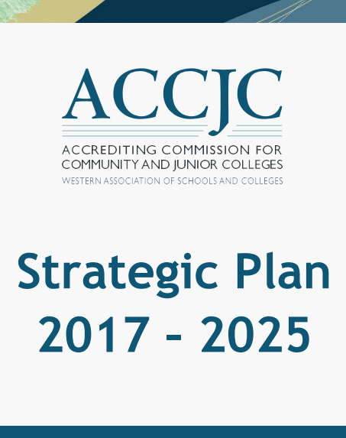
ACCJC’s Strategic Goals
Foster Innovation
Improve Communication & Collaboration
Increase Transparency
Lead Advocacy Efforts
Notes:
Also developed in addressing the strategic goals in ACCJC’s strategic plan – which also are intended outcomes of the process.

Slide 13
ACCJC Updates & Resources
Staff Liaison – Portfolio Model
Accreditation Platform
Streamline Processes
Standards Review
https://accjc.org/standards-review/
New Comprehensive Review
Guides and Manuals
Standards and Policies
Educational Series
Webinars
News & ACCJC Connect
https://accjc.org/accjc-connect/
https://accjc.org/guides-and-manuals/
https://accjc.org/eligibility-requirements-standards-policies/
https://accjc.org/announcements/
https://accjc.org/educational-series/
https://accjc.org/webinar/
Notes:
The why. Where F/S came from – developed to address our mission and core values.

Slide 14
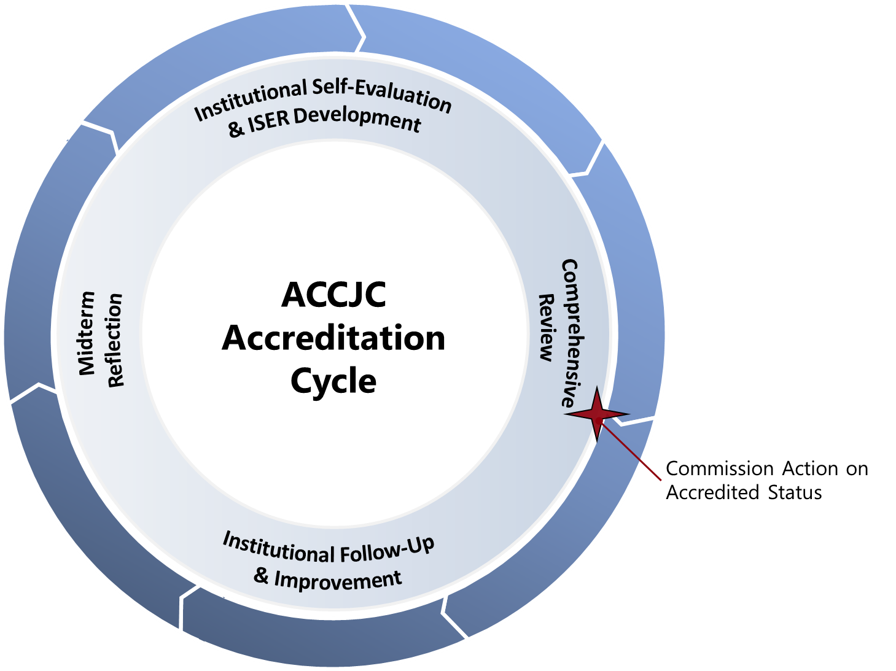
Accreditation Cycle and Reports
Self Evaluation & Comprehensive Review (every 7 years)
Follow Up Reports (if required)
Midterm Reporting (4th year after comp review)
Ongoing Reporting
Annual Report
Annual Fiscal Report
Substantive Change
7 Year

Slide 15
Overview: The Accreditation Evaluation Process
Self-Reflection (ISER)
Peer Review (Team ISER Review & Focused Site Visit)
Affirmation (ACCJC Action)
Ongoing Commitment to Improvement & Educational Excellence

Slide 16
Intended Outcomes of Self-Reflection
To develop an ISER that the college and ACCJC can use as a meaningful and effective framework for fostering institutional excellence and student success.
To demonstrate how you exemplify academic quality and continue to improve.
The goal is quality not quantity!

Slide 17
Good Practices for the Self-Evaluation
Suggested process outlined in Guide to Institutional Self-Evaluation…
Plan backward, and build in “slip time”
Keep the mission in mind
Discuss the Standard, gather the evidence, then write
Use the ISER template on ACCJC’s website
Address gaps and areas for improvement as you find them
Include as many people as possible in some aspect of the reflection
Communicate, communicate, communicate…and communicate again

Slide 18
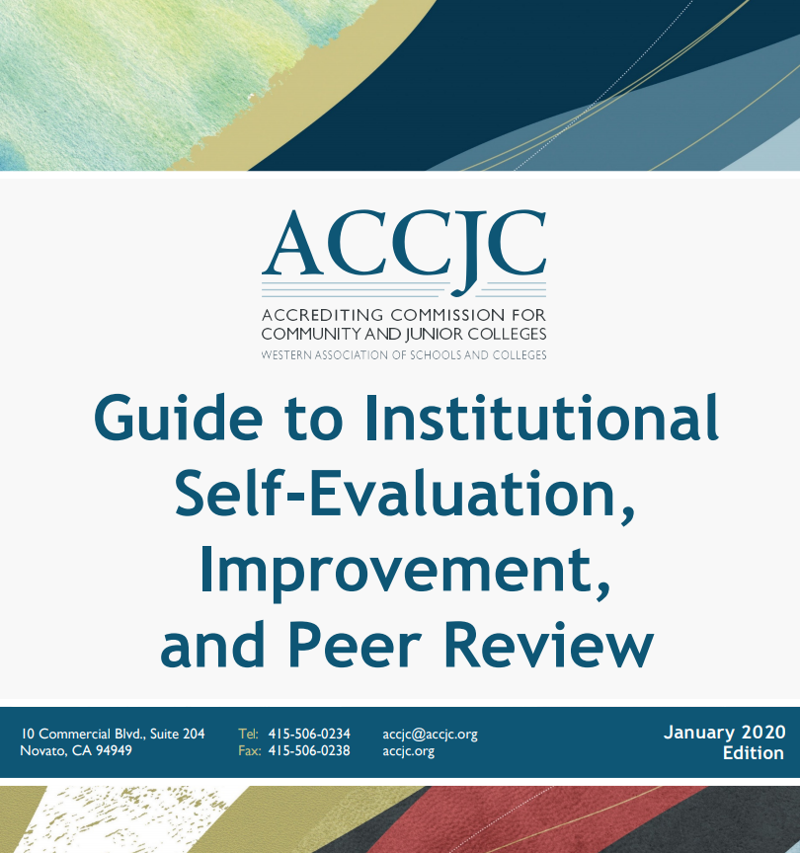
Institutional Self Evaluation Report (ISER) Resources
ISER Training – approx. 2 ½ years prior to comprehensive review
Advanced ISER training – approx. one year prior to the ISER due date
Liaison – available as needed
https://accjc.org/guides-and-manuals/

Slide 19
Four Interconnected Standards of Institutional Practice
Standard I
Standard II
Standard III
Standard IV
Mission
Instructional Programs
Human Resources
Decision-Making Roles & Processes
Physical Resources
Chief Executive Officer
Assuring Academic Quality & Institutional Effectiveness
Library & Learning Support Services
Technology Resources
Governing Board
Institutional Integrity
Student Support Services
Financial Resources
Multi-College Districts

Slide 20
Developing the ISER
Collaborative Partnership – multiple groups and perspectives working together!

Slide 21
Mindset for ISER Development
Celebrate and appreciate what works well
Look for alignment with standards
Focus on outcomes
Evidence based analysis
Open-minded to improve
Internal accountability
Holistic thinking across institutional systems
Mindful of mission accomplishment and values

Slide 22
Comprehensive Peer Review
College
Self-Reflection
ISER
Team ISER Review
Standards Validation
Core Inquires
Off-Campus Site
Notes:
Gohar – 5 minutes
Quick overview of the whole process from start to finish.

Slide 23
Comprehensive Peer Review
College
Self-Reflection
ISER
Team ISER Review
Standards Validation
Core Inquires
Off-Campus Site
PEER REVIEW PROCESS
Focused Site Visit
Core Inquires
On-Campus Site
Team Report
Commission Action
(Affirmation)
College
Prep
College will have a few months from receipt of core inquires to prepare for focused site visit.
Notes:
Gohar 5 minutes
Quick overview of the whole process from start to finish.

Slide 24
Comprehensive Peer Review
College
Self-Reflection
ISER
Team ISER Review
Standards Validation
Core Inquires
Off-Campus Site
Focused Site Visit
Core Inquires
On-Campus Site
Team Report
Commission Action
(Affirmation)
College
Prep
ISER
Due
12/15/24
Spring
2025
Fall
2025
January
2026
Notes:
Gohar 5 minutes
Mention
Benefit for Colleges:
Reduce fear / eliminate surprise, foster trust, promote collegiality, increase transparency, emphasize improvement
Time to consider team’s feedback for planning and improvement
Will also be meet & greet & Open Forum before Team ISER Review
Will be Open Forum & Exit report during Focused Site Visit

Slide 25
Expectations of Peer Reviewers
Seek to understand
Seeking to understand starts with the ISER
Practice appreciative inquiry on site
Alignment with Standards rather than hunting for deficiencies
Validation and affirmation
Goal: assist college with improving educational quality and student learning
Outcome: team report – help college improve and celebrate good practice
Excerpted from Guide for Peer Review Team Members, Fall 2021

Slide 26
Outcomes | Innovations | Improvements
Institutional/Systems Based Review
Notes:
Kevin – 1.5 minutes
Relate back to the purpose of accreditation. Are colleges using their processes to ensure they’re meeting their missions?

Slide 27
Discussion
What concerns or questions do you have about accreditation, ISER development, the review process, etc.?

Slide 28
Part Two: Nuts and Bolts of ISER Development

Slide 29
Major Steps: Institutional Self Evaluation Process
Possible Steps of the Process:
Determine leaders
Plan backward
Invite others
Interpret Standards (assign teams)
Gather evidence & make needed changes
Draft sections
Compile the report
Share with constituencies/ Review and revise the report
Share again, if needed
Edit and finalize the report
Get Board approval
Submit
Prepare for the review

Slide 30
Interpreting Individual Standards
Step 1: Use Standard Area as your lens
For Example: Standard II.A.1
Standard II = Student Learning Programs and Services
Standard II.A = Instructional Programs

Slide 31
Interpreting Individual Standards
Step 2: Isolate the basic components of the standard (i.e., subject, verb)
Standard II.A.1:
All instructional programs, regardless of location or means of delivery, including distance education and correspondence education, are offered in fields of study consistent with the institution’s mission, are appropriate to higher education, and culminate in student attainment of identified student learning outcomes, and achievement of degrees, certificates, employment, or transfer to other higher education programs.

Slide 32
Interpreting Individual Standards
Step 2: Isolate the basic components of the standard (i.e., subject, verb)
Standard II.A.1:
All instructional programs, regardless of location or means of delivery, including distance education and correspondence education, are offered in fields of study consistent with the institution’s mission, are appropriate to higher education, and culminate in student attainment of identified student learning outcomes, and achievement of degrees, certificates, employment, or transfer to other higher education programs.

Slide 33
Interpreting Individual Standards
Step 2: Isolate the basic components of the standard (i.e., subject, verb)
Standard II.A.1:
All instructional programs, regardless of location or means of delivery, including distance education and correspondence education, are offered in fields of study consistent with the institution’s mission, are appropriate to higher education, and culminate in student attainment of identified student learning outcomes, and achievement of degrees, certificates, employment, or transfer to other higher education programs.

Slide 34
Interpreting Individual Standards
Step 2: Isolate the basic components of the standard (i.e., subject, verb)
Standard II.A.1:
All instructional programs, regardless of location or means of delivery, including distance education and correspondence education, are offered in fields of study consistent with the institution’s mission, are appropriate to higher education, and culminate in student attainment of identified student learning outcomes, and achievement of degrees, certificates, employment, or transfer to other higher education programs.

Slide 35
Interpreting Individual Standards
Step 2: Isolate the basic components of the standard (i.e., subject, verb)
Standard II.A.1:
All instructional programs, regardless of location or means of delivery, including distance education and correspondence education, are offered in fields of study consistent with the institution’s mission, are appropriate to higher education, and culminate in student attainment of identified student learning outcomes, and achievement of degrees, certificates, employment, or transfer to other higher education programs.

Slide 36
Interpreting the Standards
Standard II.A.1 (Instructional Programs)
All instructional programs, regardless of location or means of delivery, including distance education and correspondence education,
are offered in fields of study consistent with the institution’s mission,
are appropriate to higher education, and
culminate in student attainment of identified student learning outcomes, and achievement of degrees, certificates, employment, or transfer to other higher education programs.

Slide 37
Interpreting the Standards
Standard I.A.1:
The mission describes the institution’s broad educational purposes, its intended student population, the types of degrees and other credentials it offers, and its commitment to student learning and student achievement.

Slide 38
Interpreting the Standards
Standard I.A.1:
The mission describes the institution’s broad educational purposes, its intended student population, the types of degrees and other credentials it offers, and its commitment to student learning and student achievement.

Slide 39
Interpreting the Standards
Standard I.A.1:
The mission describes the institution’s broad educational purposes, its intended student population, the types of degrees and other credentials it offers, and its commitment to student learning and student achievement.

Slide 40
Interpreting the Standards
Standard I.A.1 (Mission)
The mission describes
the institution’s broad educational purposes,
its intended student population,
the types of degrees and other credentials it offers, and
its commitment to student learning and student achievement.

Slide 41
Interpreting Standards – Steps to Success
Step 1: What area is the standard in?
Step 2: What is the standard about (i.e., subject, verb)
Step 3: What is the standard asking for (policy, process, documentation)?
Step 4: What’s the best evidence (not all evidence) that demonstrates the college is meeting standard?
Step 5: Write to the evidence

Slide 42
BREAK

Slide 43
Interpreting the Standards Activity
Discuss at your table Standards and accompanying questions that have been assigned to your group.
Think about sources of evidence.
Be prepared to discuss thoughts/findings with the entire group.

Slide 44
Activity Let’s Discuss
I.A.2 (Mission): The institution uses data to determine how effectively it is accomplishing its mission, and whether the mission directs institutional priorities in meeting the educational needs of students.
I.B.4 (Assuring Academic Quality and Institutional Effectiveness/Academic Quality): The institution uses assessment data and organizes its institutional processes to support student learning and student achievement.
I.B.5 (Assuring Academic Quality and Institutional Effectiveness/Institutional Effectiveness): The institution assesses accomplishment of its mission through program review and evaluation of goals and objectives, student learning outcomes, and student achievement. Quantitative and qualitative data are disaggregated for analysis by program type and mode of delivery.

Slide 45
Activity Let’s Discuss
I.B.2 (Assuring Academic Quality and Institutional Effectiveness/Academic Quality): The institution defines and assesses student learning outcomes for all instructional programs and student and learning support services.
II.A.3 (Instructional Programs): The institution identifies and regularly assesses learning outcomes for courses, programs, certificates and degrees using established institutional procedures. The institution has officially approved and current course outlines that include student learning outcomes. In every class section students receive a course syllabus that includes learning outcomes from the institution’s officially approved course outline.
II.C.2 (Student Support Services): The institution identifies and assesses learning support outcomes for its student population and provides appropriate student support services and programs to achieve those outcomes. The institution uses assessment data to continuously improve student support programs and services

Slide 46
Activity Let’s Discuss
I.C.8 (Institutional Integrity): The institution establishes and publishes clear policies and procedures that promote honesty, responsibility and academic integrity. These policies apply to all constituencies and include specifics relative to each, including student behavior, academic honesty and the consequences for dishonesty.
III.A.13 (Human Resources): The institution upholds a written code of professional ethics for all of its personnel, including consequences for violation.
IV.C.11 (Governing Board): The governing board upholds a code of ethics and conflict of interest policy, and individual board members adhere to the code. The board has a clearly defined policy for dealing with behavior that violates its code and implements it when necessary. A majority of the board members have no employment, family, ownership, or other personal financial interest in the institution. Board member interests are disclosed and do not interfere with the impartiality of governing body members or outweigh the greater duty to secure and ensure the academic and fiscal integrity of the institution.

Slide 47
Activity Let’s Discuss
I.C.5 (Institutional Integrity): The institution regularly reviews institutional policies, procedures, and publications to assure integrity in all representations of its mission, programs, and services.
IV.C.7 (Governing Board): The governing board acts in a manner consistent with its policies and bylaws. The board regularly assesses its policies and bylaws for their effectiveness in fulfilling the college/district/system mission and revises them as necessary.

Slide 48
Structure of the Report
Title page
Certification page/signatures
Table of Contents
Introduction
Student achievement data and institution-set standards
Organization of the self-evaluation process
Organizational information
Compliance with ERs 1-5
Compliance with Commission policies
Analysis of Standards
Evidence of Meeting the Standard
Analysis and Evaluation
Conclusion
Quality Focus Essay

Slide 49
Structure of Analysis of Standards
Evidence of Meeting the Standard
Indicates WHAT specific evidence demonstrates alignment with the Standard
Briefly describes the evidence in context of the standard to explain WHY it is relevant
Analysis and Evaluation
Indicates HOW the evidence demonstrates alignment with the Standard
Evaluates the effectiveness of the policy, procedure, or practice in meeting the Standard
Conclusion at end of main sections
Provide a brief summary at a high, holistic level on the effectiveness of the College’s efforts towards the Standard
If the College determines improvements are needed, improvement plans should follow

Slide 50
Improvement Plans and the QFE
Self-Identified Improvement Plans (a.k.a. planning agenda)
Purpose: Plans to strengthen college’s alignment to specific standards
Will report out on progress in the Midterm Report
Quality Focus Essay (QFE)
Purpose: Long-term plans to improve student learning and achievement
Should identify intended outcomes (measurable and achievable)
Should identify responsible parties/groups
Should have a timeline
Will report out on results in the Midterm Report
Not used by Commission in decision, but teams will provide feedback

Slide 51
Good Practices for Approaching the Report
Interpret the Standard, gather the evidence, then write
Keep the narrative concise, clear, direct, and focused
more is not necessarily better
Use simple, clear, business-style writing
keep readers in mind
Remember ERs 1-5 & Commission Policies
Use the Guide & ISER template (available on ACCJC website)

Slide 52
Good Practices for Evidence
Gather your evidence before you begin writing
More evidence is not necessarily better
Provide representative samples showing results of institutional processes
Use evidence to demonstrate how processes/cycles are institutionalized
Call out relevant sections of large documents (highlights, excerpts, etc.)
“Freeze” evidence from websites in a PDF or screenshot
Refer to Guide to Institutional Self-Evaluation…

Slide 53
ISER Guide and Template
https://accjc.org/guides-and-manuals/

Slide 54
Helpful Resources and Publications
Available on ACCJC’s website (accjc.org);
Eligibility Requirements
Standards of Accreditation
Commission Policies
Guides and Manuals
Educational Series
Webinars, conferences and symposiums
Ongoing trainings
News and Communications
Announcements
ACCJC Connect subscribe to or visit: https://accjc.org/accjc-connect/
Recent Commission Actions

Slide 55
What Happens Next?
Begin: ISER Development
Dec. 15, 2024: ISER Due to ACCJC
Spring 2025: Team ISER Review (peer review)
Fall 2025: Focused Site Visit (peer review)
January 2026: Commission decision
ACCJC training & support: Throughout the process

Slide 56
Next Steps
Website Reviews
AIQ Membership: Classified staff
ISER team membership
Contact AIQ chairs with questions!
Grace Commiso Grace.commiso@bakersfieldcollege.edu
Jessica Wojtysiak Jessica.Wojtysiak@bakersfieldcollege.edu

Slide 57
Remaining Questions and Comments & THANK YOU!

